Slide 1
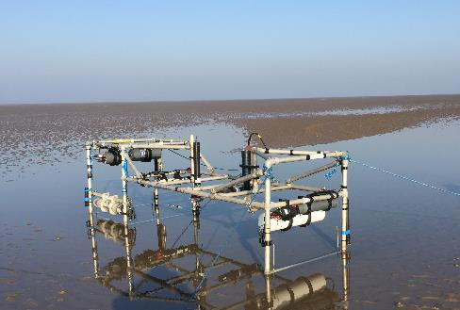
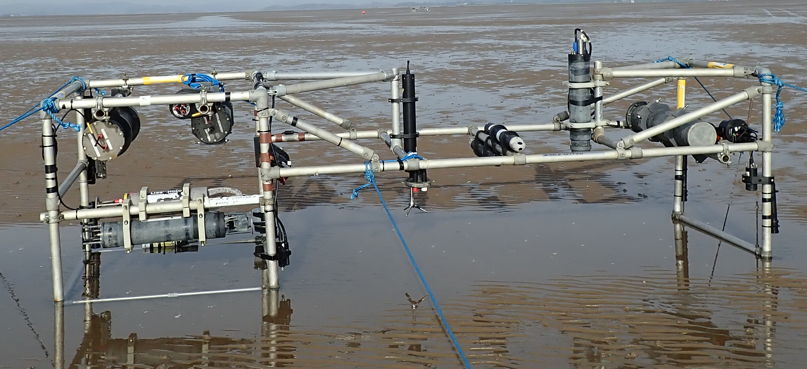
Does Morecambe bay respond to wave events in a way we expect?
C. A. Unsworth
D. Lichtman
M. E. Williams
P. D. Thorne
X. Wei
J. Brown
L. O. Amoudry

Slide 2
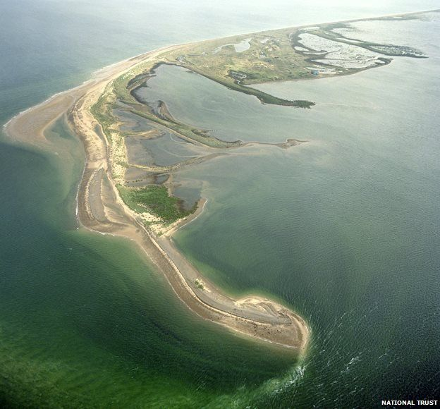
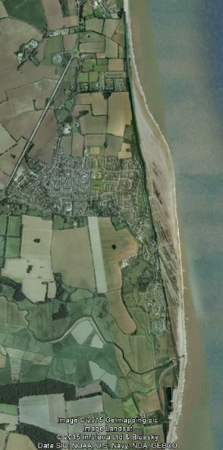
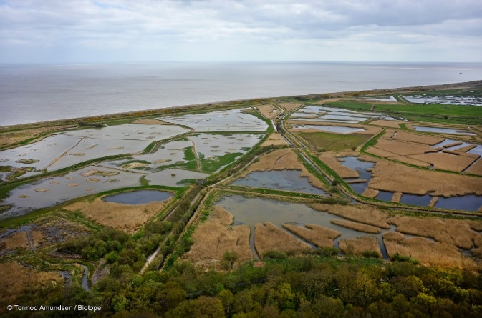
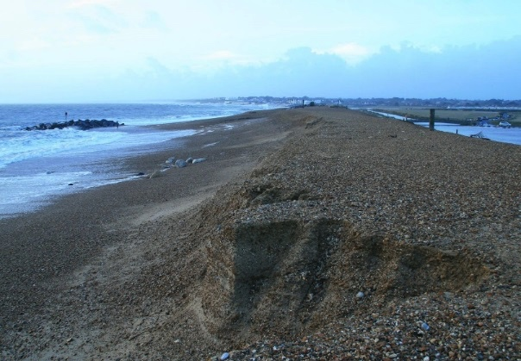












Physical and biological dynamic coastal processes and their role in coastal recovery
dynamic behaviour
resilience
recovery

Slide 3
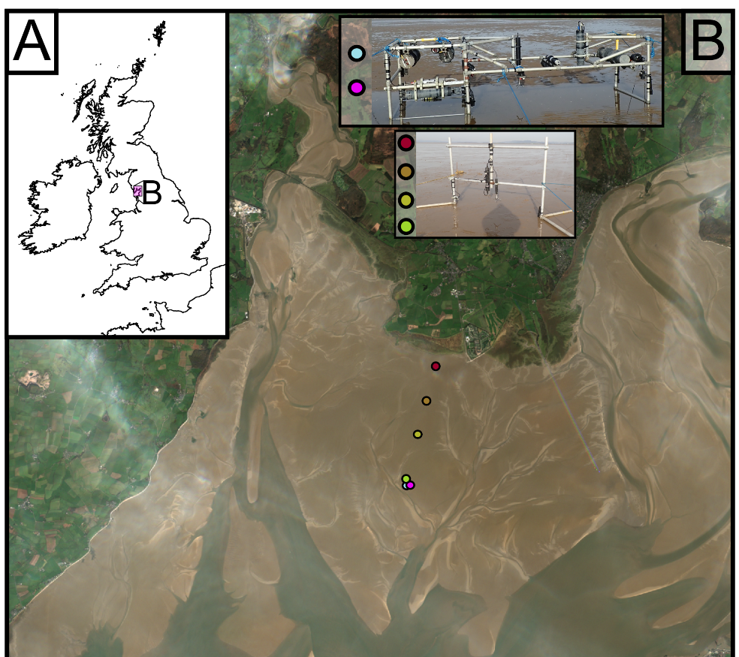
Morecombe bay, UK
Tidal Range up to 10.5 m
Ebb recession up to ~12km
Sheltered from Atlantic waves
Concave up profile (depositional)
“larger” Waves come from SW
Morphologically very dynamic!

Slide 4
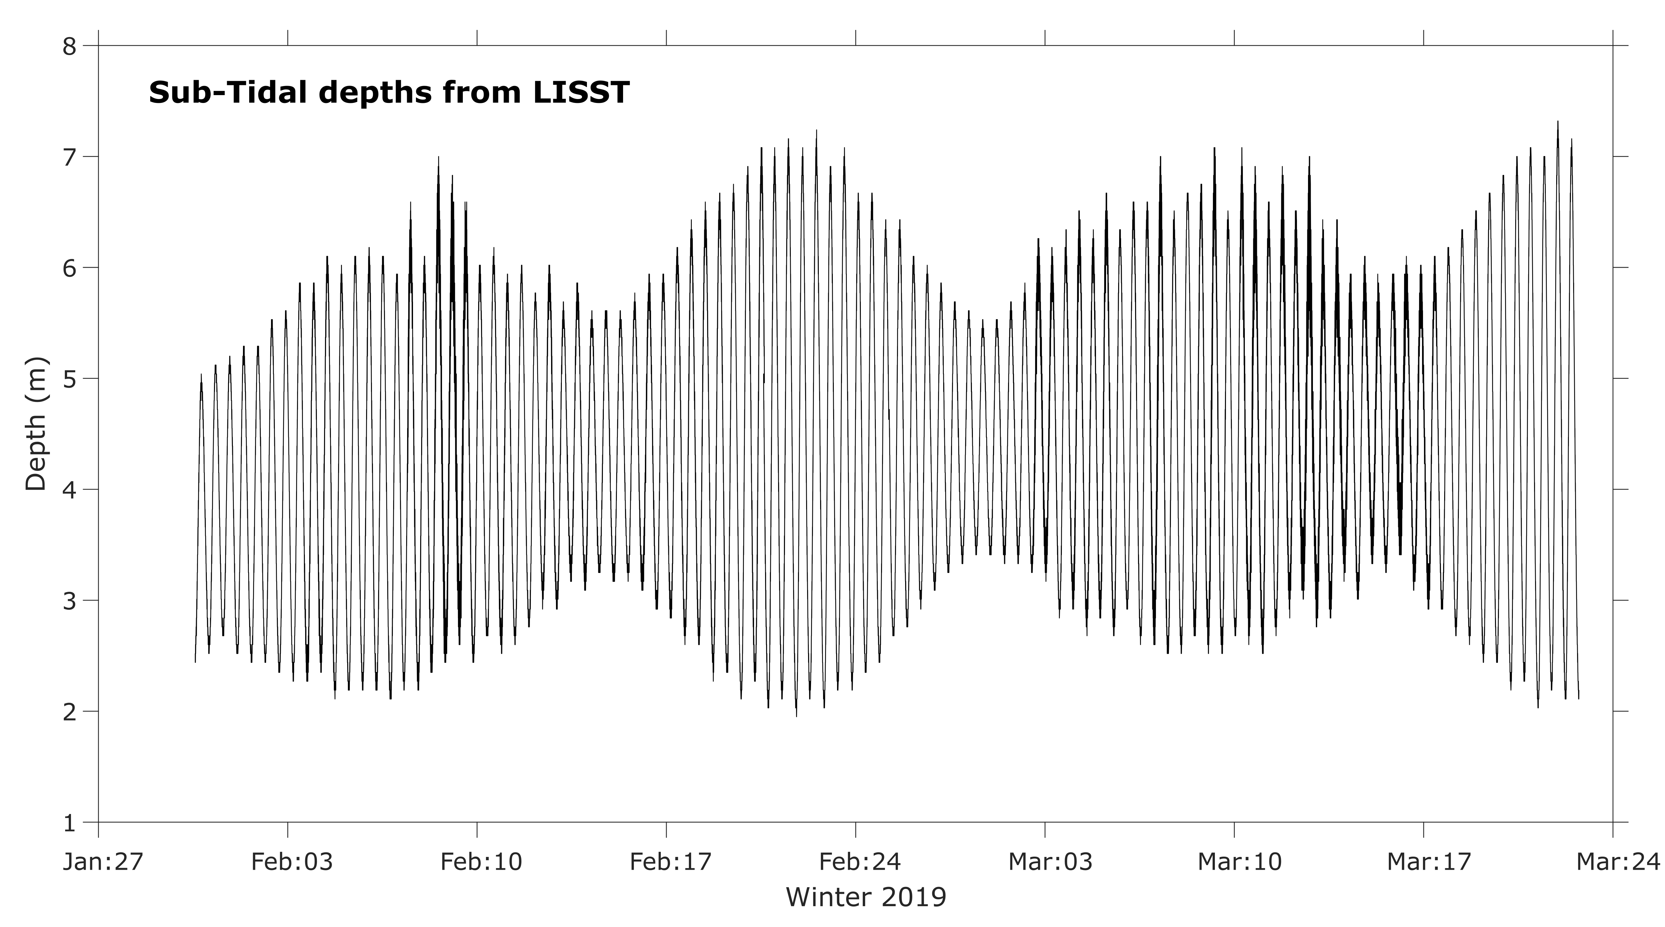
Naturally…

Slide 5
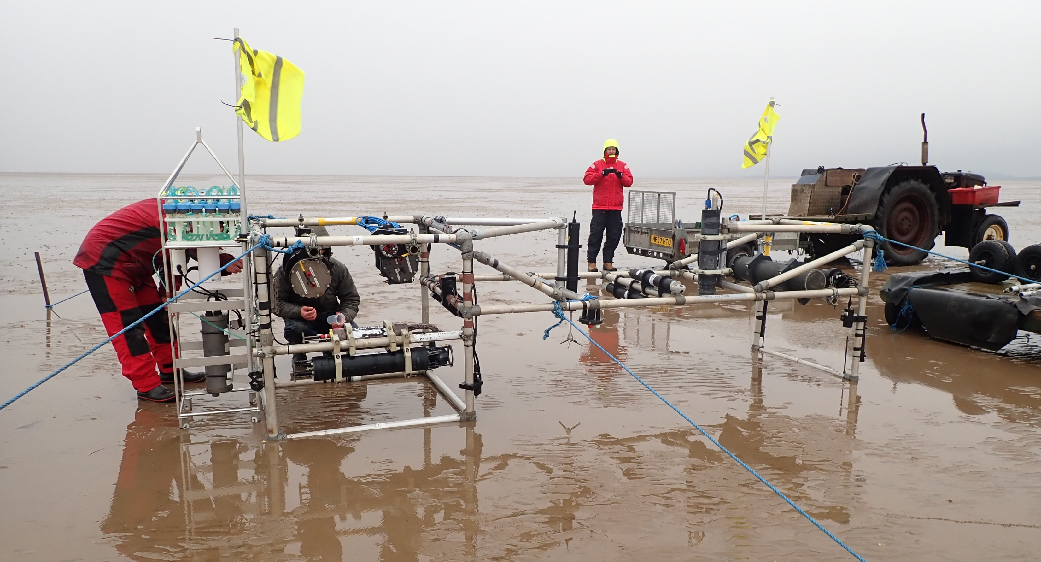
Intertidal measurement frames
Local cockle pickers’ tractor
Maybe a slide on bed sediment samples
Phytoplankton sampler!
ADCP’s
CTD’S
LISST 100X
3D ARP
LISST HOLO
ADV
4 Frequency ABS

Slide 6
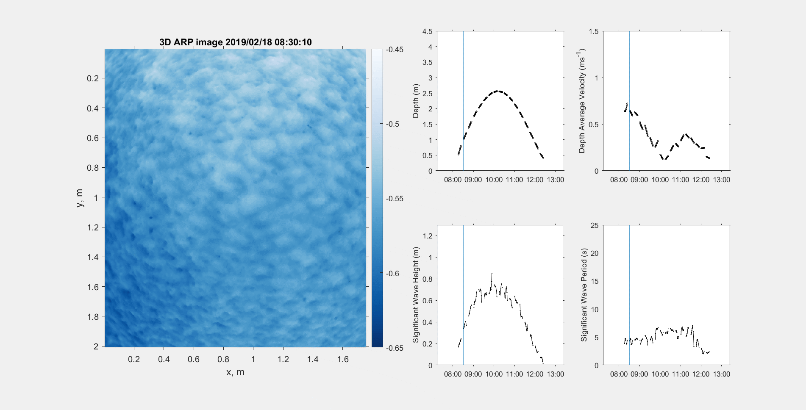
flood

Slide 7
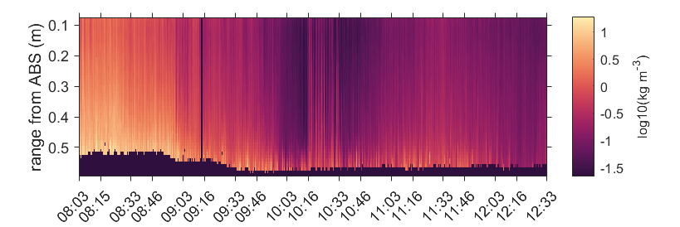
Quantifying hydrodynamics
Transport due to suspended sediments
Flood tide
Ebb tide
High water wave resuspension

Slide 8
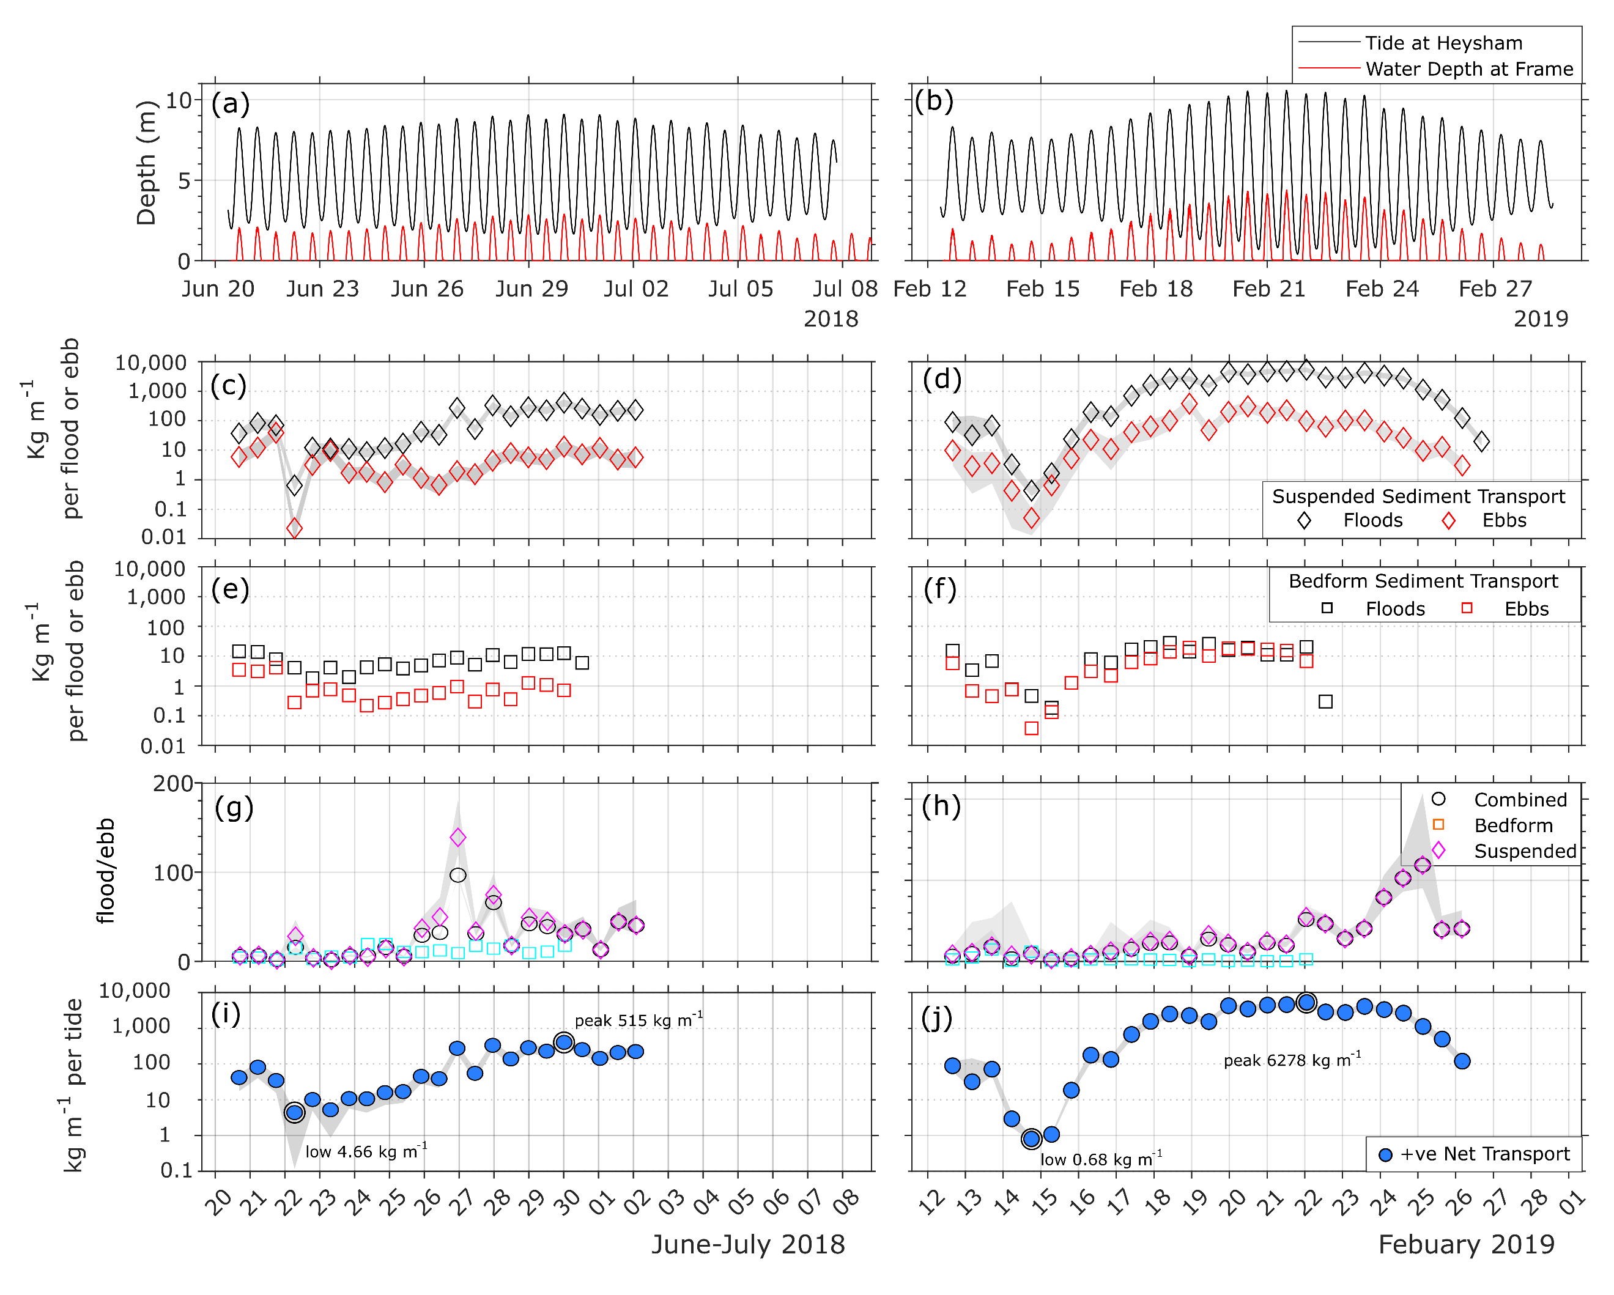
Wavy conditions
Wavy conditions
Asymmetries in suspended sediment transport indicate that waves did increase ebb transport (as would be expected).
However- it appears that waves also increased flood transport, particularly near neap tides.
The tidal asymmetry in suspended sediment transport rose sharply once wave conditions calmed, suggesting lower sediment mobility, and perhaps greater capture of sediment higher up the flats
Sediment transport measured via bedform movement was predominantly flood dominant, but not always.
In the largest tides, there were no bedforms – sheet flow and suspension were dominant.
Sediment transport via bedforms was found to be an order of magnitude lower than the suspended sediment transport.
The large winter spring tides produced a considerable amount of sediment transport. The largest, 6278 kg m⁻¹ per tide, is more than twice that measured by the entire summer survey

Slide 9
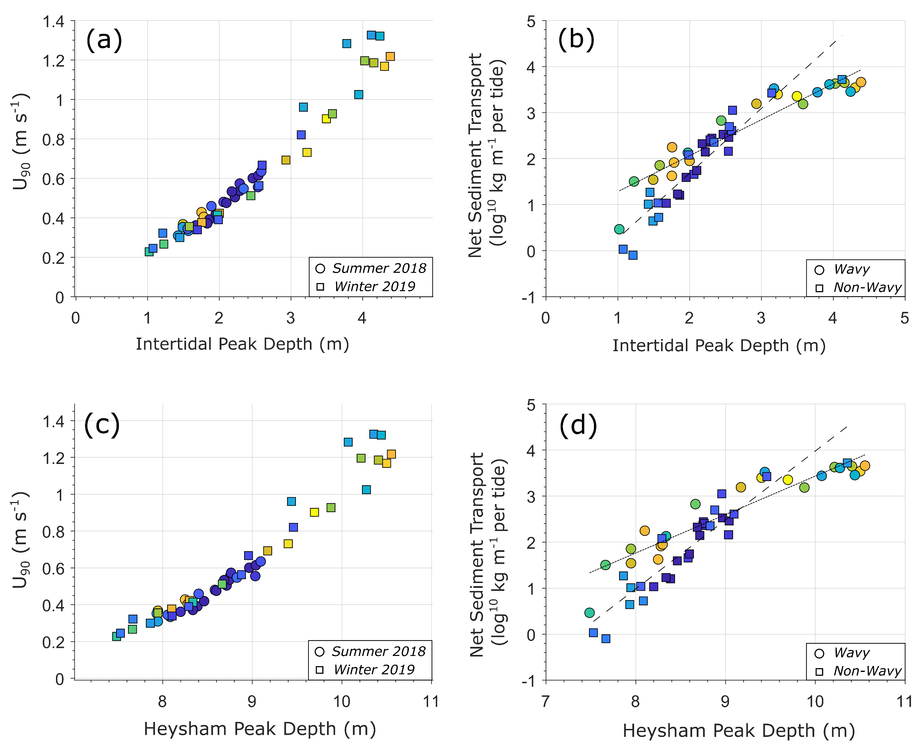
We found two trends in the amount of sediment transported per tide –
A higher slope when no or only small waves were present, and conversely lower slope when waves were present
This produced enhanced transport toward shore for wavy neap tides, and reduced transport in wavy springs?
Not Wavy
Net tidal sediment transport
Wavy
Peak tidal depth

Slide 10
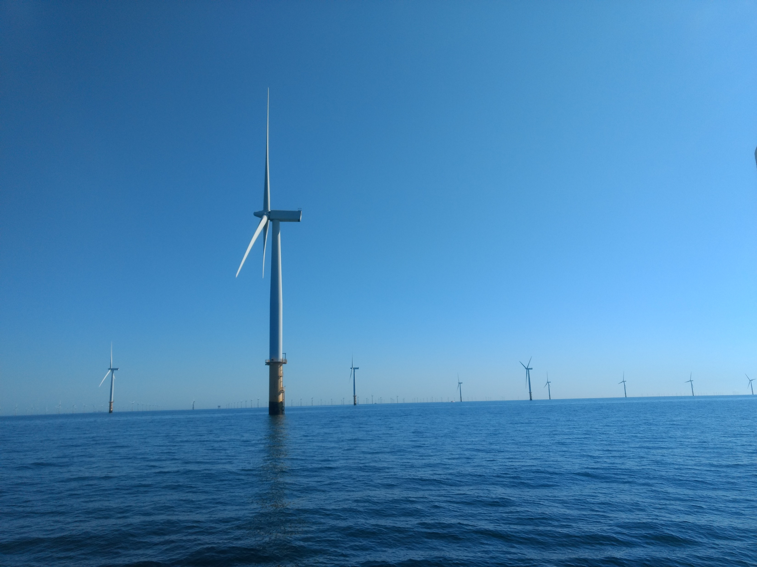

Slide 11
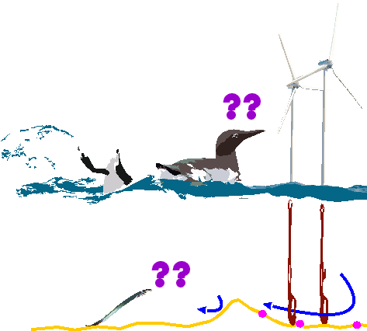
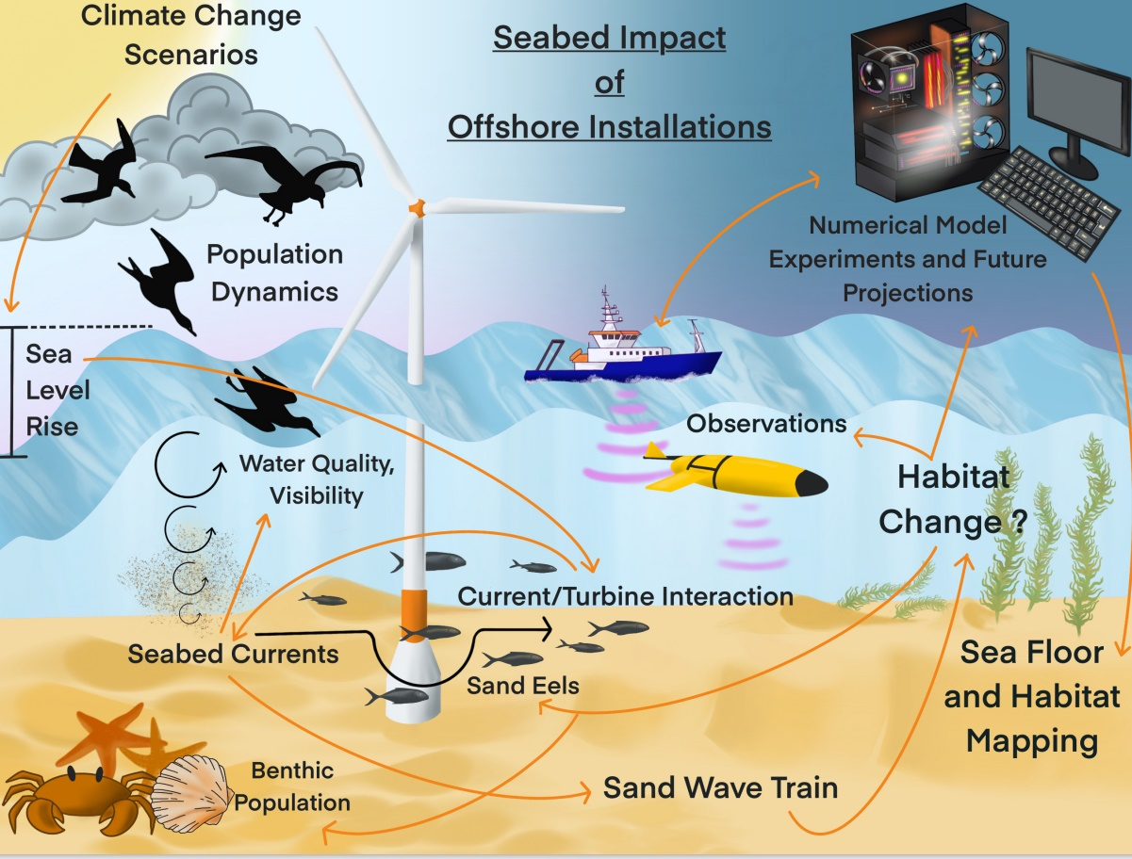
Seabed modification around offshore wind farms
The Ecowind-Accelerate Team
Lead: Katrien Van Landeghem
Shelf scale - Lucy Bricheno, Julia Rulent
Local Scale - Chris Unsworth, Connor McCarron, Martin Austin, Richard Whitehouse, Mike Clare
Biology – Lisa Skin, Tabitha Pearman, Olivia Hicks, Andrew Gates, James Strong, Sharon Macallan, Veerle Huvenne, James Waggitt, Claire Carrington and Shaun Fraser (and more)
CGG - Nick Heavens, Sharon Macallan, David Gold (and more)
Illustration by Dr Julia Rulent – NOC Liverpool

Slide 12

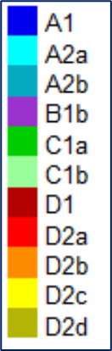
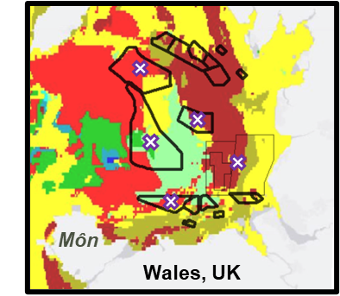
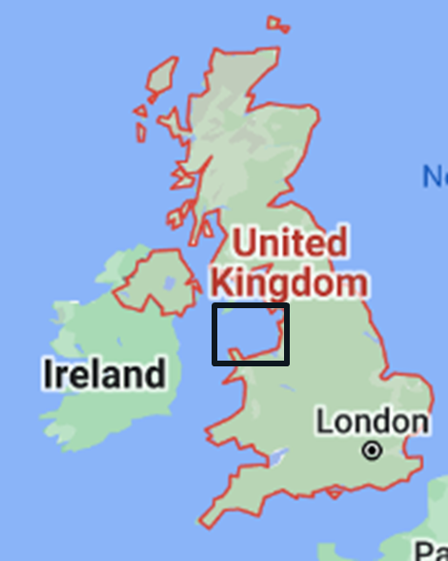
When the seabed hosts infrastructure and most of the UK’s benthic habitats…
Habitat assemblage clusters:
Combined impacts of climate change and OWFs…
… on seabed sediment mobility?
… on habitat distribution, biodiversity & ecosystem services?
… on interaction between habitat, prey & seabird foraging?
OneBenthic:
Cooper and Barry, 2017
Planned activities
Policy context: net environmental gain, nature recovery, biodiversity targets, net zero targets, effective and ecologically meaningful compensatory measures
Avoid
Minimise
Mitigate
Compensate
Net Gain

Slide 13
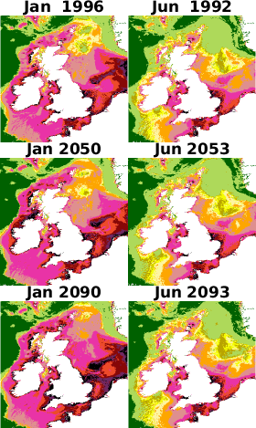
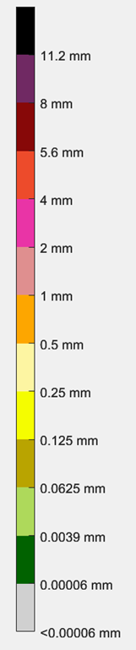
Q1: Are changes to seabed mobility from OWF comparatively large to
(1) natural variability today and (2) climate induced future changes (to variability)?
Median sediment grain size mobilised,
winter vs summer, to mid-and end-century,
from monthly average of maximum bed stress (tides and waves interacting).
Novelty: climate impact on seabed sediment transport capacity.
Ecological relevance: e.g. when gravel (scour protection!) starts moving on silty beds…
Comms: Based on “extreme winter”, and seasonality and transient events can affect local conditions unpredictably.
=> Range of change in future
UKC4 (NEMO) model
Future: 2050 and 2100
Change in sea level, tides, waves
Notes:
how the maps are made: we take hourly wave stress from WW3, and hourly current stress from NEMO. These are combined using the method of Soulsby to get a combined stress for waves and currents called Tau_mean and Tau_max. You can't just add them up linearly. Tau_max is probably the most useful as it determines the threshold of motion and entrainment rate of sediments (while the Tau_mean is the simpler summation without the non-linear part.). These hourly Tau_mean and Tau_max are then averaged over the whole month to give a single monthly average. These are what is plotted in the two different maps

Slide 14
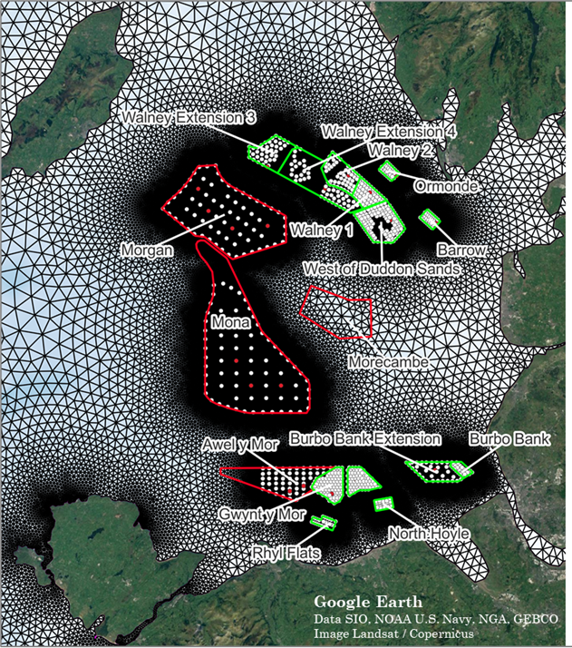
Q2: How will bed composition and seabed mobility change from different scenarios of OWF sizes and climate?
Fully coupled TELEMAC, TOMAWAC and SISYPHE
TPXO tidal elevations, ERA5 waves, winds and atmospheric pressure.
Fully calibrated and validated + new sediment map
(3,504 sediment samples: 659 BGS, 2355 OneBenthic, 490 Miscellaneous Cruises)
BGS Bed Rock layer
BGS Hard Substrate Layer + JNCC cobbles
Few problems to solve:
Sediment transport modelling is large source of uncertainty.
Turbulent wake of monopile adds large uncertainty.
3D model ideal, but not achievable at regional scale.

Slide 15
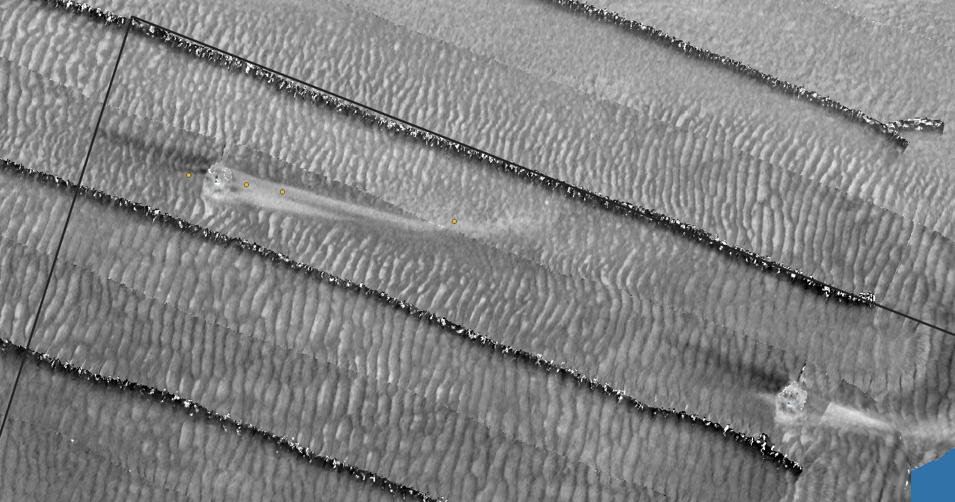
Accelerated Sediment Mobility
200 m
Low
Backscatter
High
At this site: sandy gravelly

Slide 16
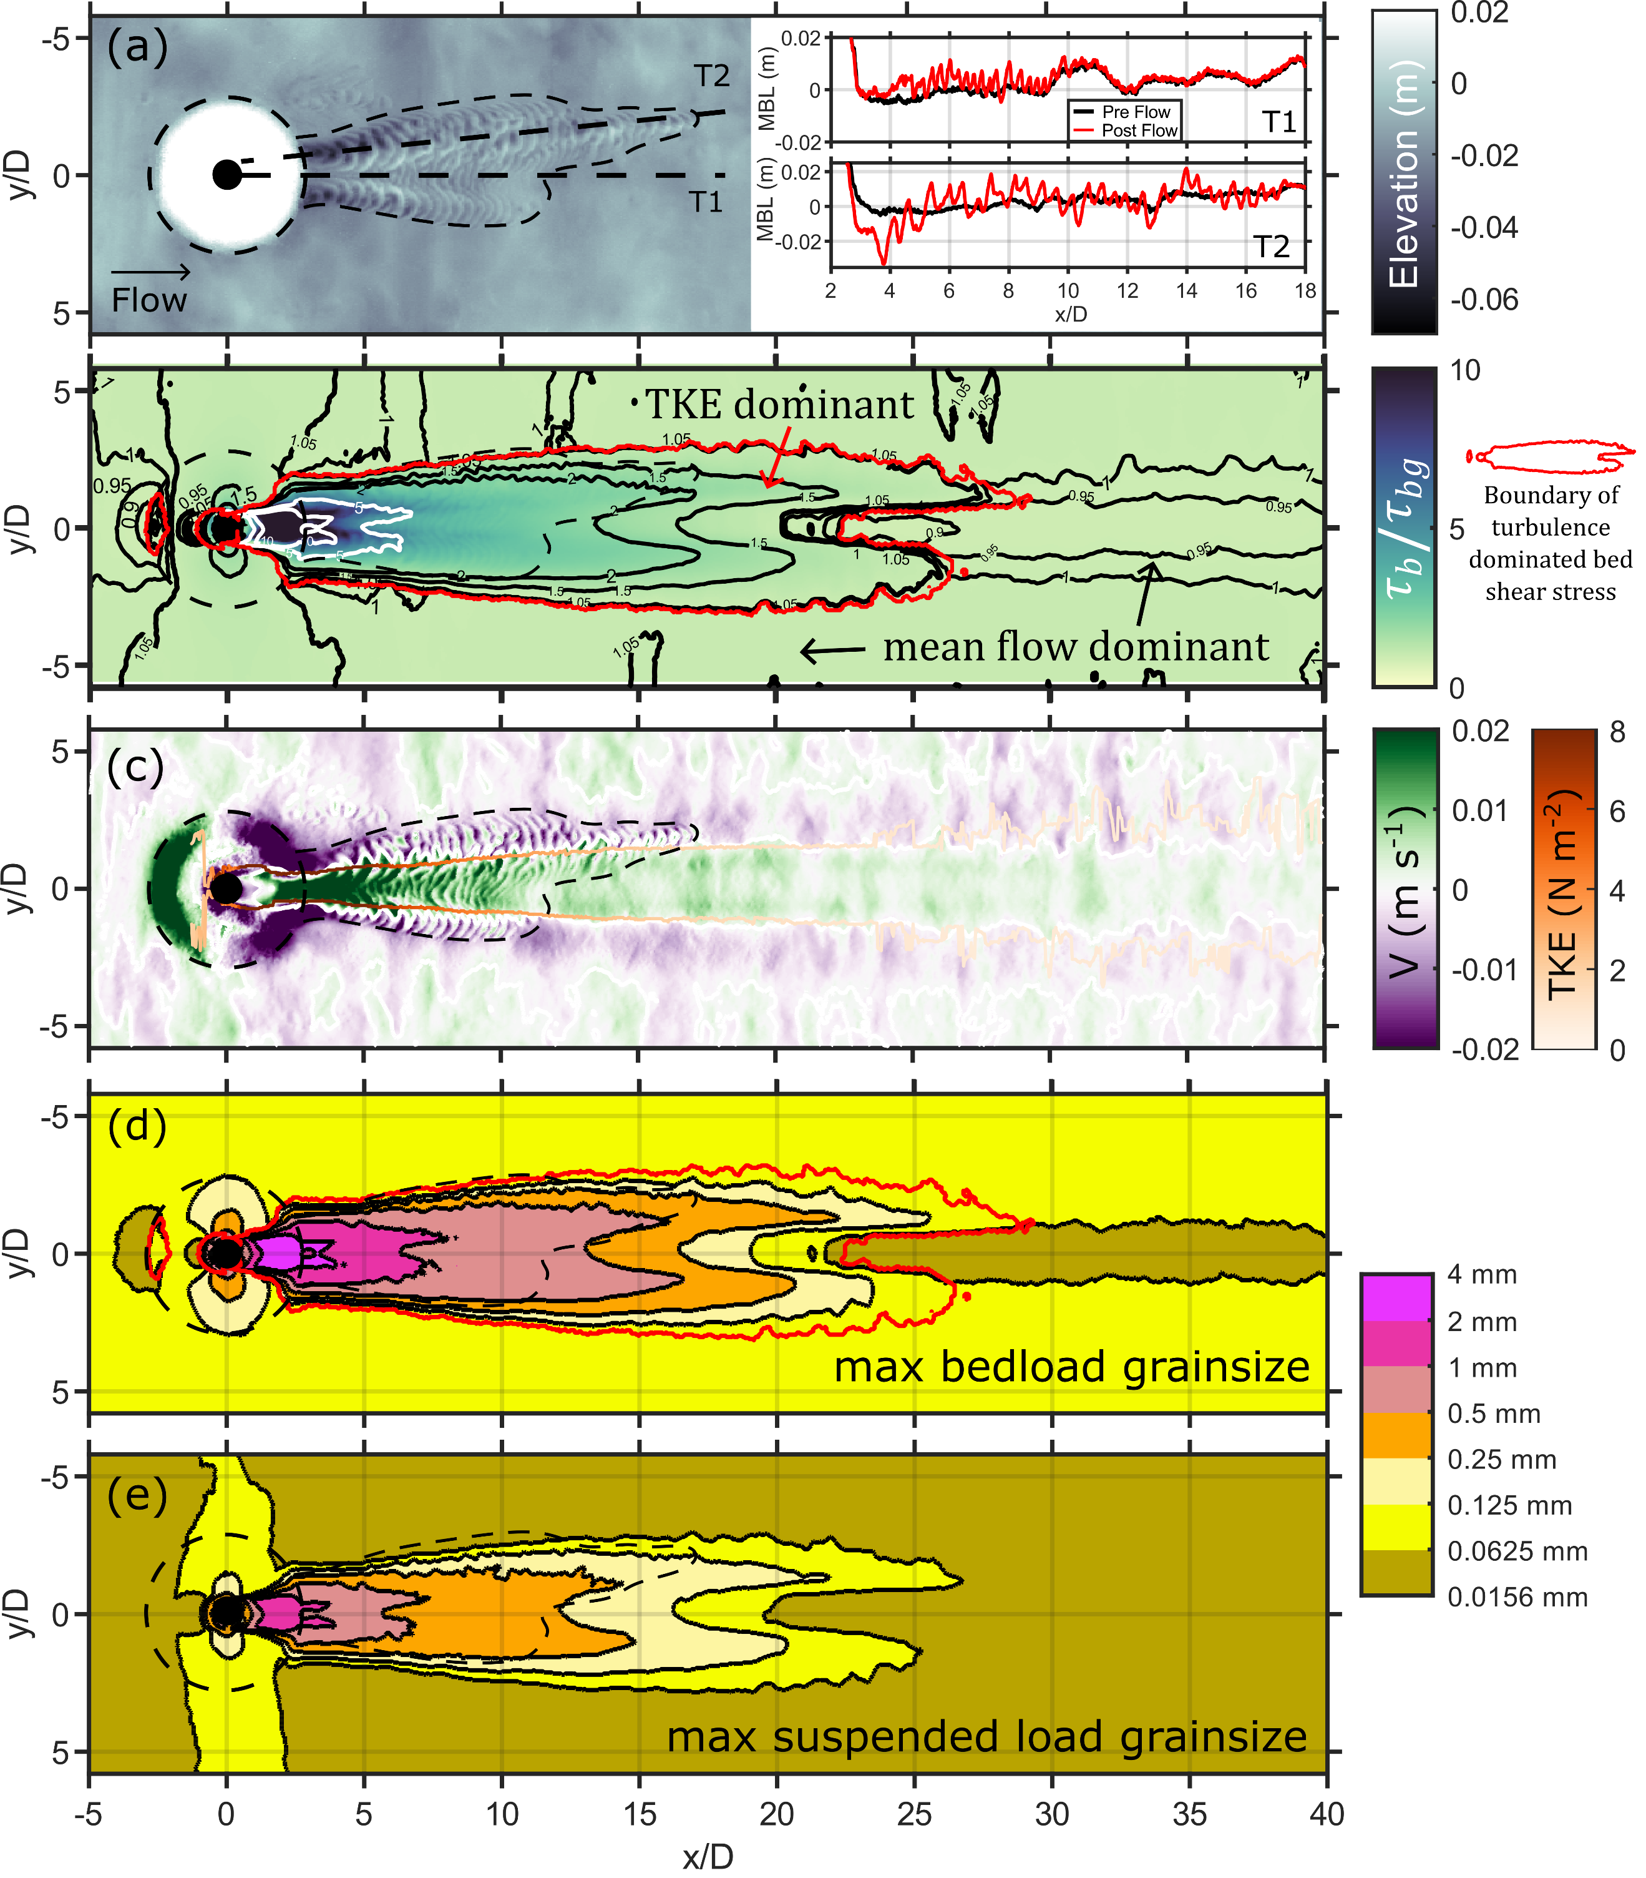
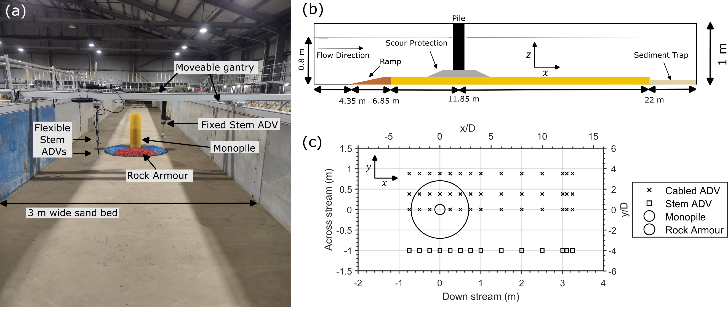
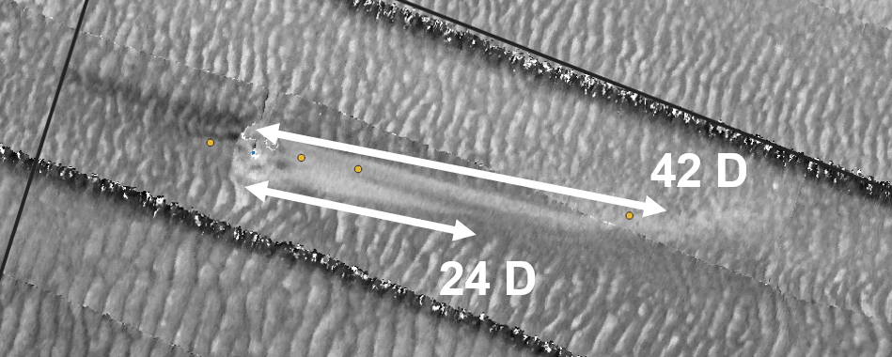
Q2b: How exactly does turbulence drive bed stress in monopile wake?
-> results from large flume experiments at HR Wallingford…
Lab sand = 275 μm
Next step: 3D model from offshore windfarm:
Low
Backscatter
High
Next TELEMAC User Conference: Bangor University, 15+16 Oct 2025

Slide 17
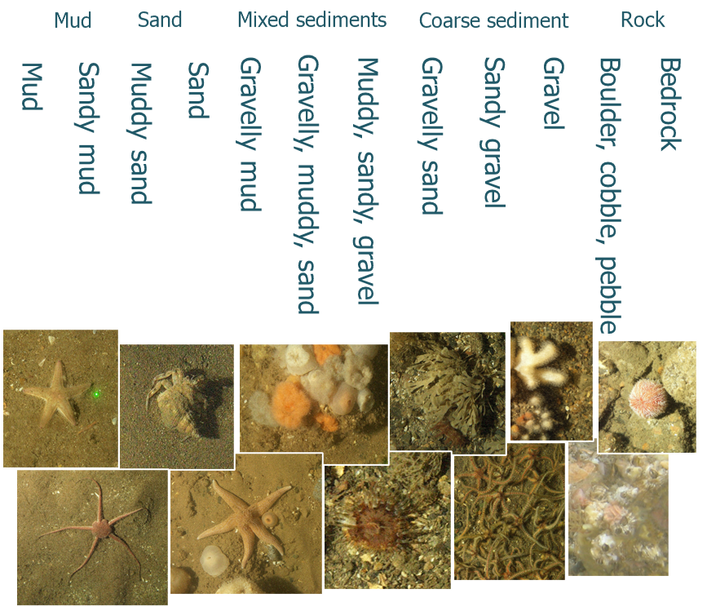
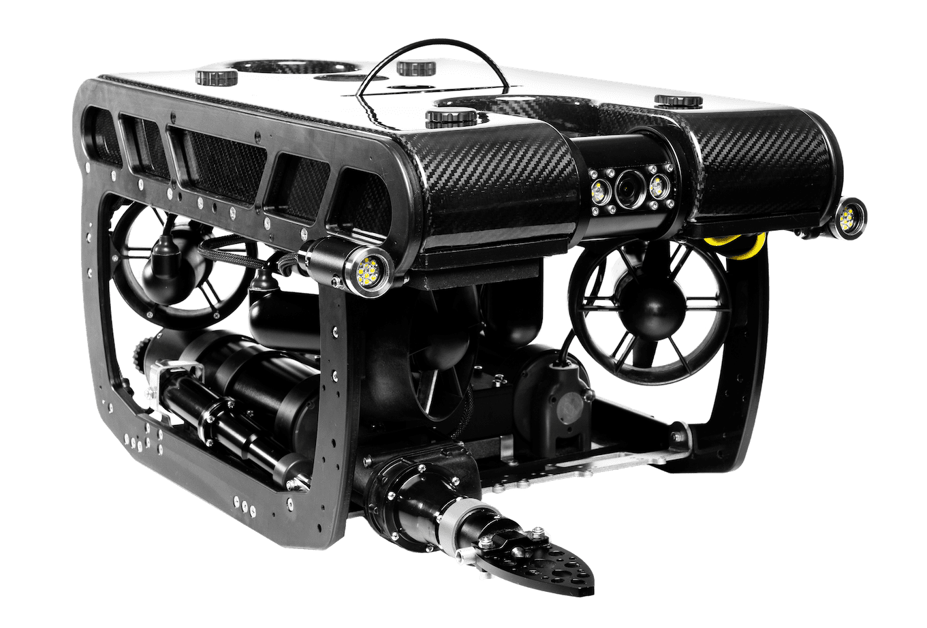

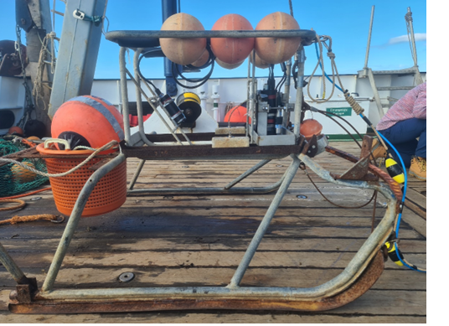
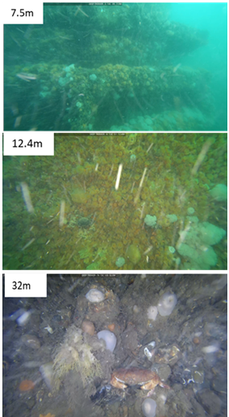
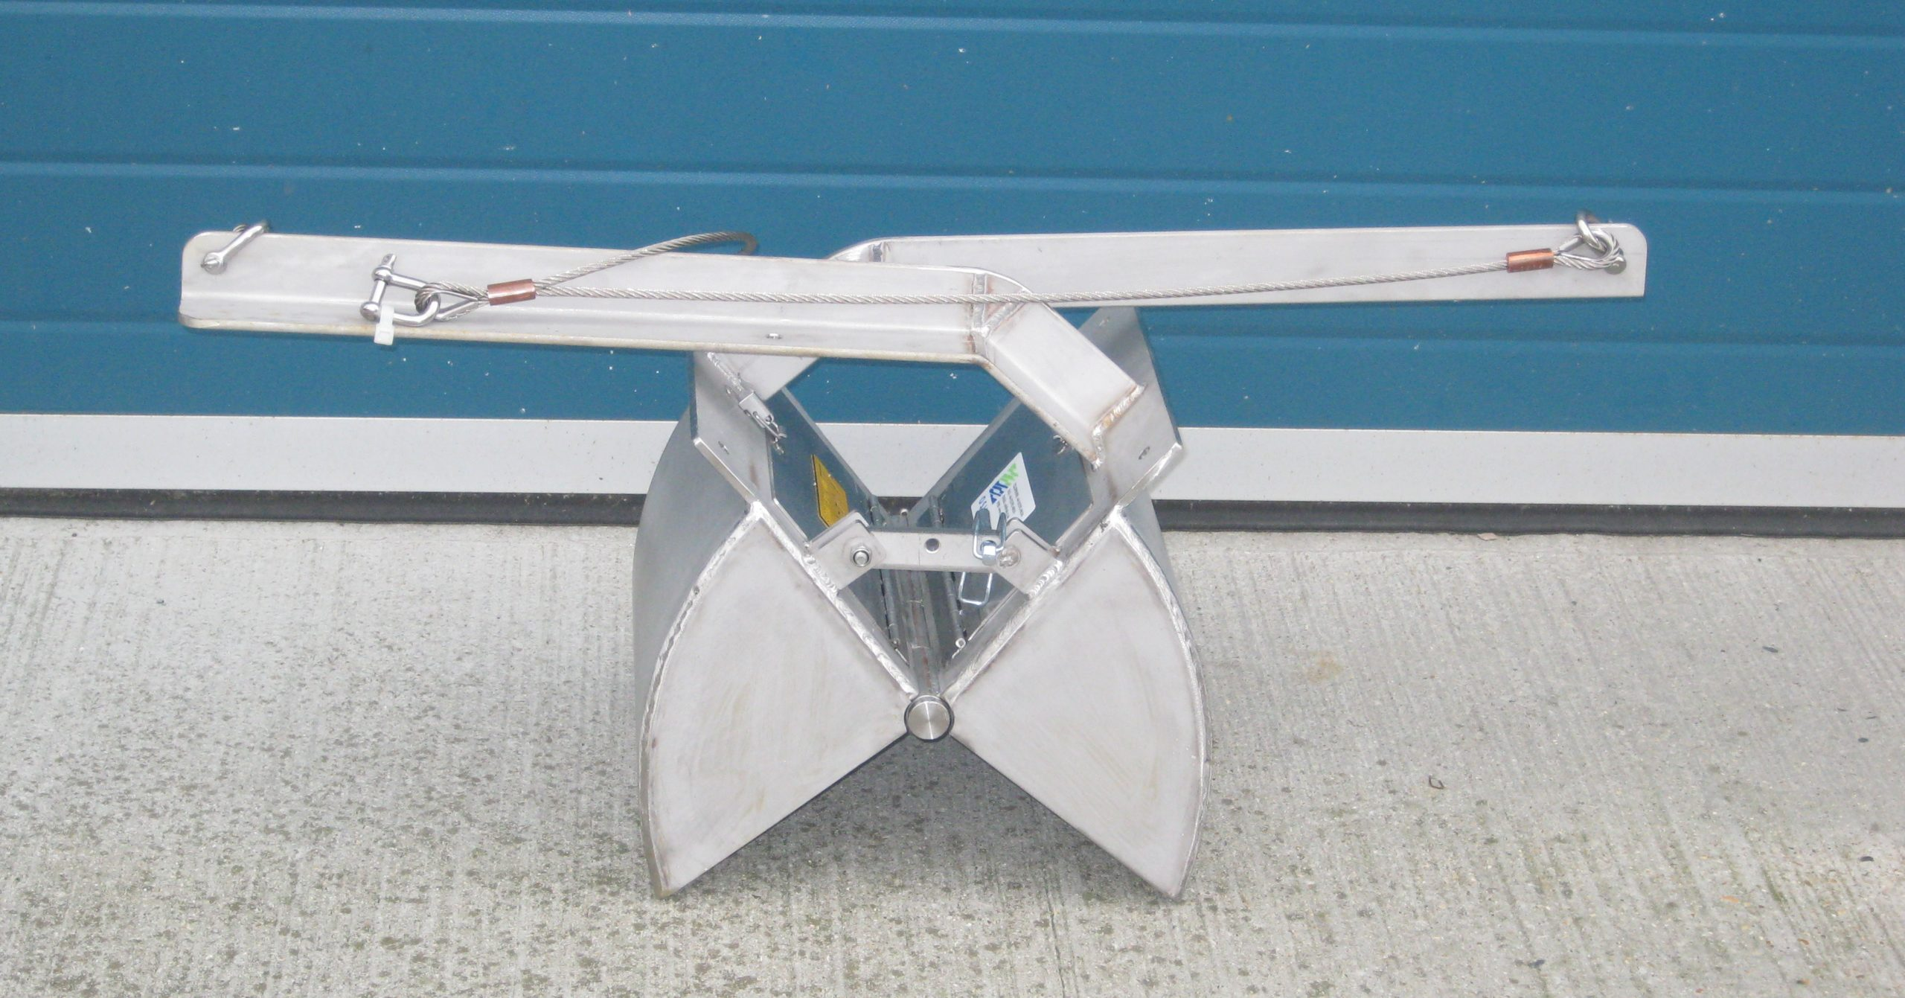
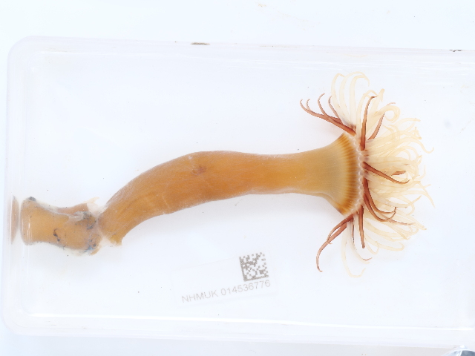
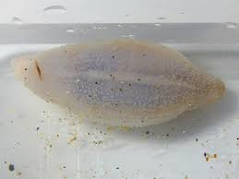
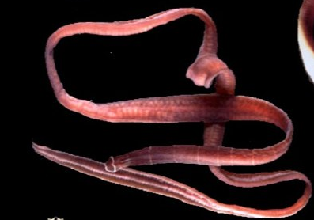
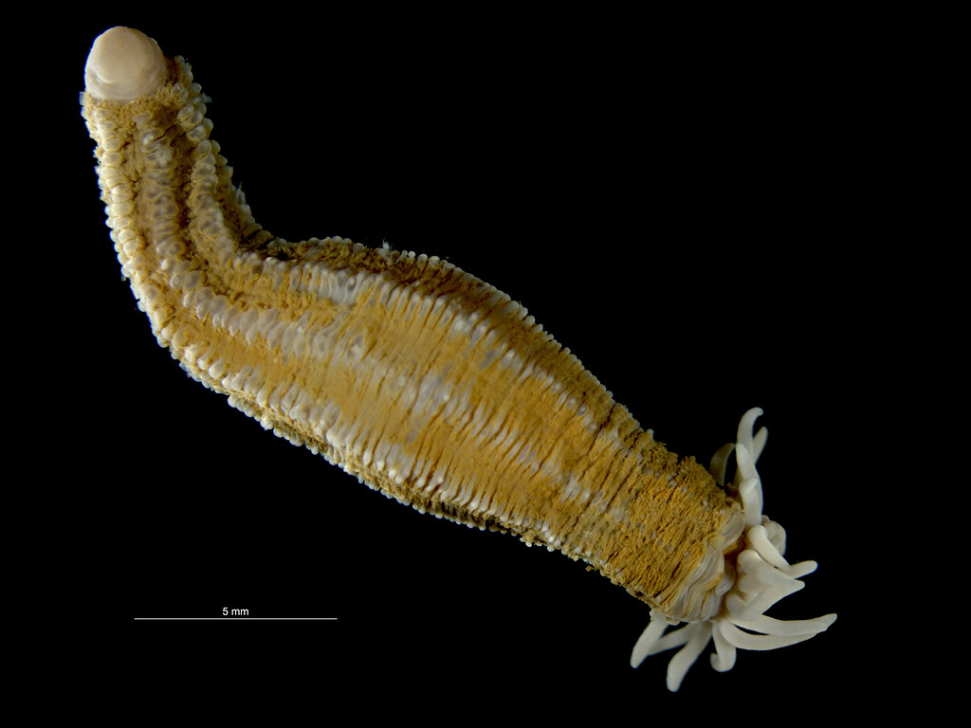
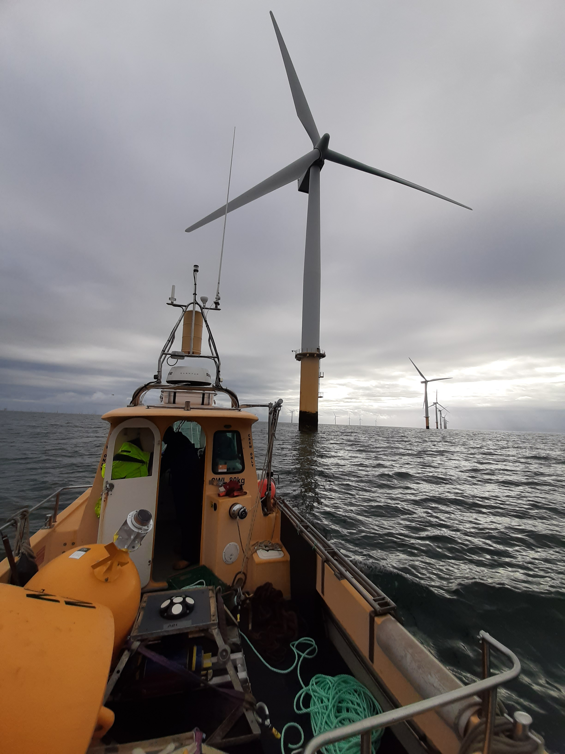
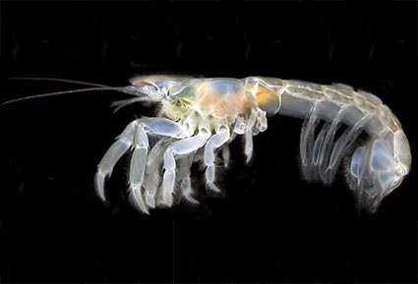
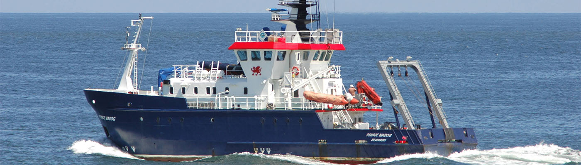
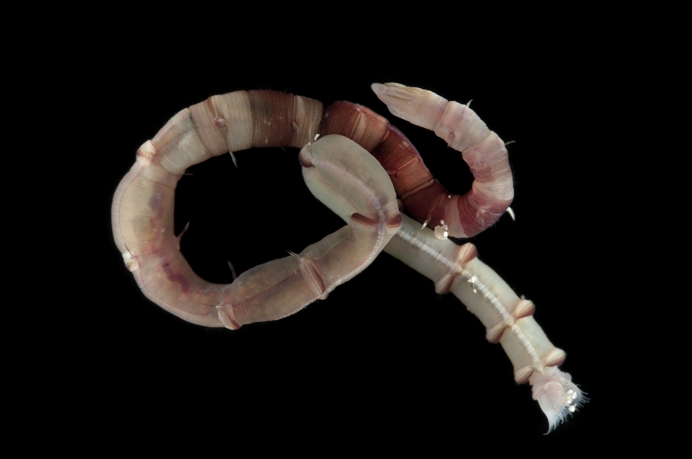
Q3: Consequences of seabed changes for benthic habitats?
So what is species - habitat associations inside and outside OWF?
Significantly different communities observed between similar substrata based on their location either within or outside of an OWF.
More within-OWF data are required to increase the confidence of these findings.

Slide 18
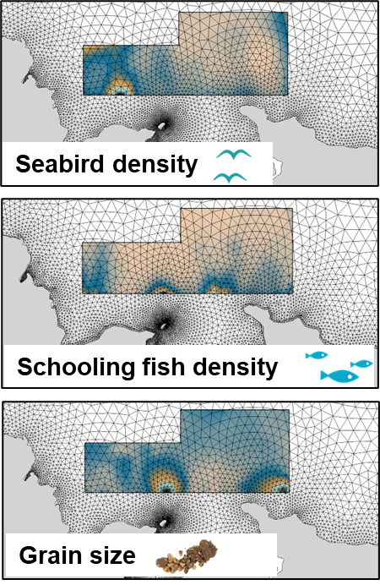
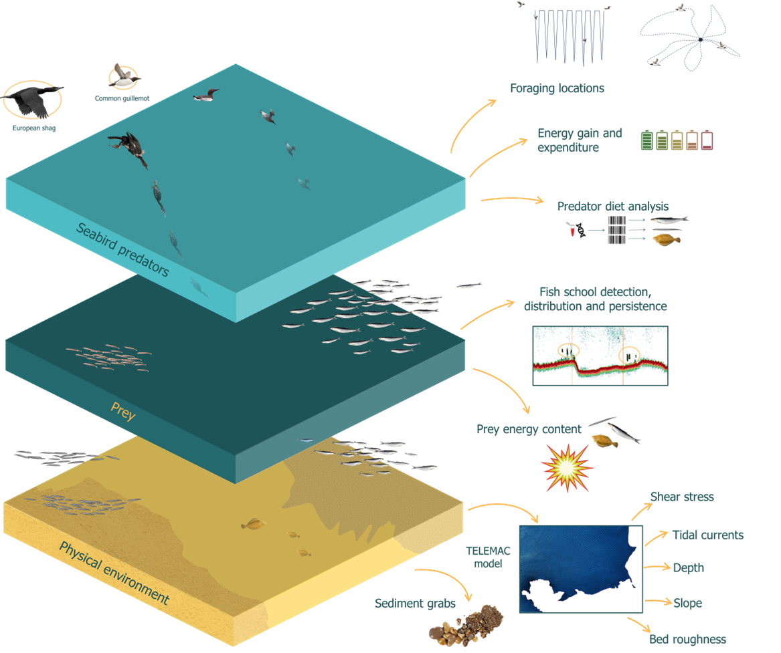
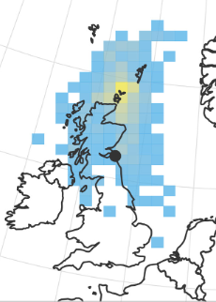

Q4: Consequences of seabed changes for seabirds (via movement decisions, energy budget & foraging success)? So what are fine-scale relationships between seabirds, habitats and prey?
=> Understand consequences of changes to habitat under different scenarios for bird distribution.
Energy gain landscape analyses.

Slide 19
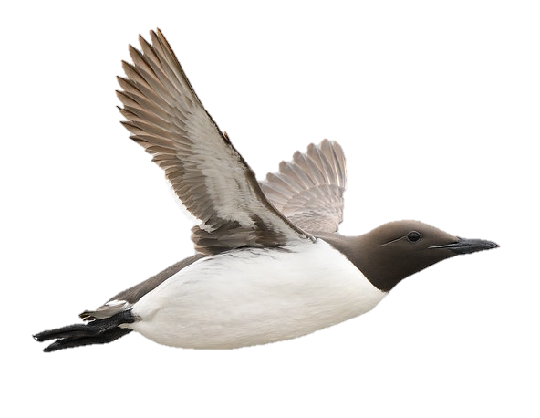
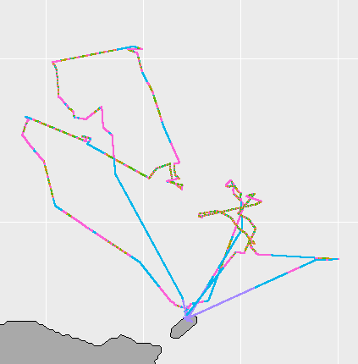
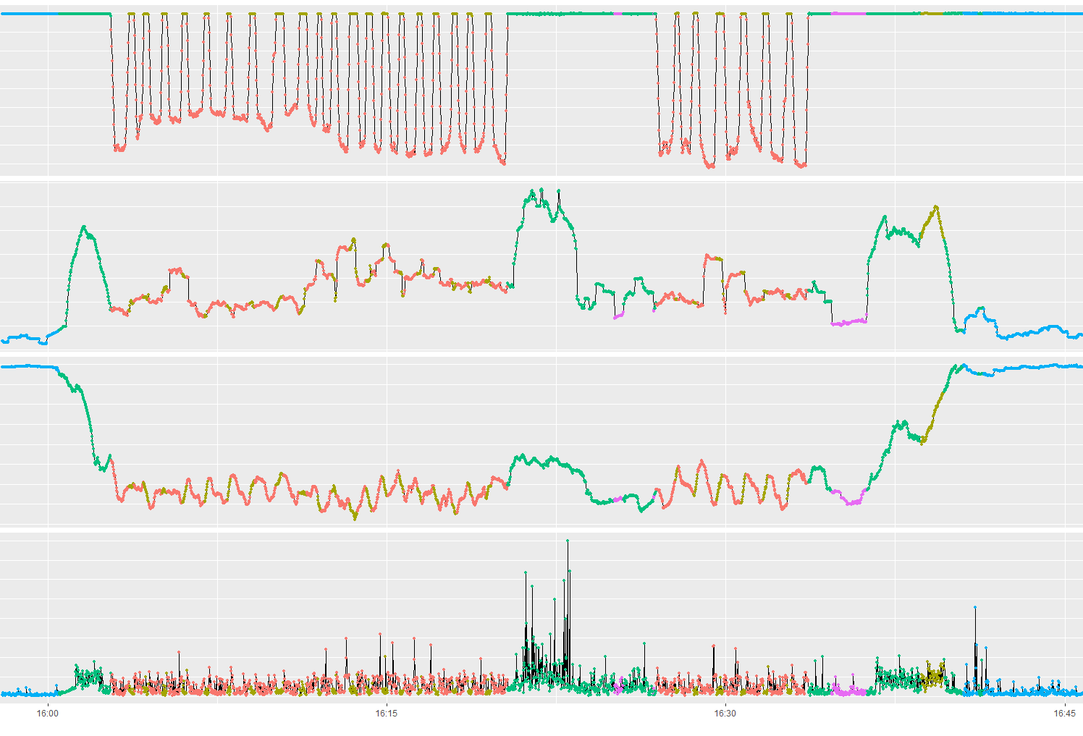
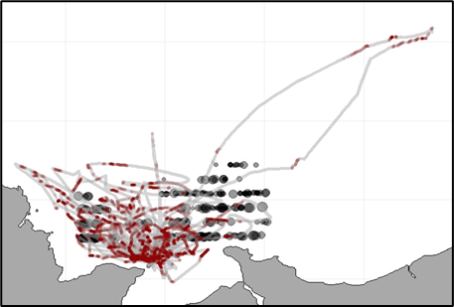
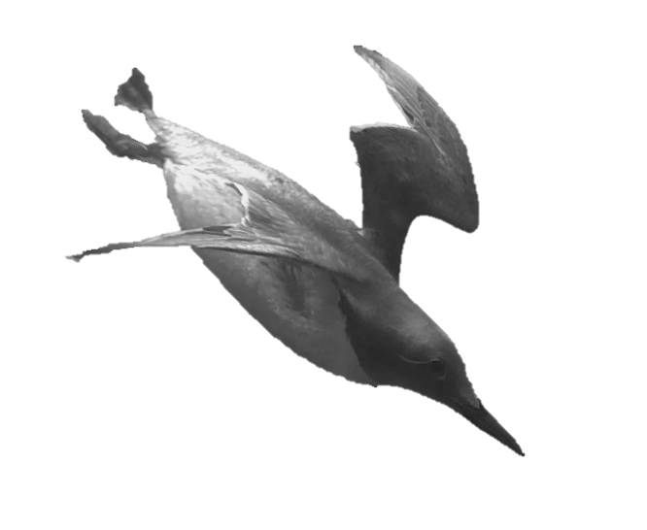
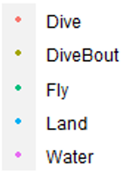
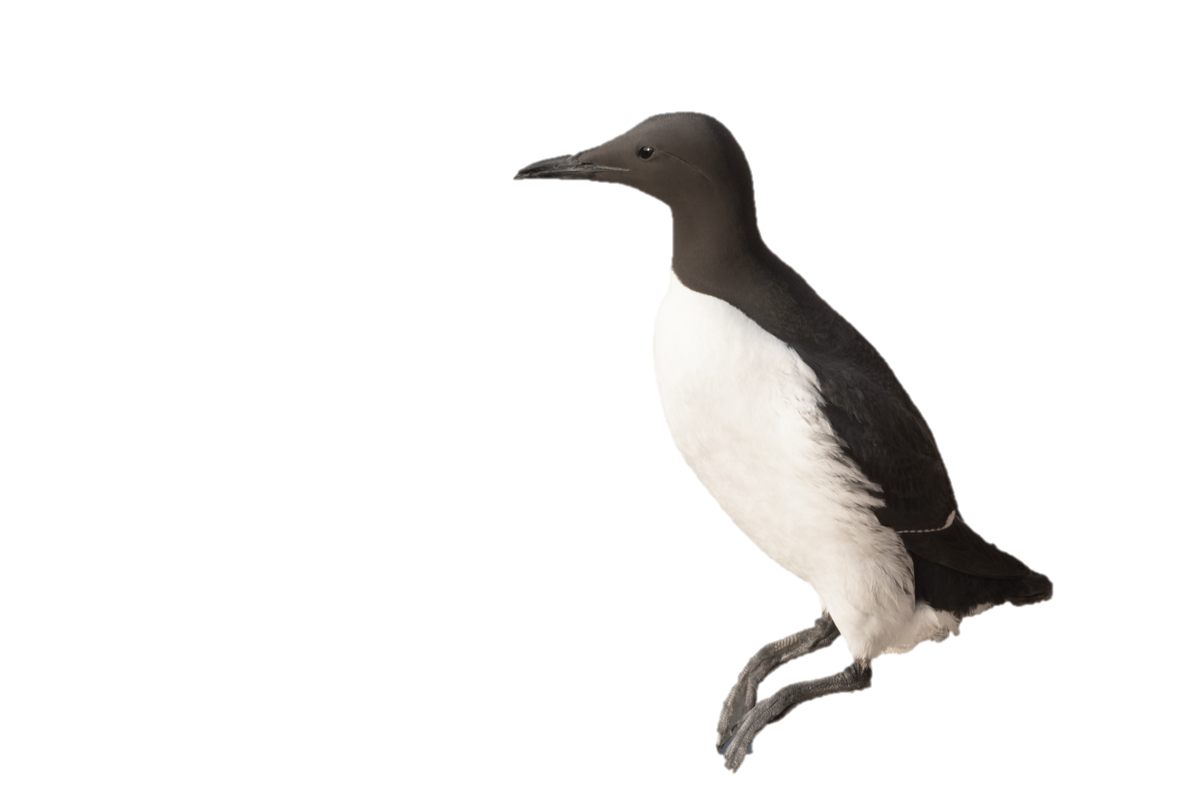
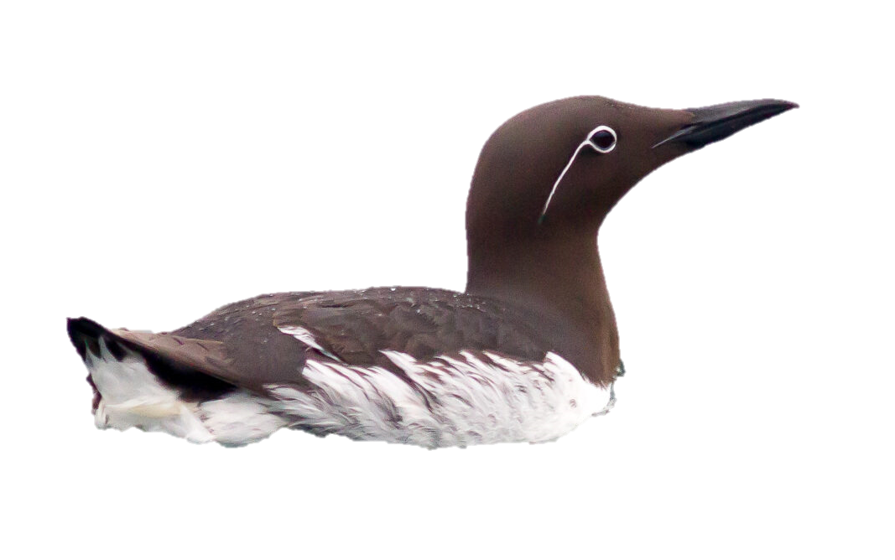




Q4: b: Assigning behaviours: which different areas are more profitable (from prey)?
Depth
fish
diving birds
Dorso ventral amplitude
Pitch
Energy expenditure
school morphology + link to seabed
Notes:
3 photos are European Shags

Slide 20

Ecological implications of accelerated seabed mobility around windfarms (ECOWind-ACCELERATE)
Katrien Van Landeghem, Bangor University: k.v.landeghem@bangor.ac.uk
Q1: Changes to seabed mobility from OWF compared to (1) natural variability and (2) climate? tbd, climate impacts sediment transport capacity.
Q2: How will seabed mobility change from OWF and climate? tbd, but we improved knowledge and TELEMAC model setup:
a: Wake of monopile: what drives bed stress? Turbulent mixing regimes.
b: How exactly? Turbulence dominates up to 25 monopile diameters away.
Q3: Consequences of seabed changes for benthic habitats? There are in Irish Sea, but more data inside OWFs needed for better confidence.
Q4: Consequences of seabed changes for seabirds?
a: Drivers of bird and fish presence and density? Sand, mud and suspended sediments matter + birds go to habitats associated with catchability of prey.
b: Assigning behaviours: Which different areas are more profitable (from prey)? tbd, eating vs feeding!

Slide 21
I predict I will be over time…
Two different stories
There is a lot going on in the North West!
Next time?
Liverpool tidal barrage?
Marine heat waves?
https://www.marineheatwaves.org/tracker.html
Local cockle pickers’ tractor
Maybe a slide on bed sediment samples
Phytoplankton sampler!
ADCP’s
CTD’S
LISST 100X
3D ARP
LISST HOLO
ADV
4 Frequency ABS

Slide 22



