Slide 1
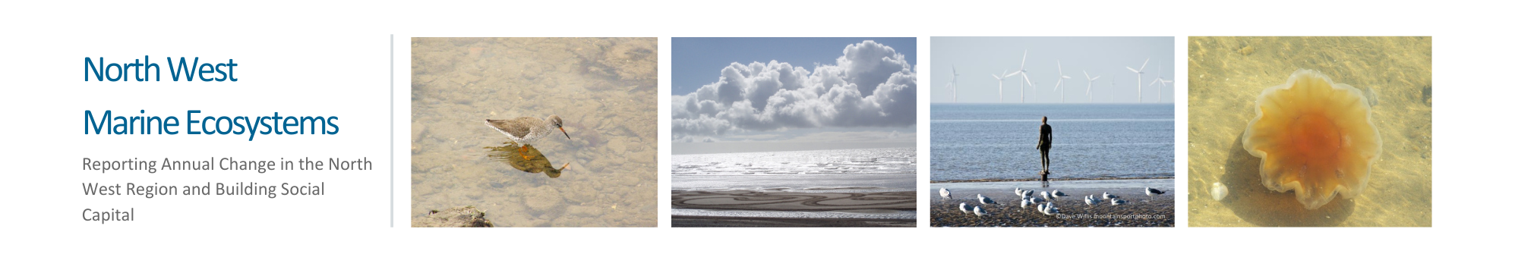
NW England Regional Sea
Georgia de Jong Cleyndert, North West Wildlife Trusts

Slide 2
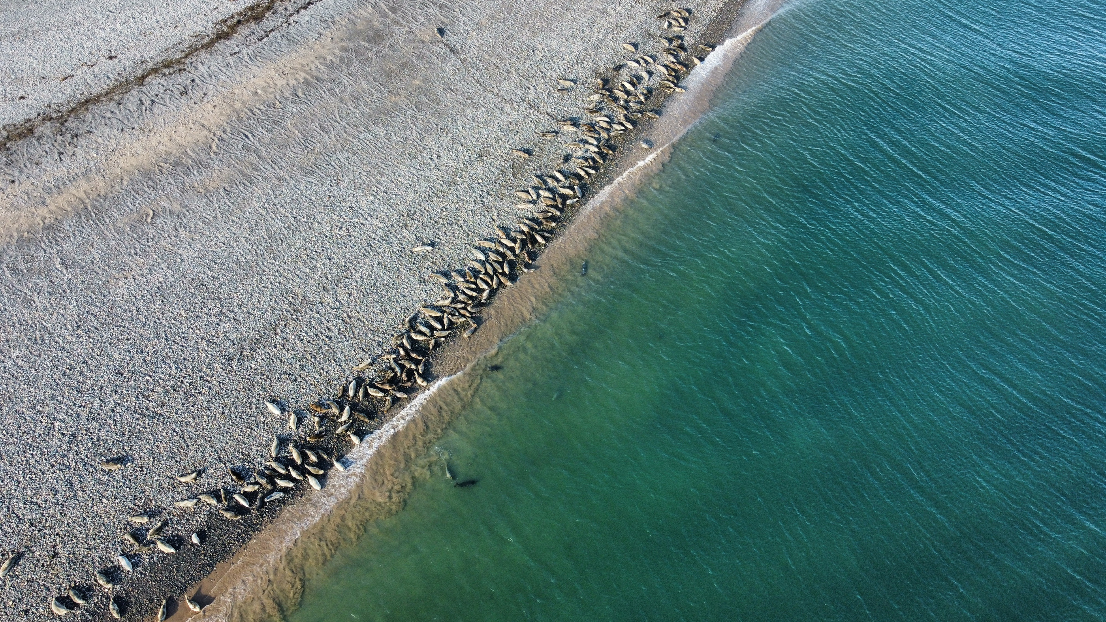
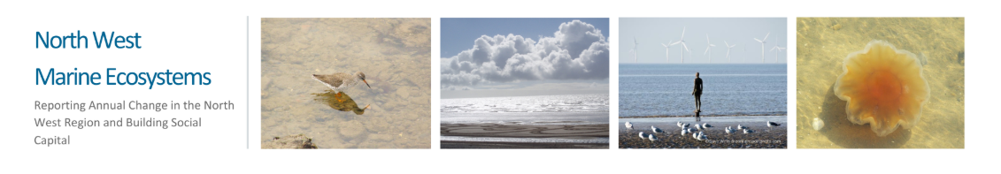

North West Regional Sea
Georgia de Jong Cleyndert
North West Wildlife Trusts
Notes:
It’s a real pleasure to be here today, speaking on behalf of the North West Wildlife Trusts—Cumbria, Lancashire, and Cheshire.
This is a somewhat difficult spot to fill—setting the scene for a room full of people who already know, love, and work along this extraordinary stretch of coastline and marine area.
Together, we’re connected by a shared commitment to the North West regional sea: a place of remarkable biodiversity, deep cultural roots, but also a very busy area with a large variety of existing activities competing for limited space.
This slot aims to frame that bigger picture—before we dive into the detail—by exploring the wonders, the challenges, and the opportunities that define this unique marine environment (albeit from the NWWT perspective!)

Slide 3
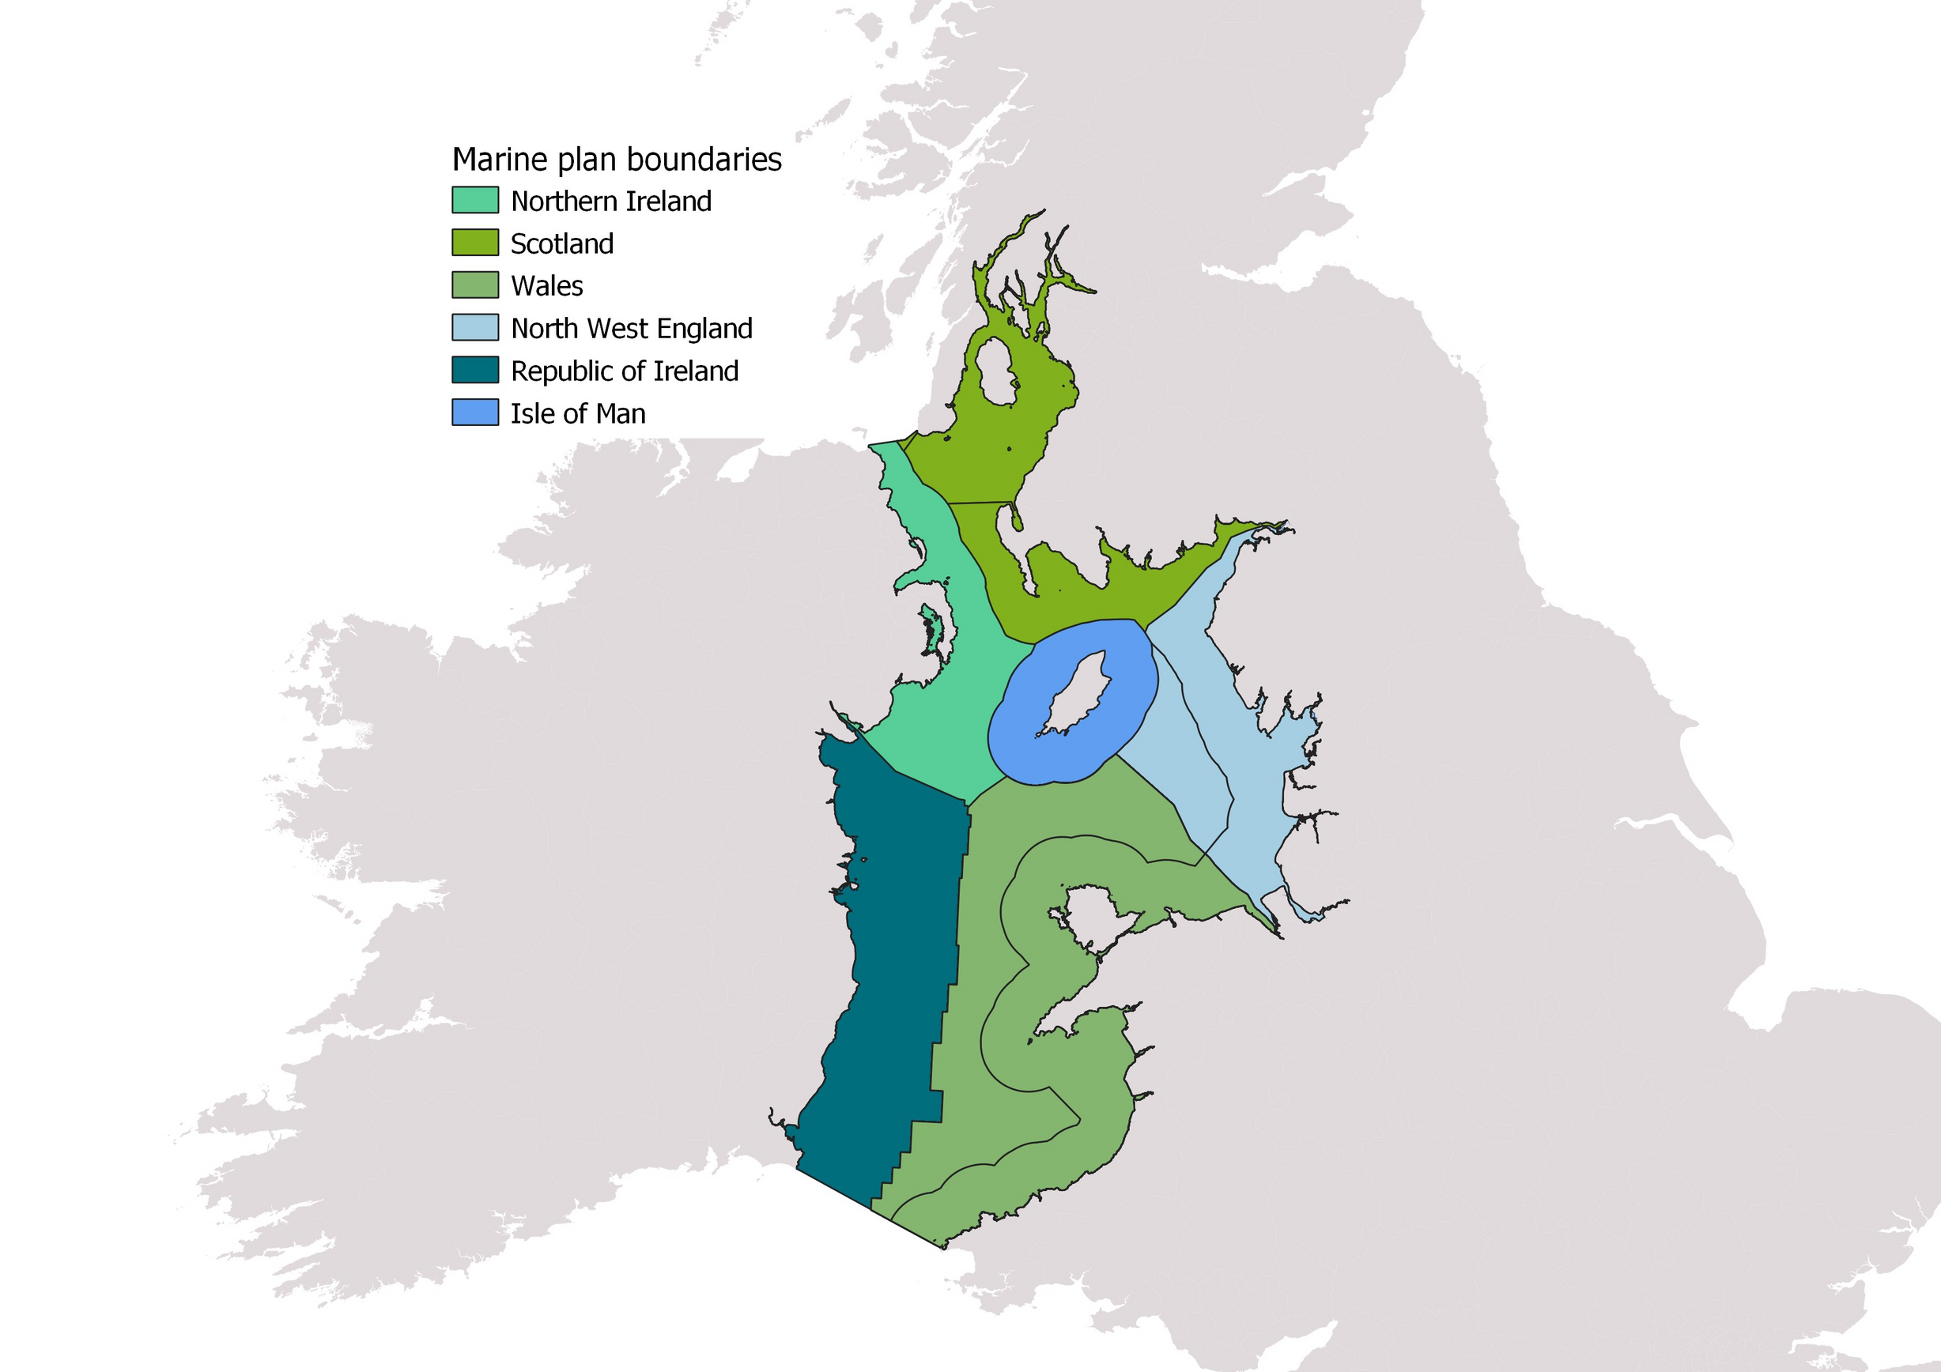

Solway Firth
Dee Estuary
Area: 4,900km2
Notes:
The north west regional sea (or the the Eastern Irish Sea), stretches from the Solway Firth down to the Dee Estuary, is a truly remarkable place. If we go by the inshore and offshore north west marine plan area, it is a total of approximately 4,900 square kilometres of sea.

Slide 4
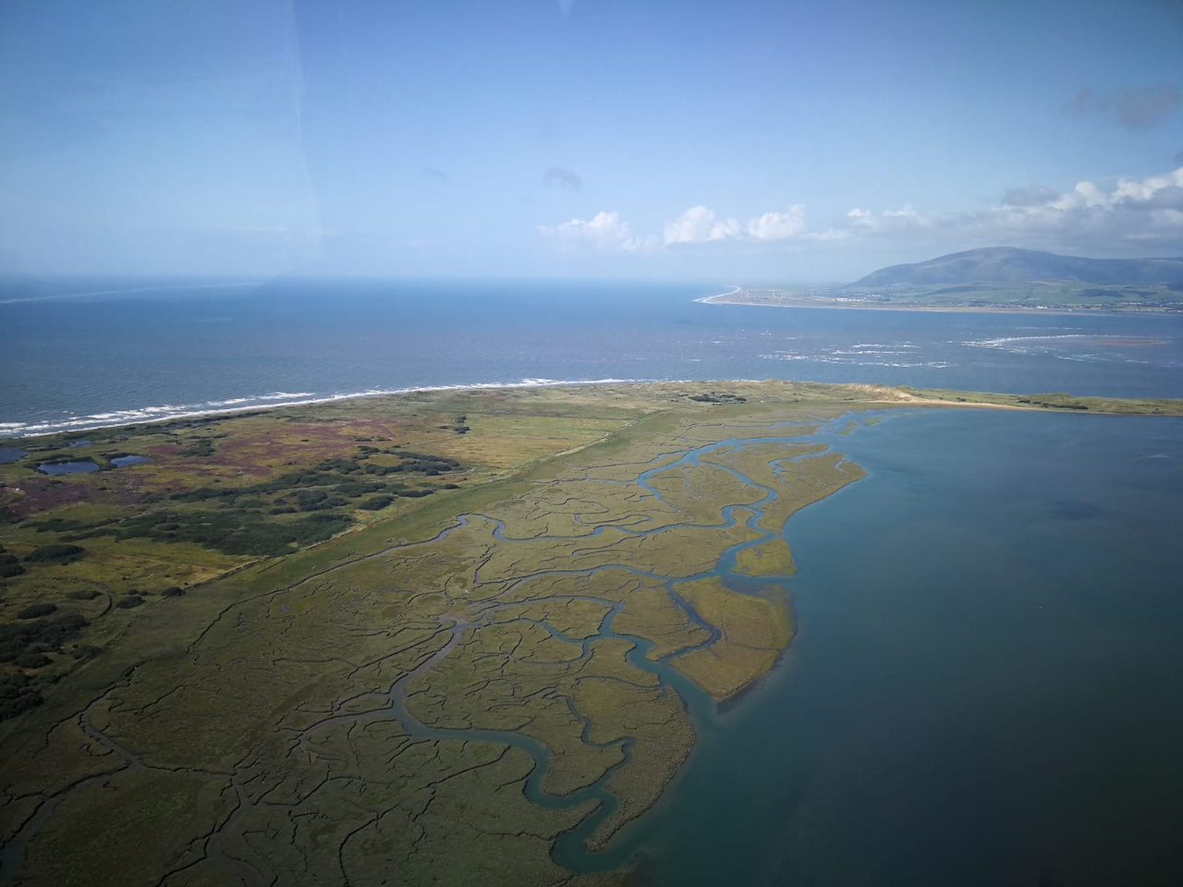
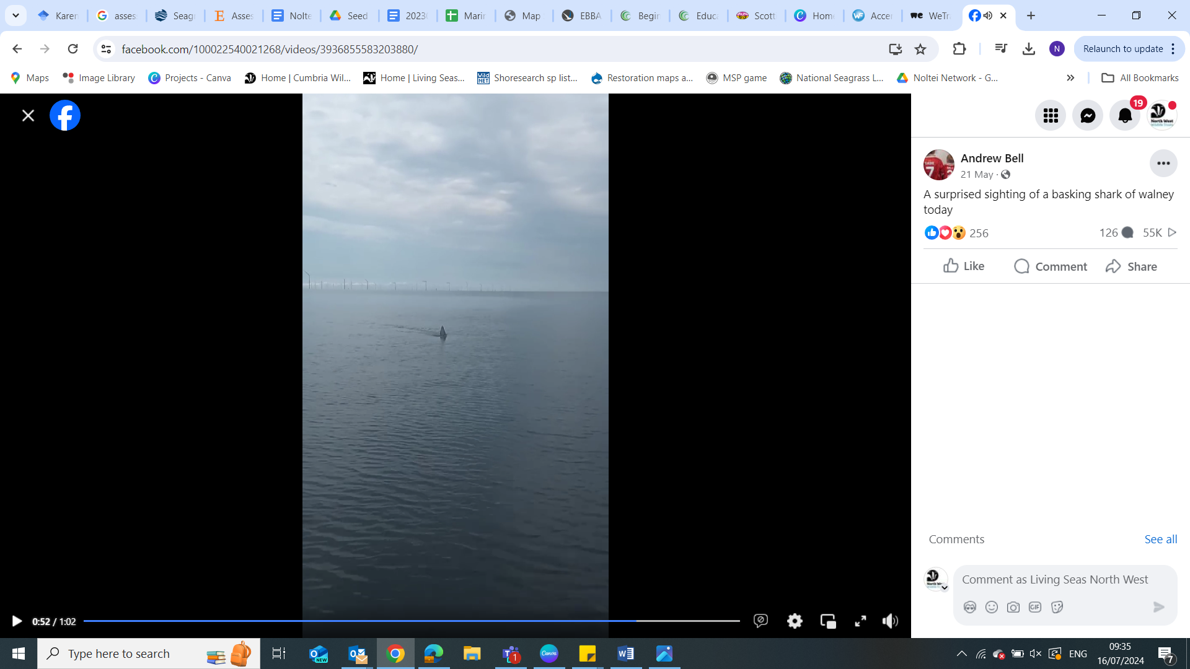
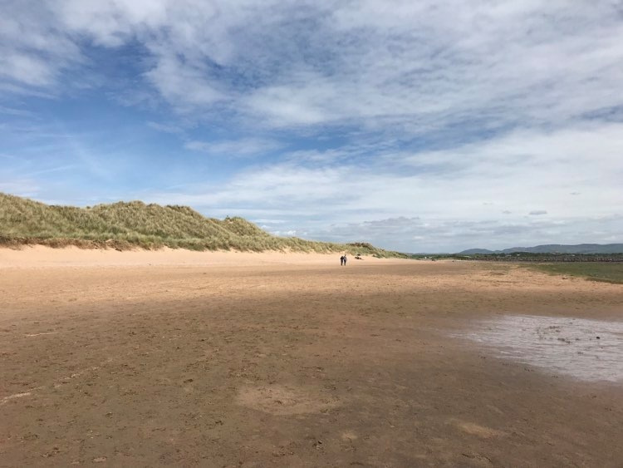
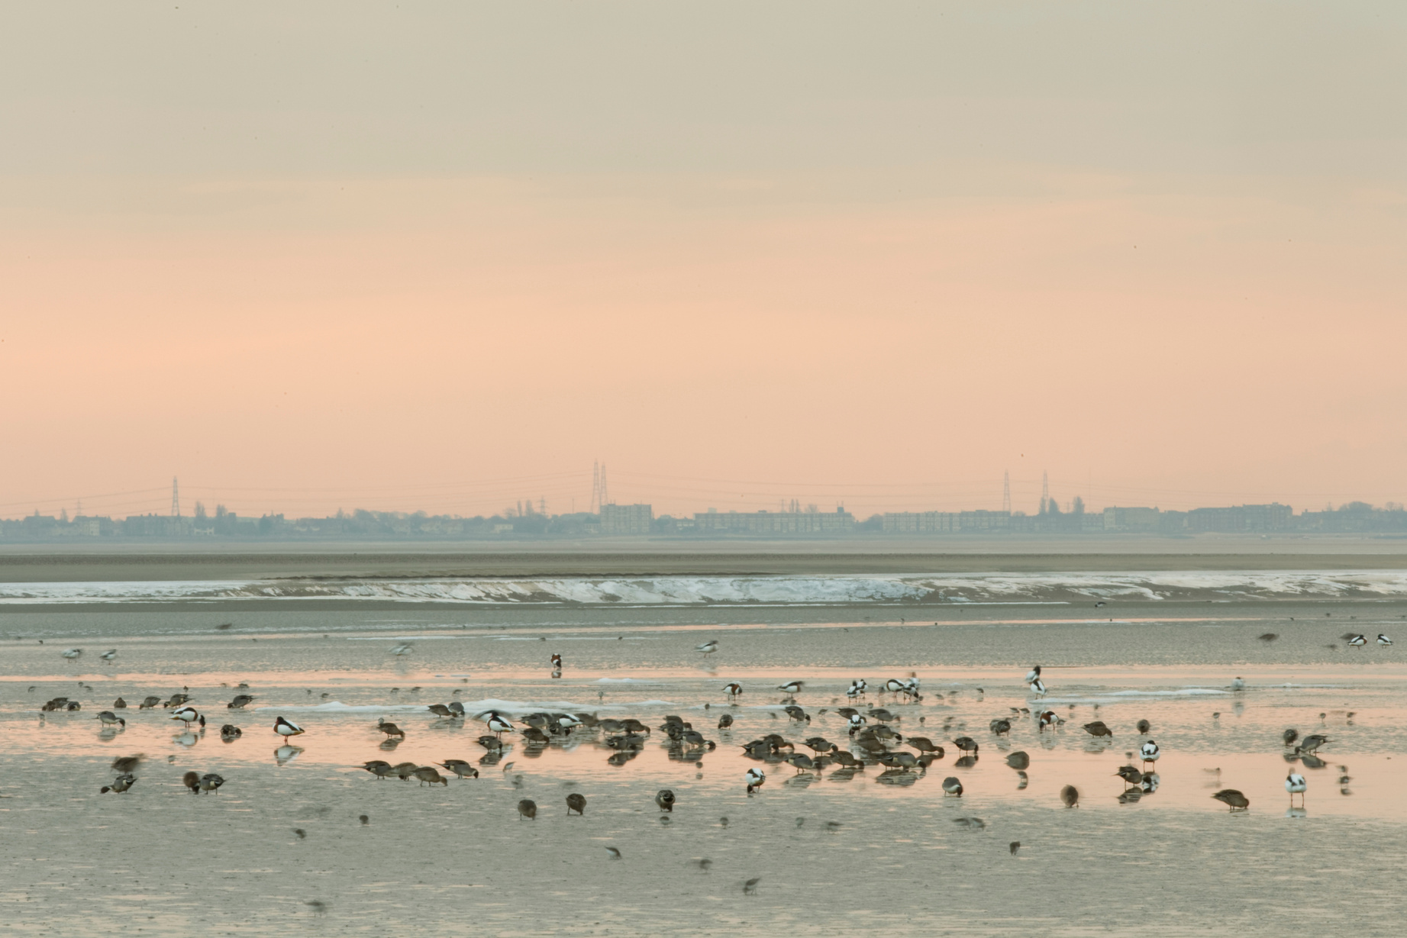
Notes:
It is a region that hosts an extraordinary array of marine life.
Mosaic of habitats supporting a vast range of species. Which is reflected in the number of statutory and non-statutory designated sites.

Slide 5
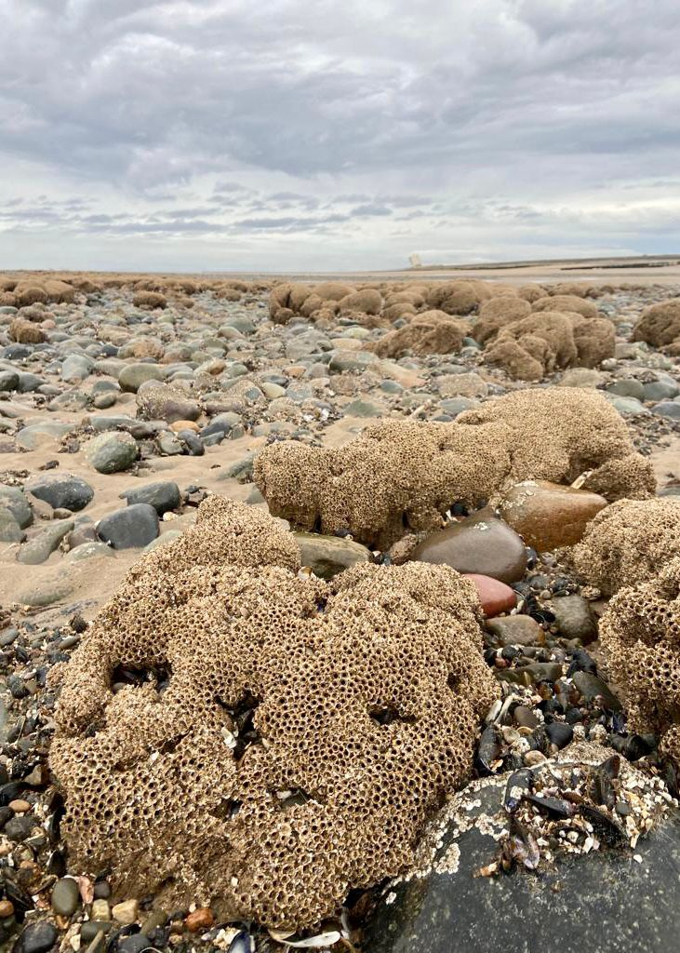
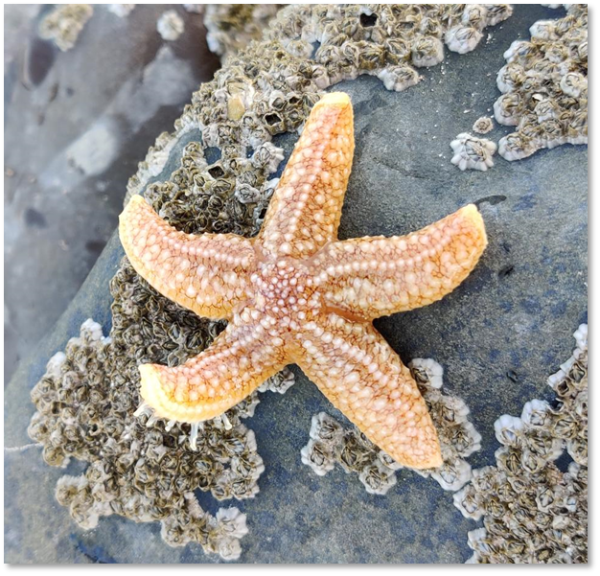
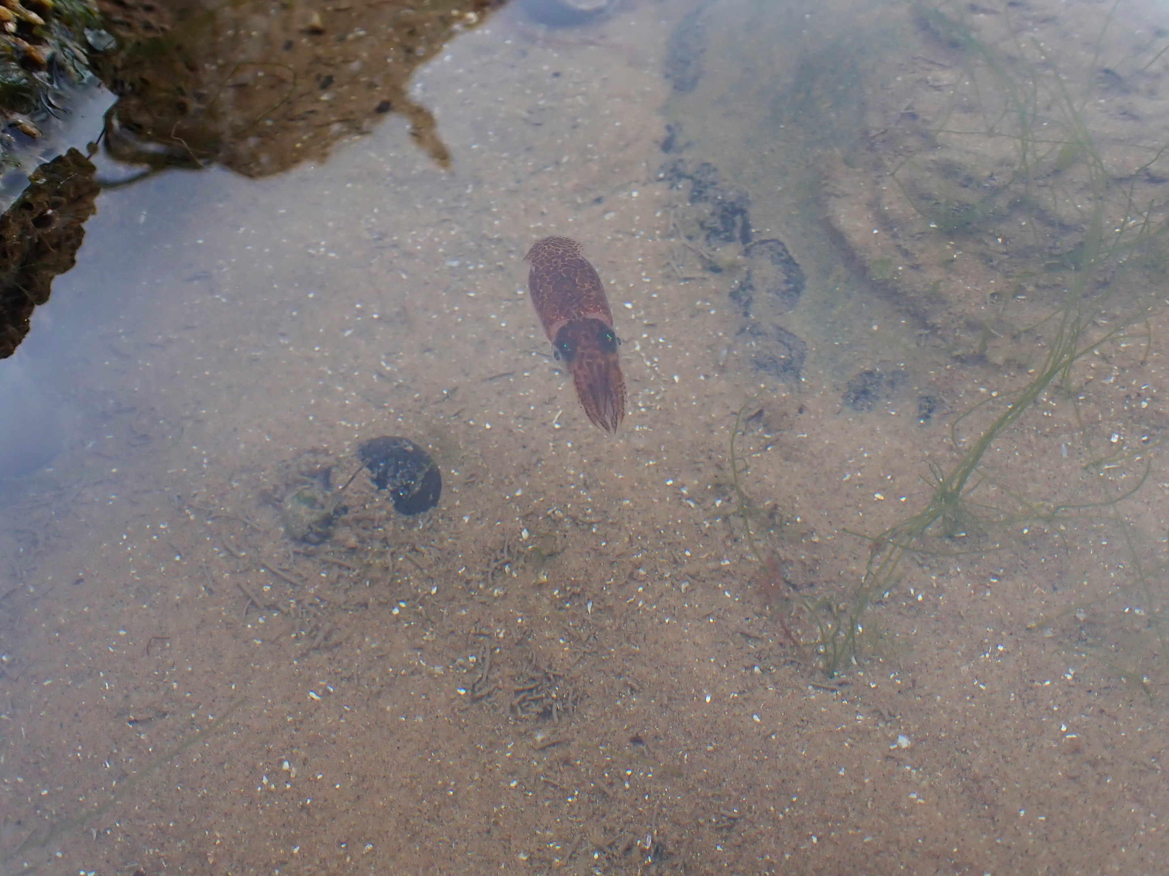
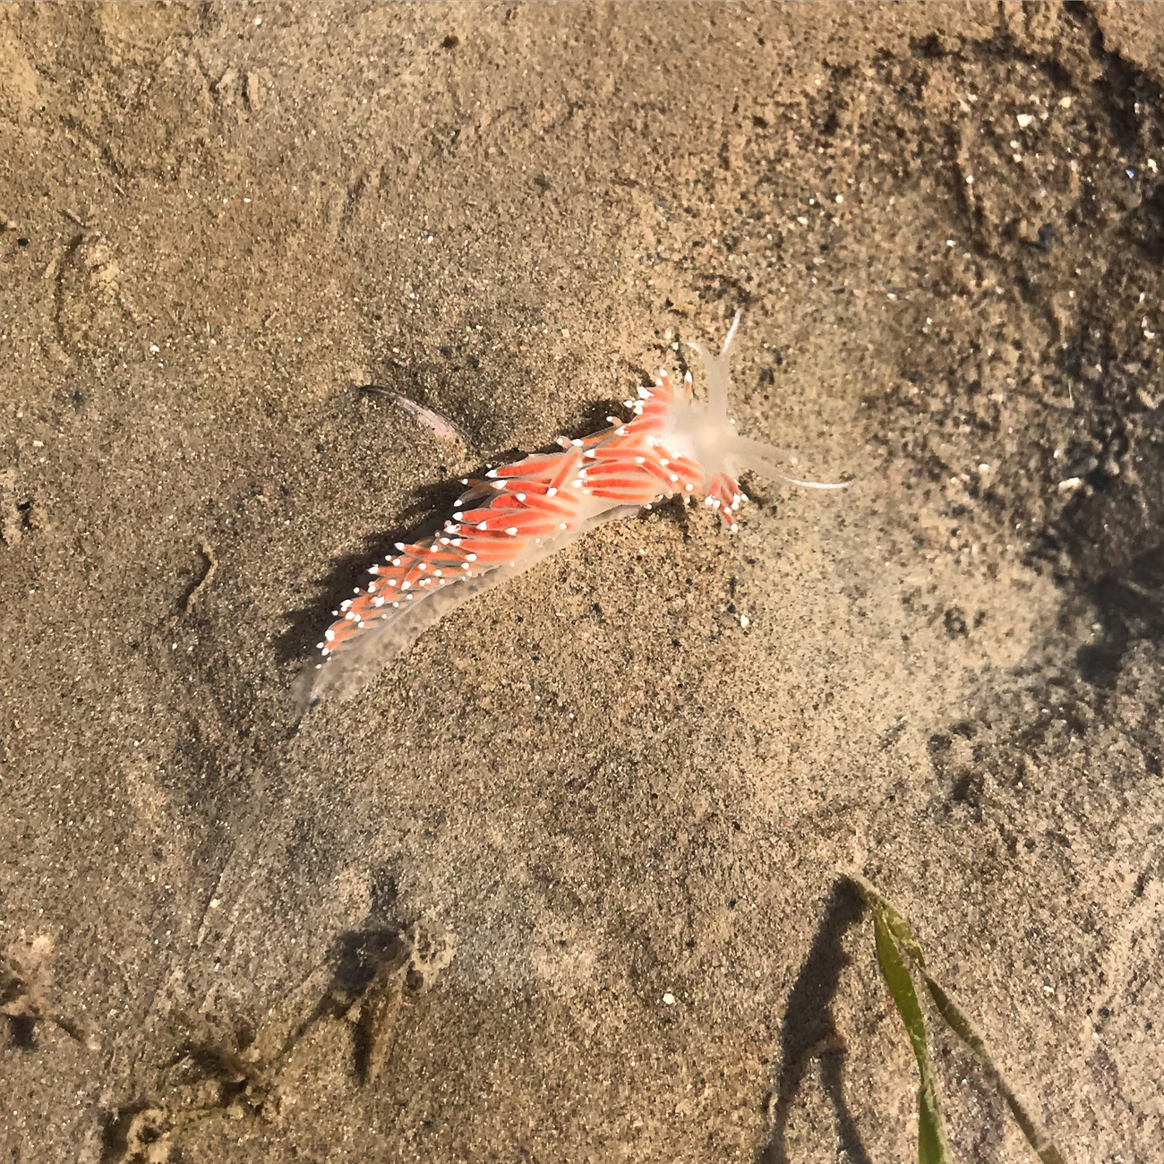
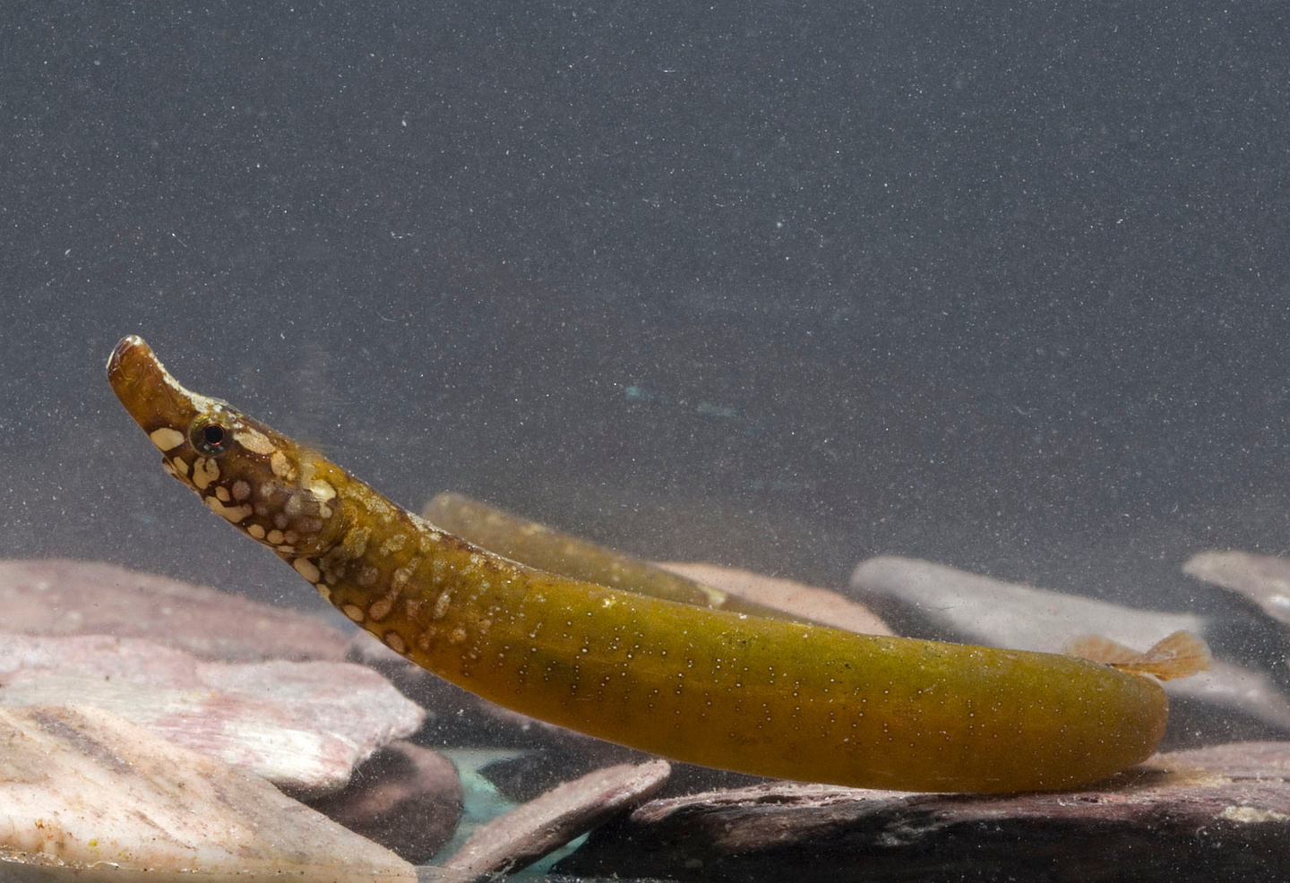
Notes:
The shoreline and rockpools provide insight into the wider marine areas. In the intertidal, seagrass beds provide shelter for species like pipefish and honeycomb worm reefs provide complex habitat for a whole host of species.

Slide 6
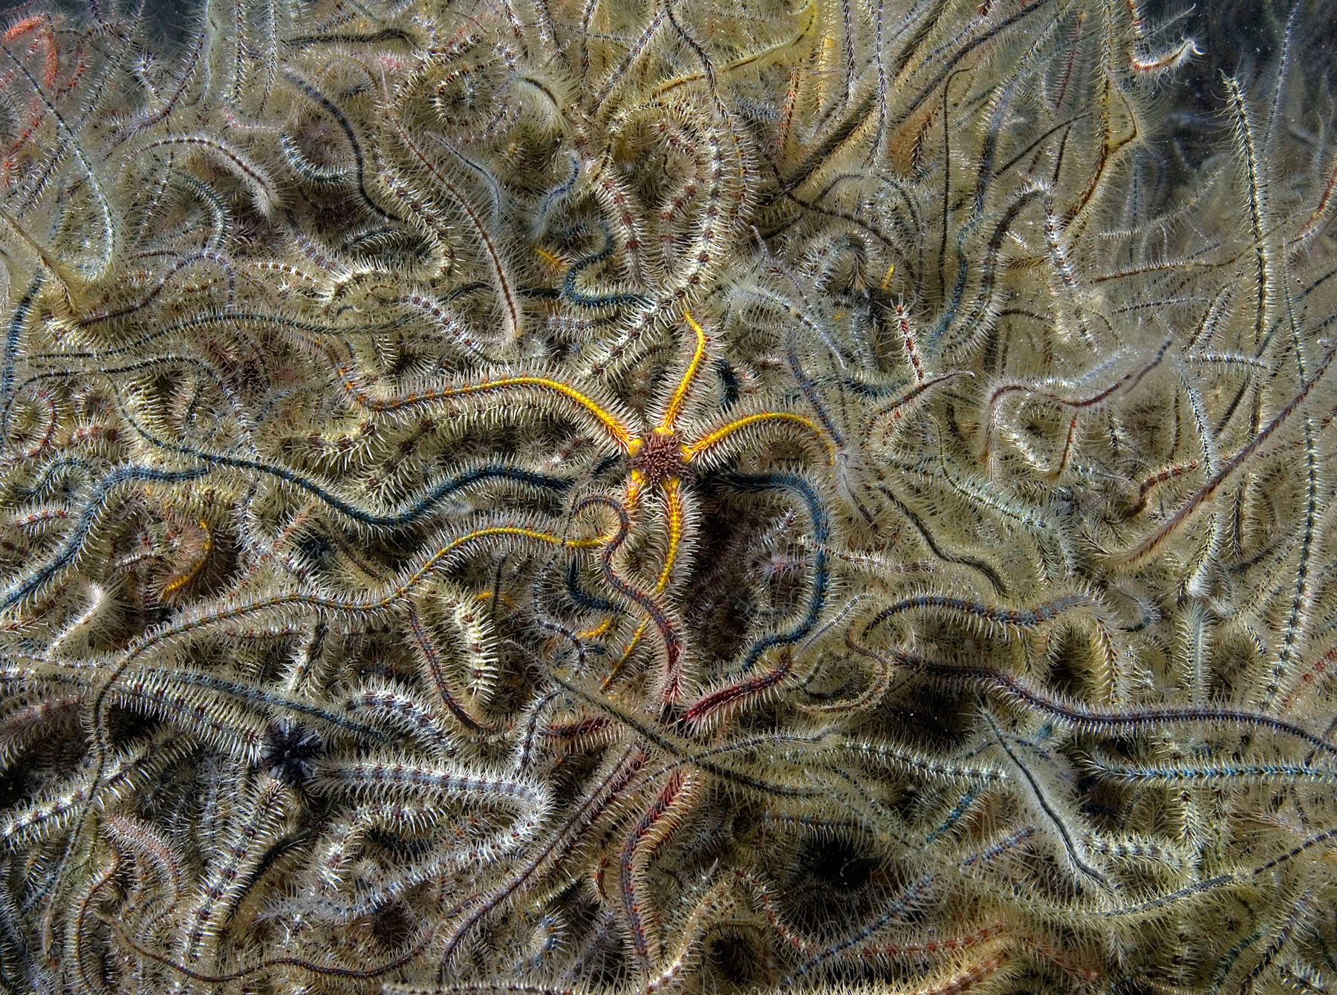
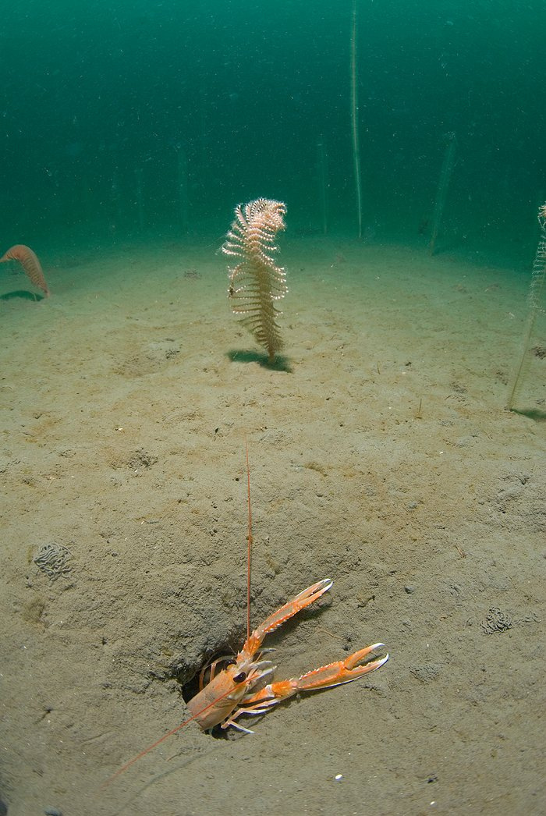
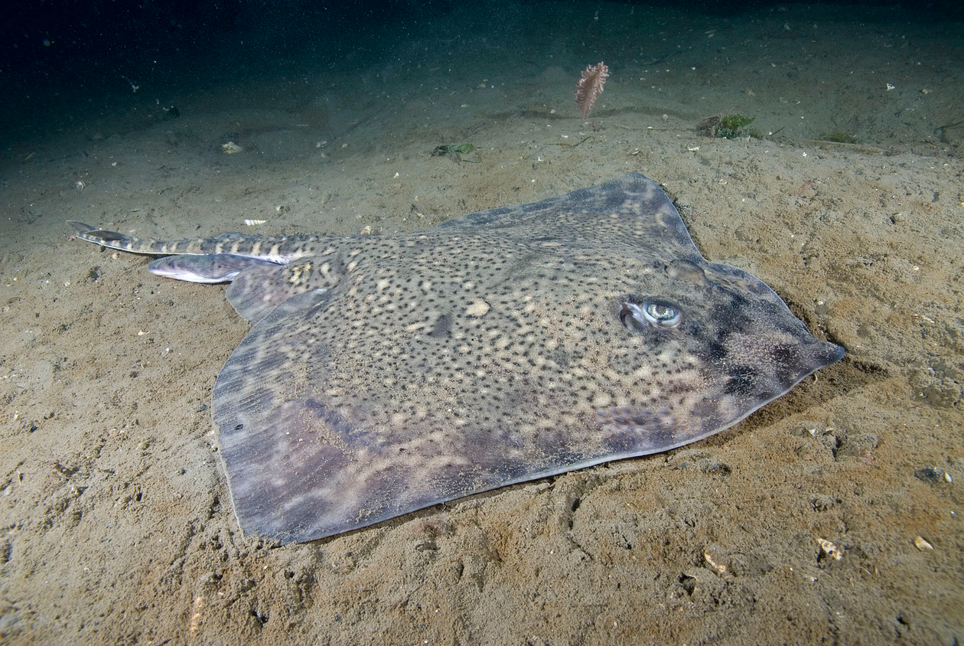
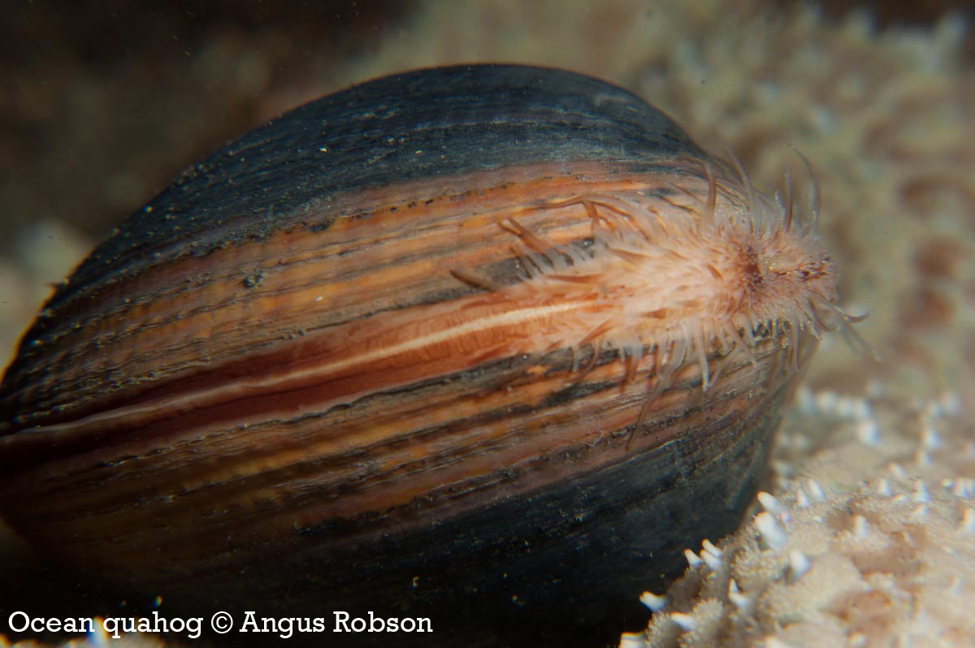
Notes:
And beneath the waves, muds, sands and gravels, support a variety of benthic species and provide important spawning, nursery and feeding grounds for a range of fish, skates and rays.

Slide 7
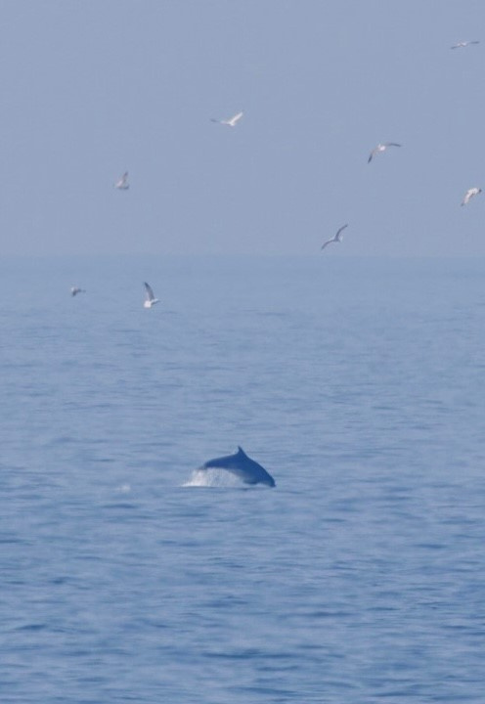
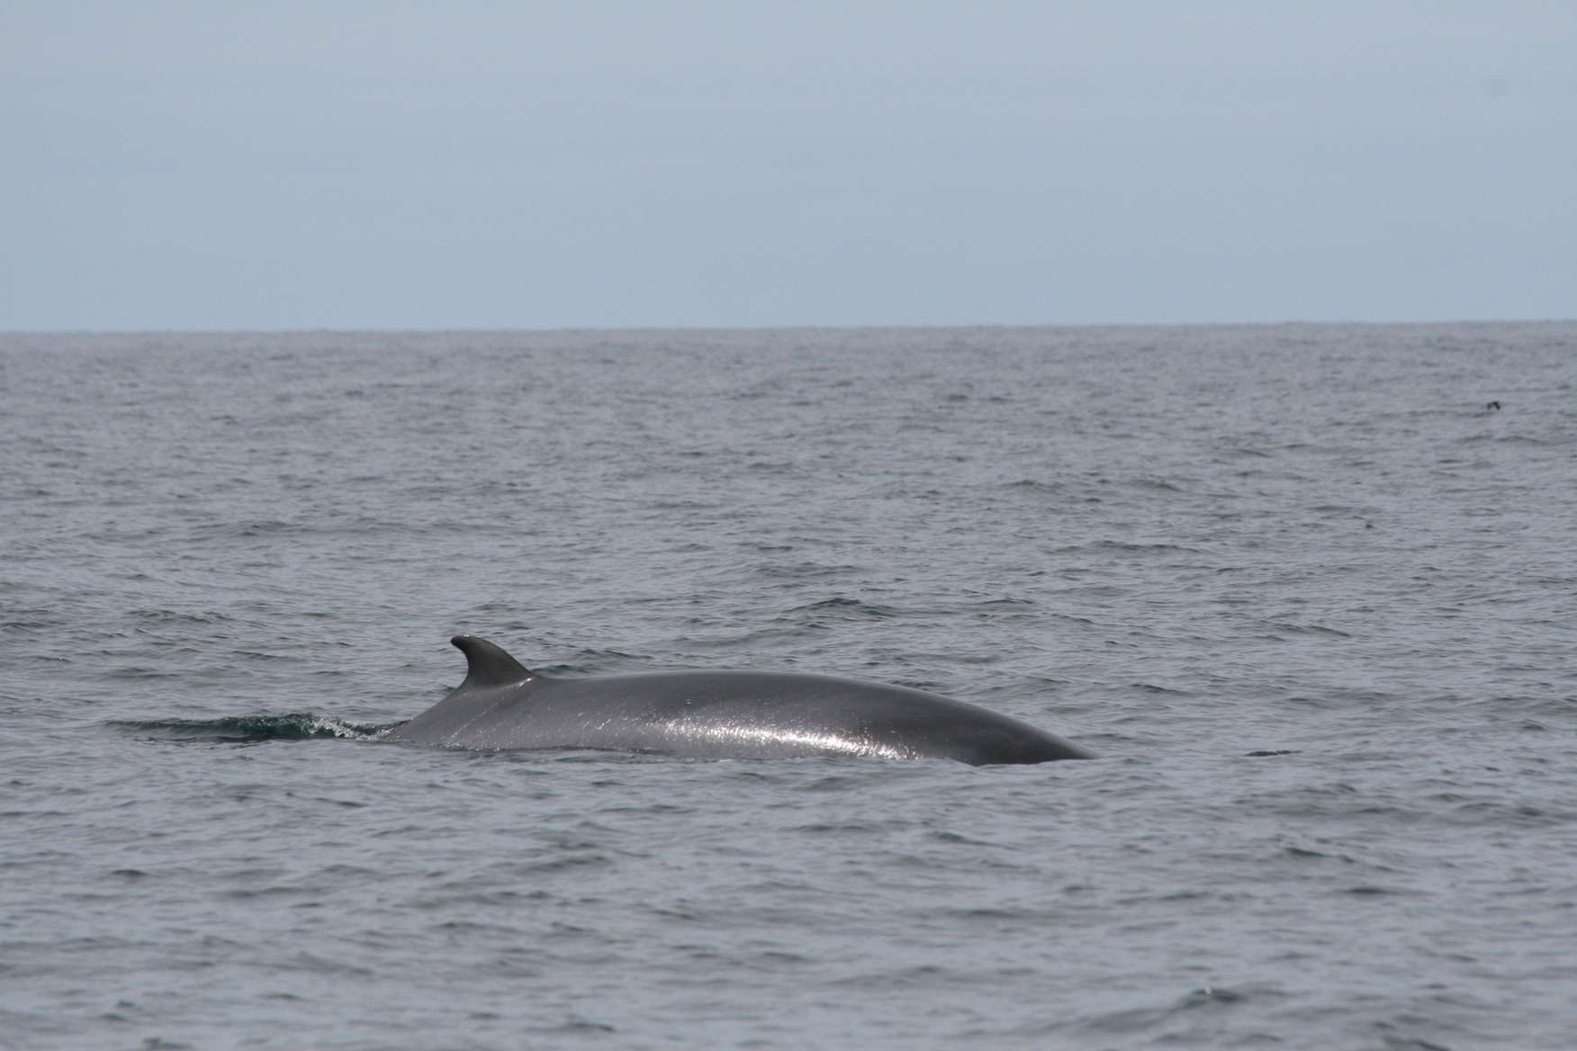
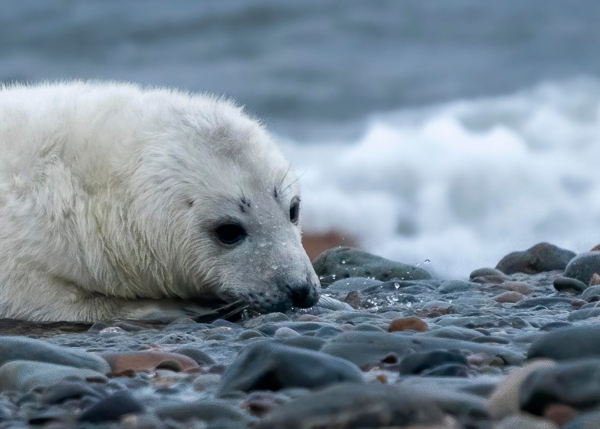
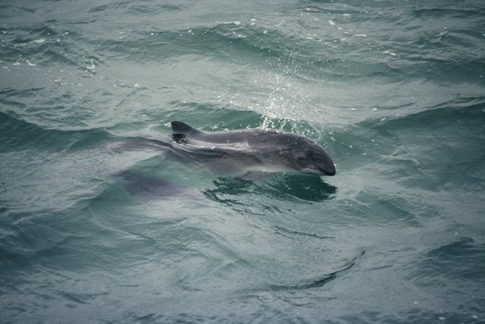
Notes:
In turn, these feed our larger visitors such as Harbour porpoises and bottlenose dolphins and grey seals.

Slide 8
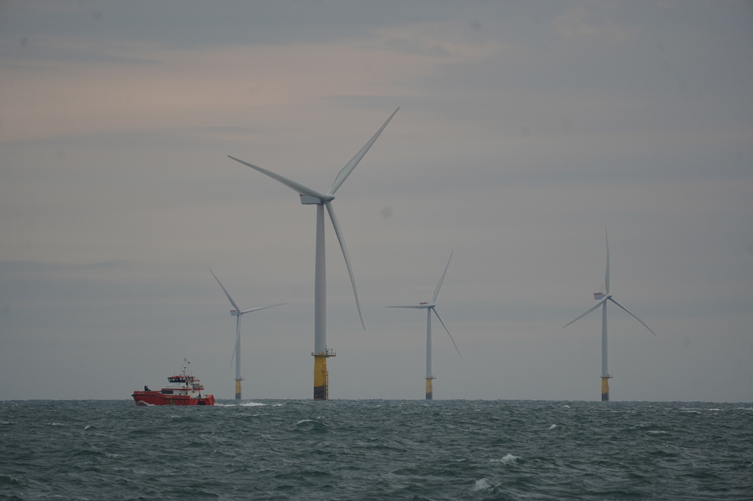
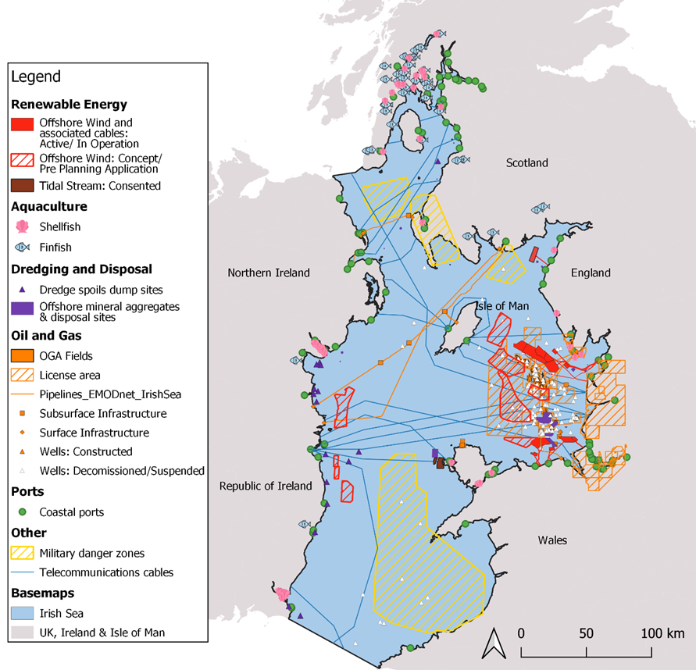
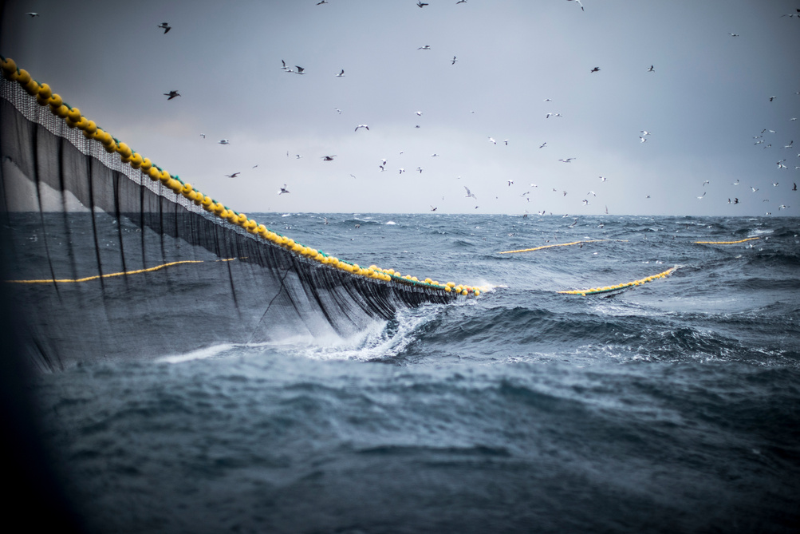
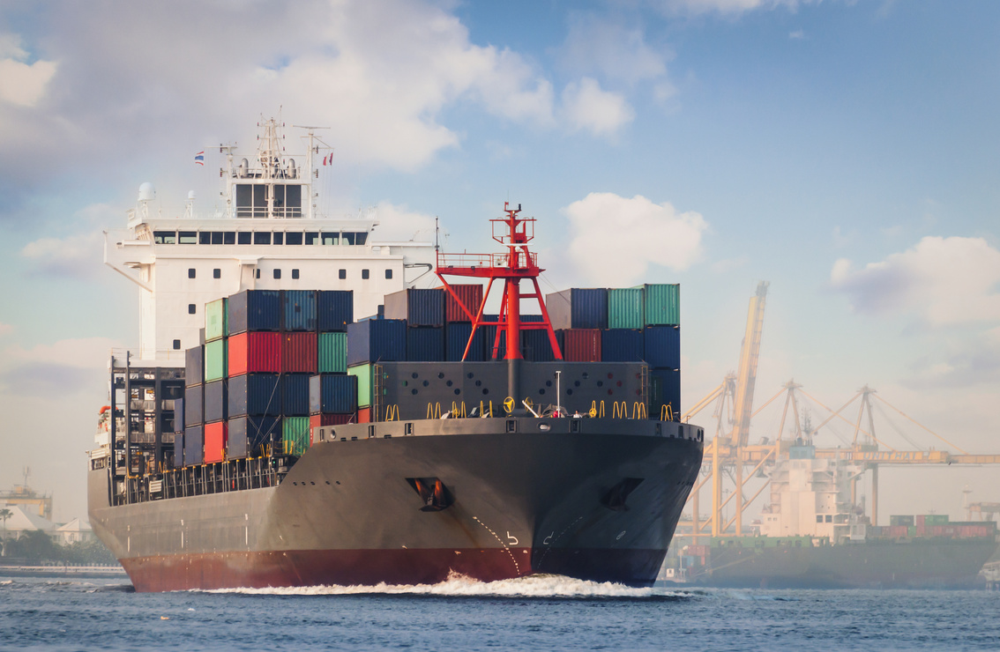
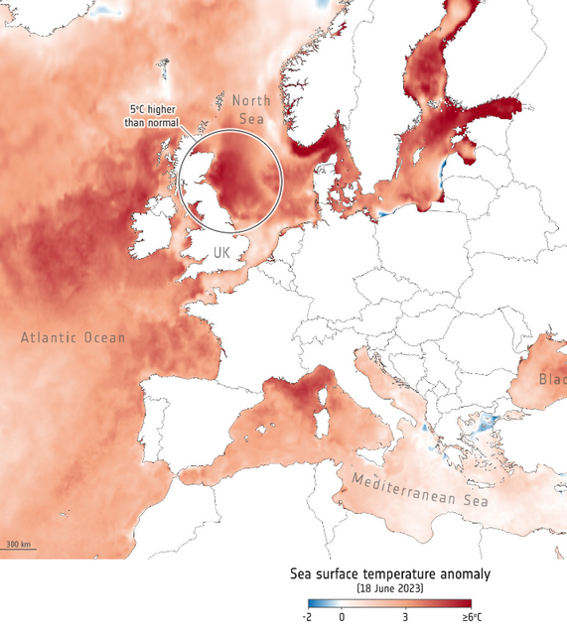
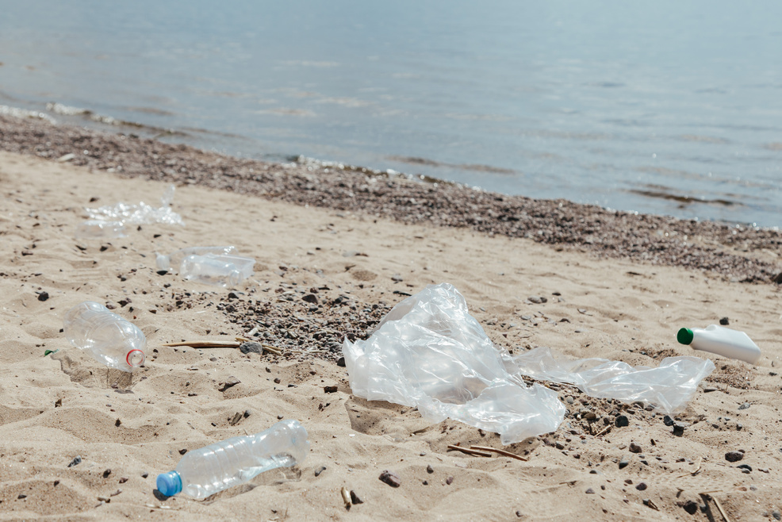
Increasing pressure on the marine environment
Offshore & coastal development
Unsustainable fishing
Shipping
Climate Change
Pollution
Notes:
But they are also under increasing pressure.
From overfishing, increased development, to the intensifying impacts of climate change and pollution—from storm overflows to microplastics—our seas are being asked to bear more than ever before.
The expansion of offshore wind and other infrastructure, while essential to our net zero future, poses new questions about how we balance our energy transition with the biodiversity crisis.

Slide 9



Offshore & coastal development
Increasing pressure on the marine environment
Unsustainable fishing
Shipping
Climate Change
Pollution
Notes:
But they are also under increasing pressure.
From overfishing, increased development, to the intensifying impacts of climate change and pollution—from storm overflows to microplastics—our seas are being asked to bear more than ever before.
The expansion of offshore wind and other infrastructure, while essential to our net zero future, poses new questions about how we balance our energy transition with the biodiversity crisis.

Slide 10
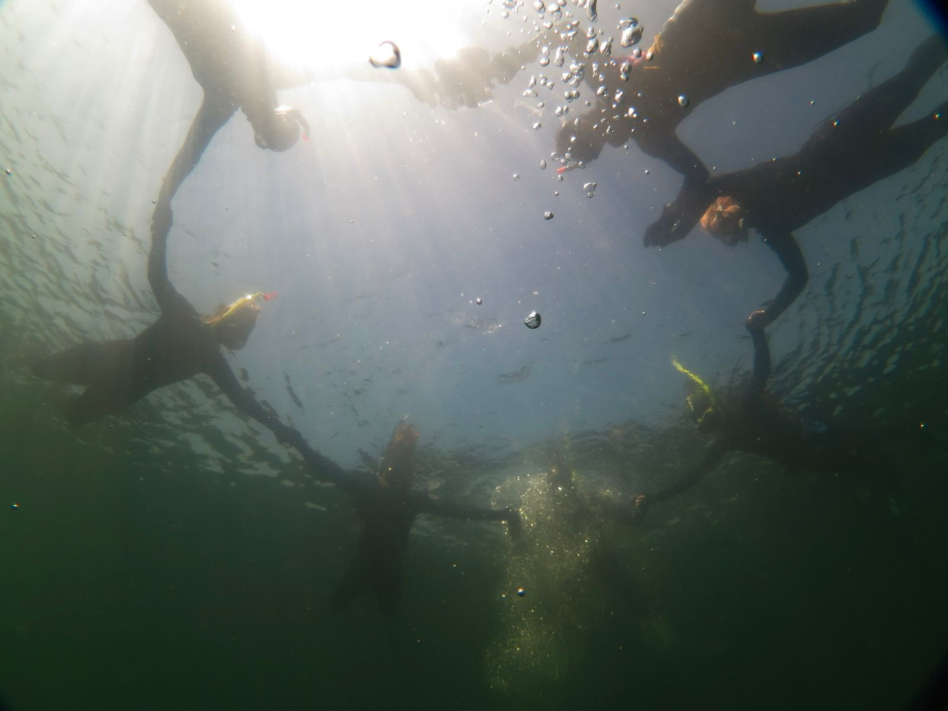
Notes:
Let’s be clear: this is not a battle between conservation and progress.
But it is a call for smarter progress—evidence-led, locally informed, and ecologically sensitive.
And it’s a call for collaboration.
With the people in the room. With citizen scientists, practitioners, academics, policy makers and industry. But also beyond….

Slide 11
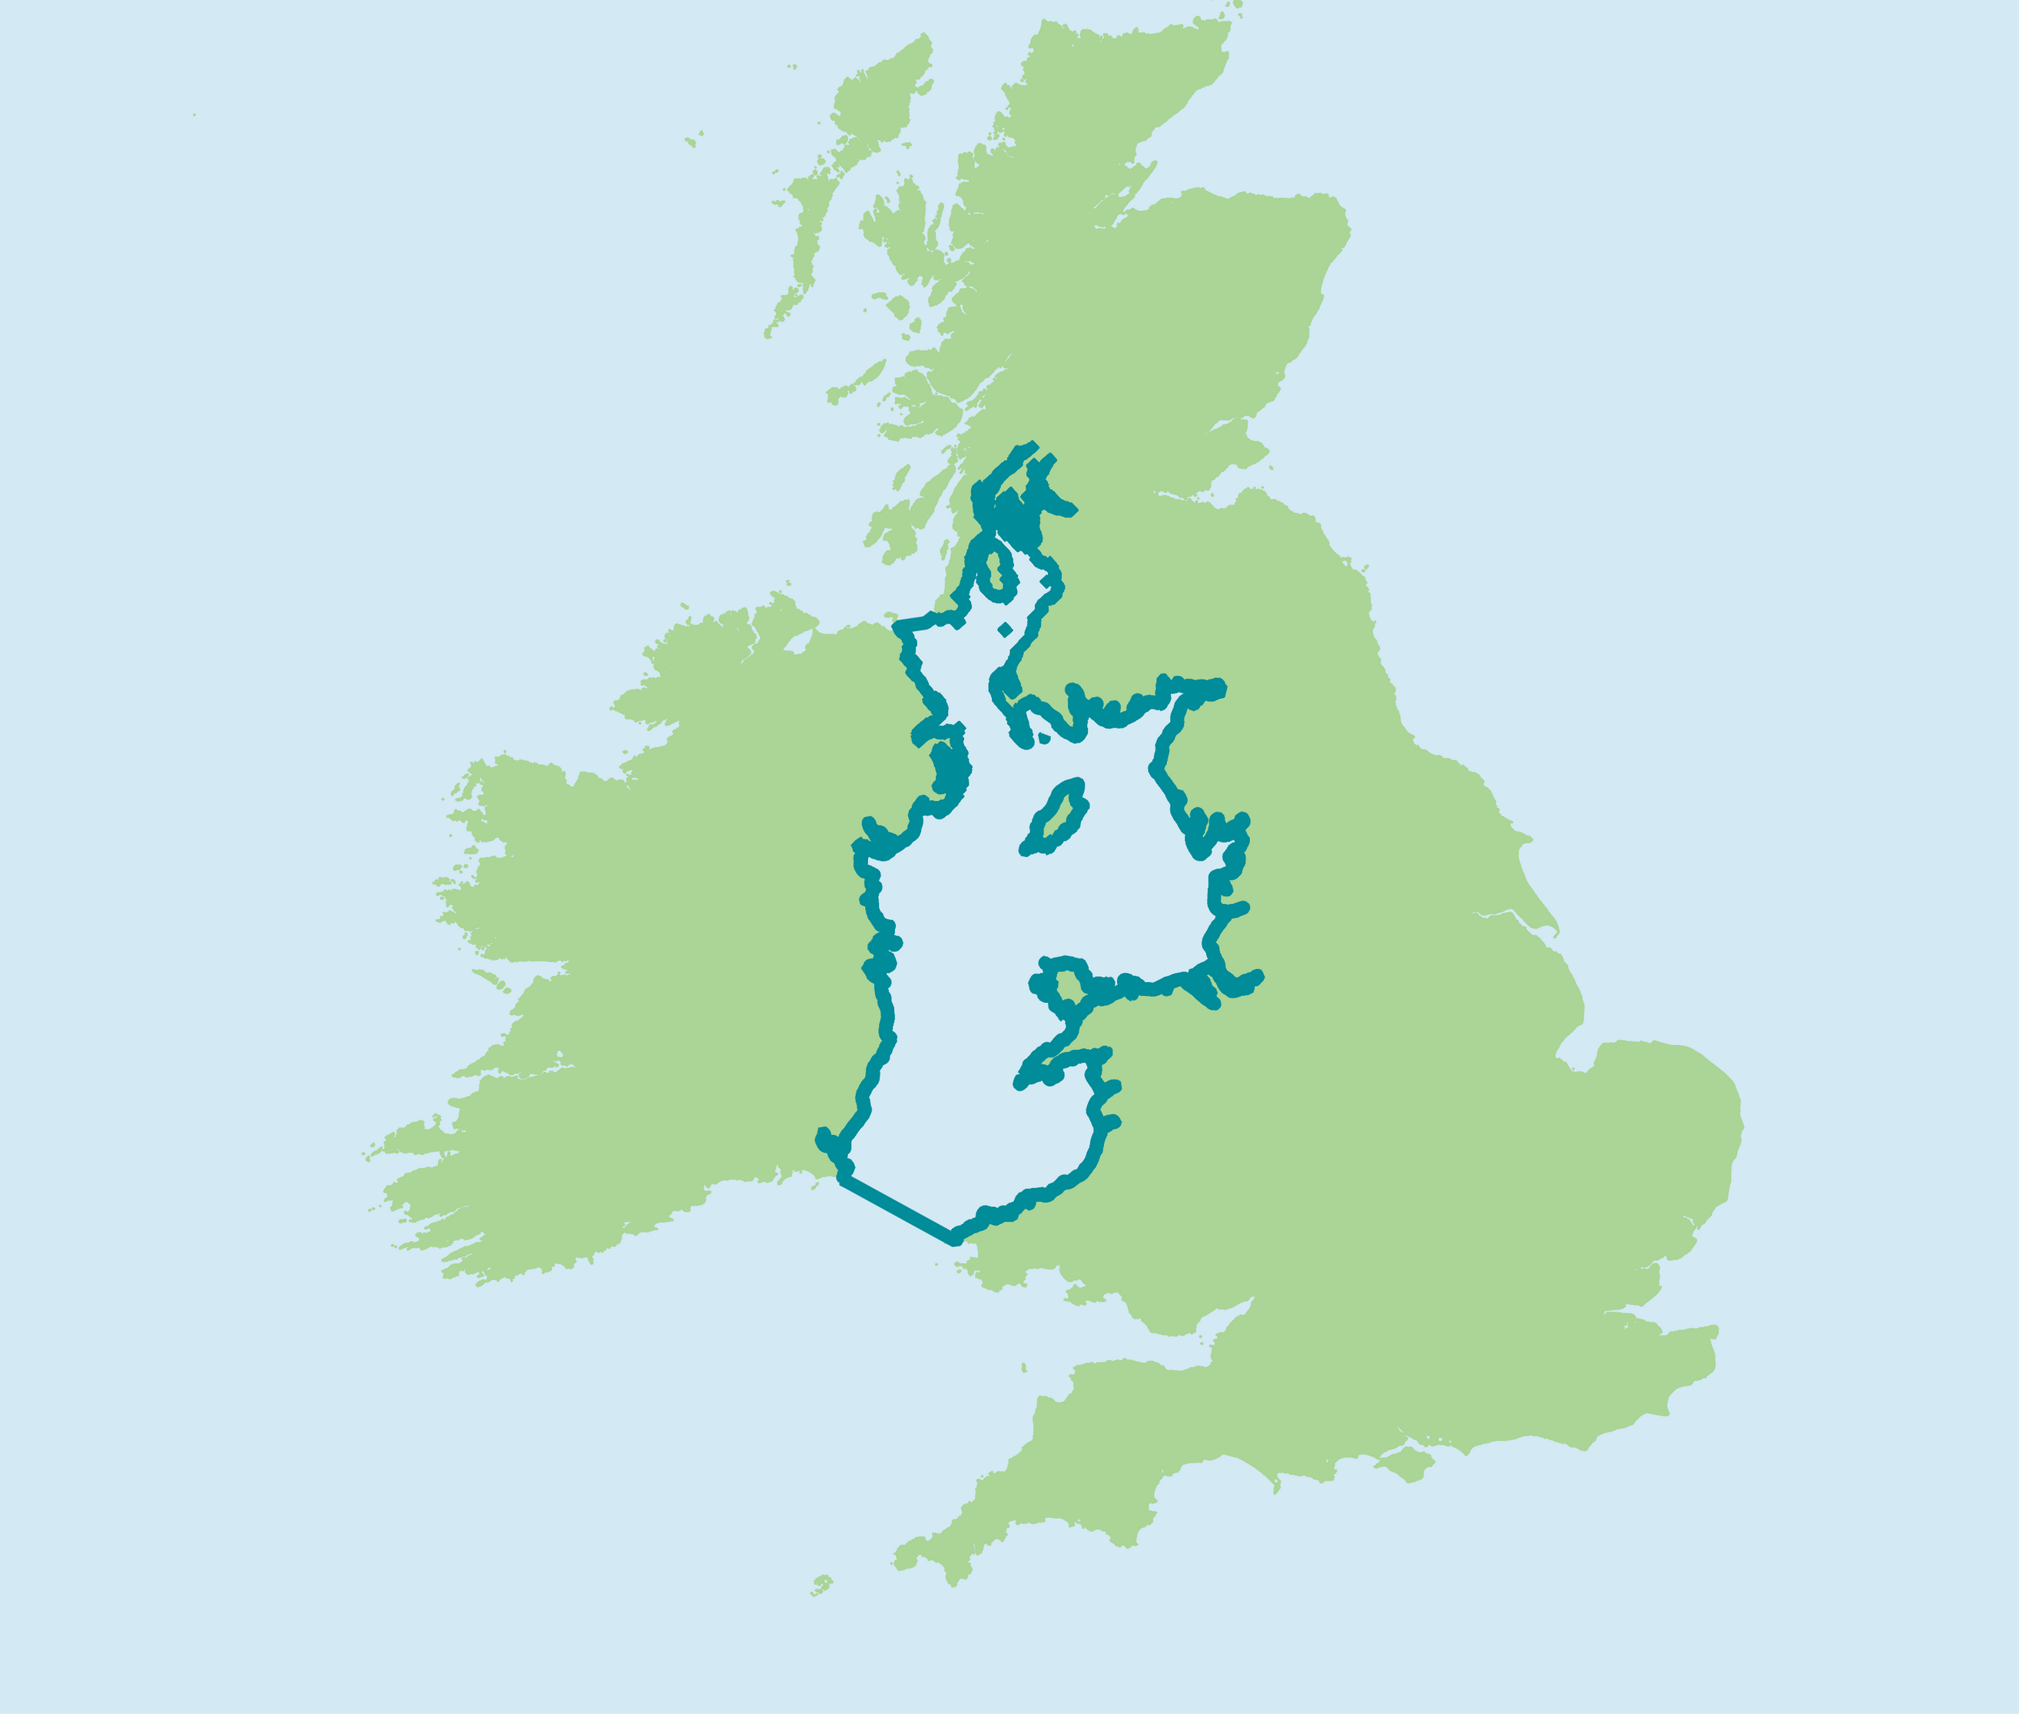
Notes:
Although this is the North West Marine Ecosystems, the Irish Sea doesn’t recognise county lines or national borders..
What happens in one part of our sea echoes across its entirety.
That’s why working across boundaries—between England, Wales, Scotland, Northern Ireland, and the Republic of Ireland—is essential.

Slide 12
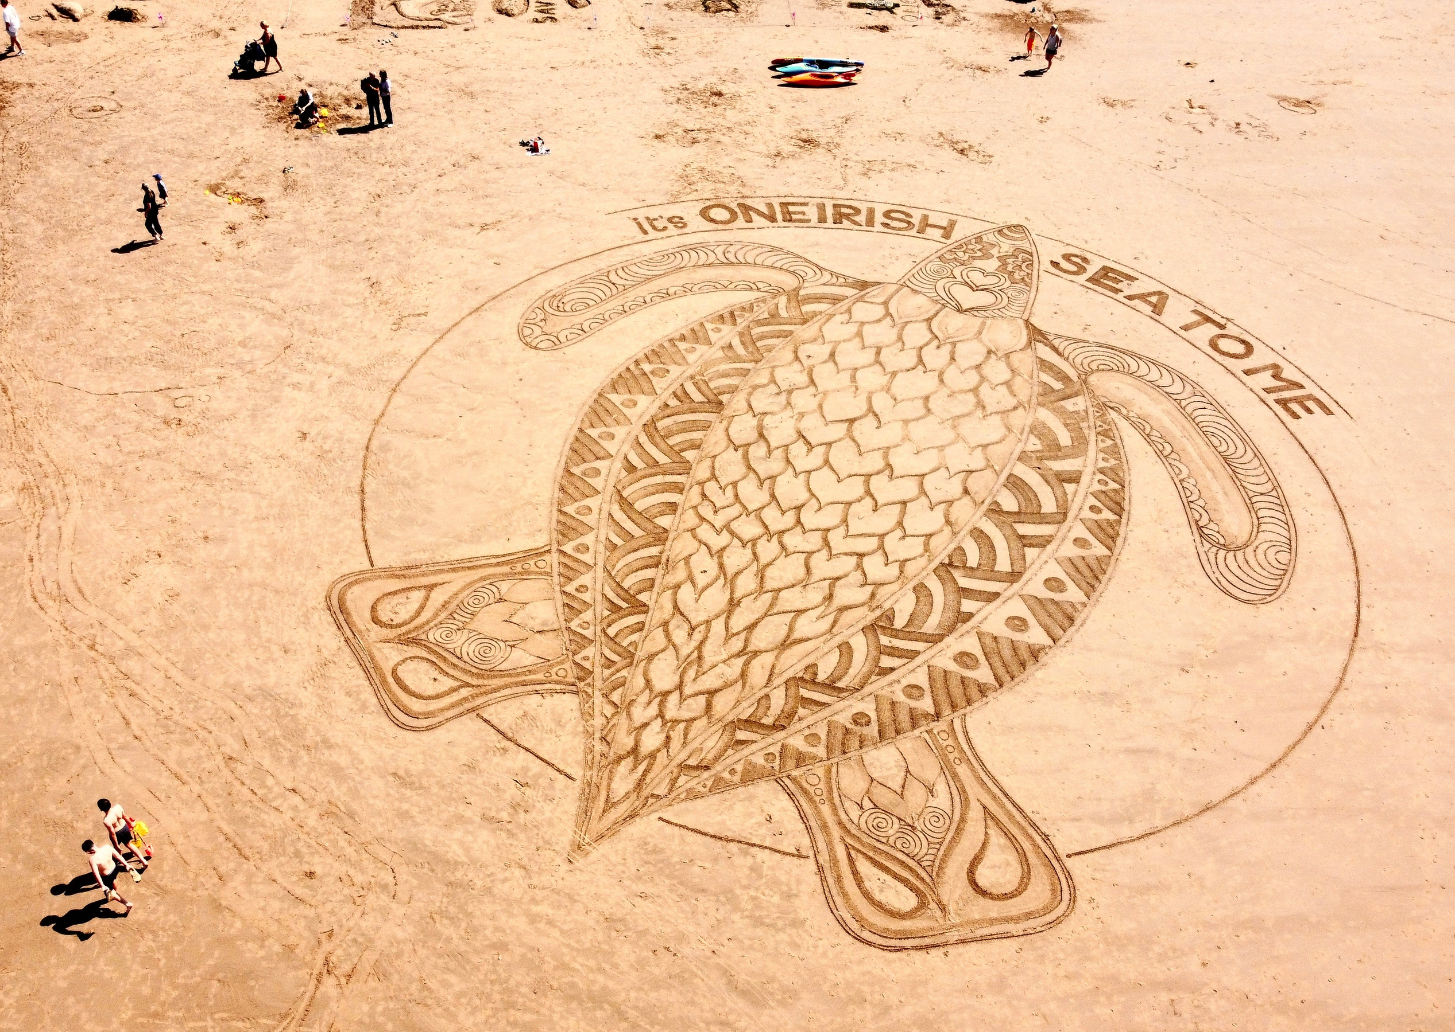
Notes:
We need a coordinated approach and joined up thinking in order to have the biggest impact.
The good news is: that there Is a huge amount of positive action already happening

Slide 13
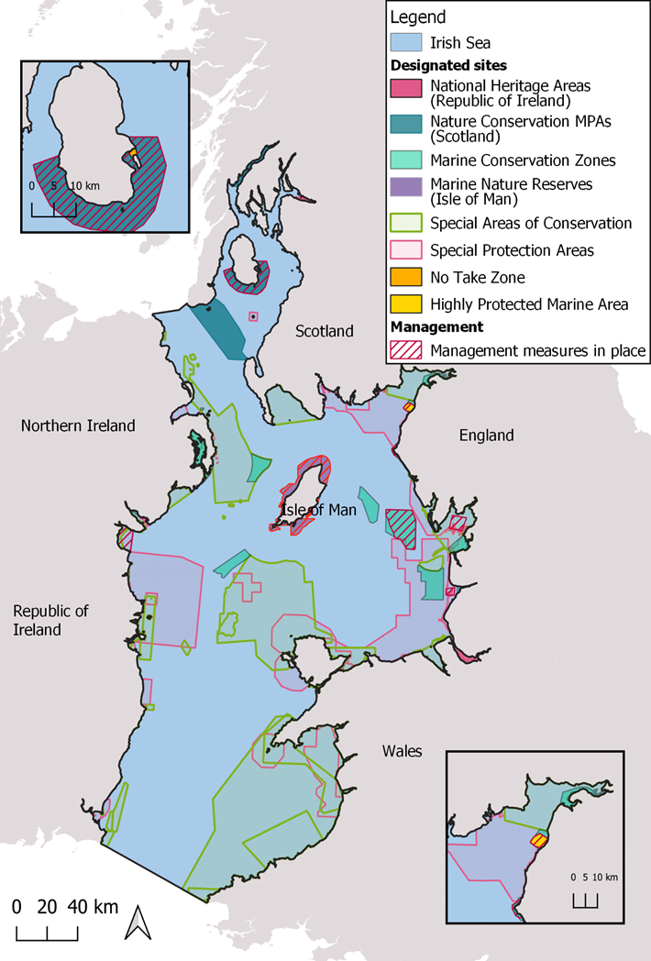
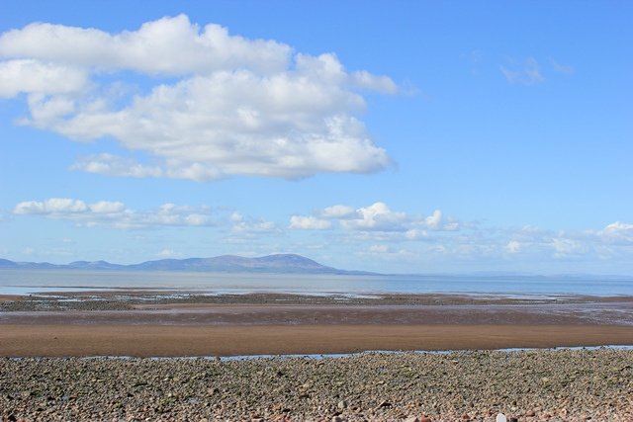

Allonby Bay
Notes:
The designation of Allonby Bay as England’s first inshore Highly Protected Marine Area was a milestone—recognising the value of giving nature space to fully recover – albeit there is still much work to do – it is a step in the right direction!
especially in the context of 30x30
It is a step in the right direction

Slide 14
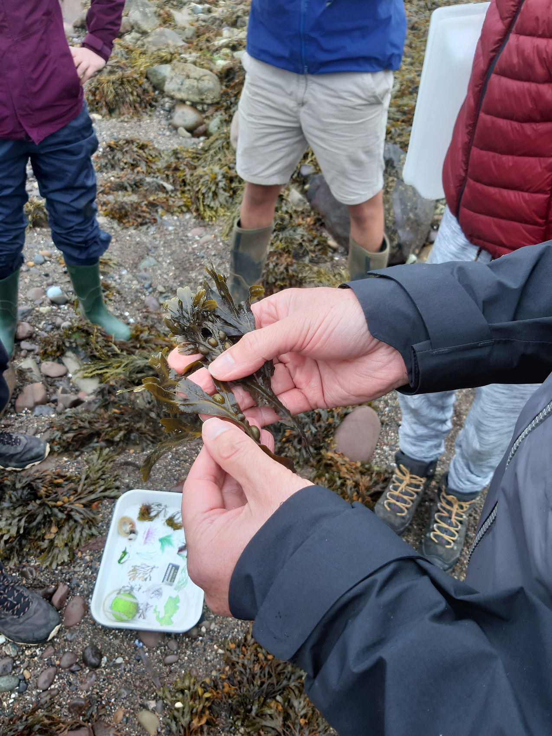
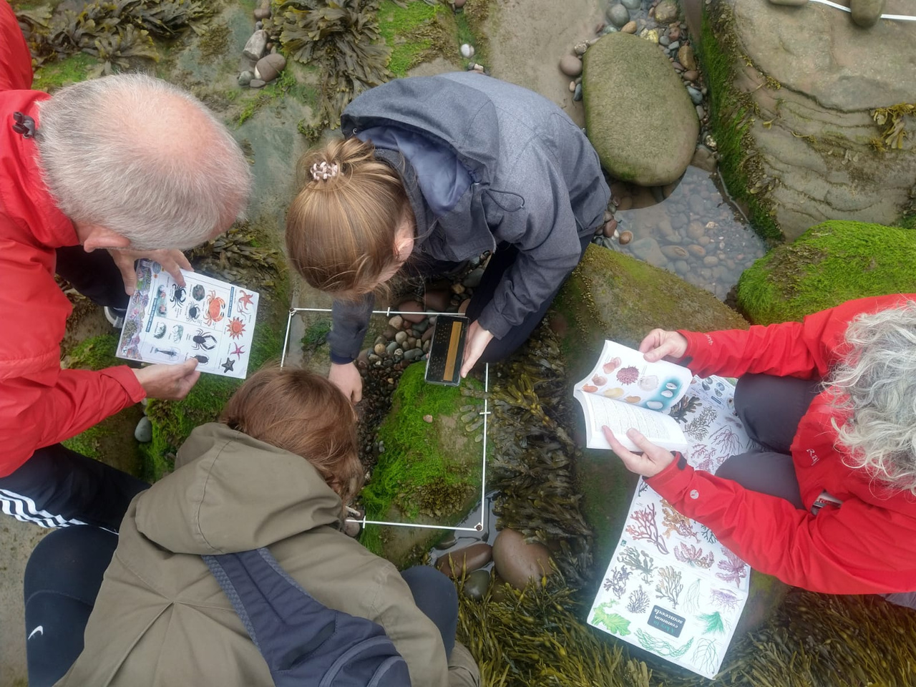

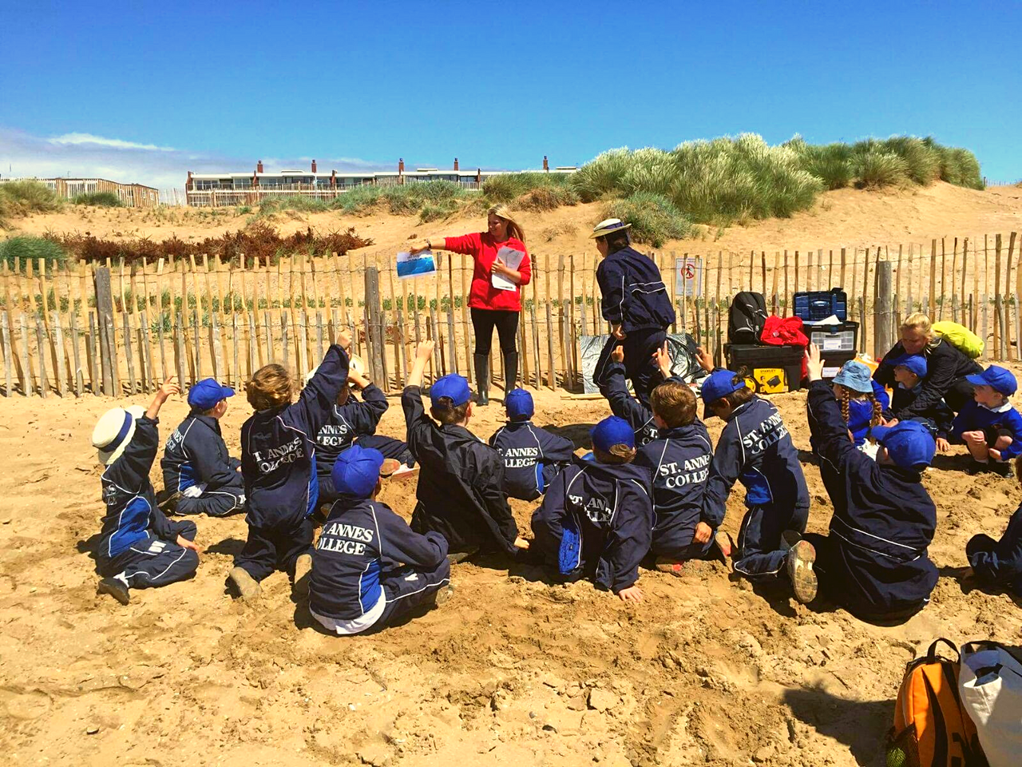
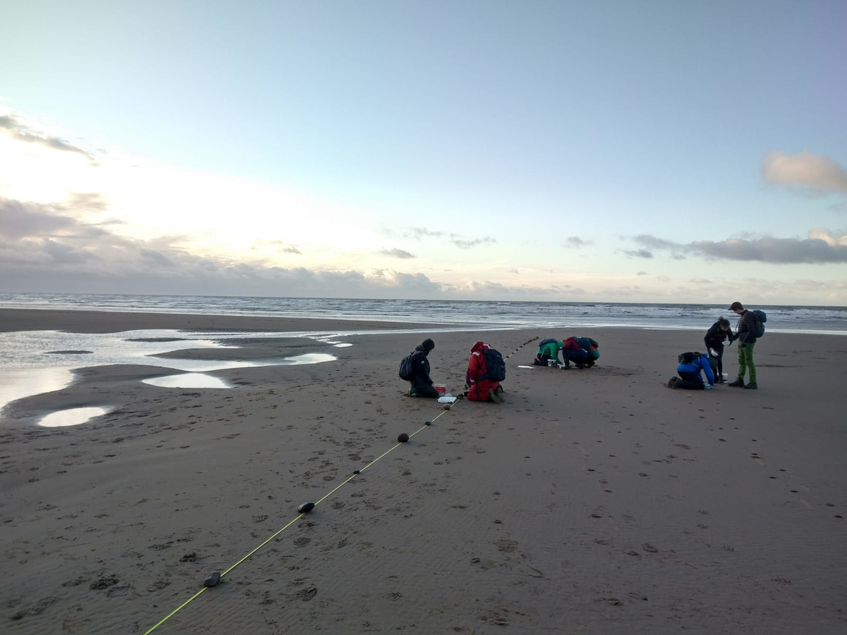
Notes:
Through a variety of citizen science programmes and engagement, we’re connecting communities with the hidden wonders of their coastlines.

Slide 15
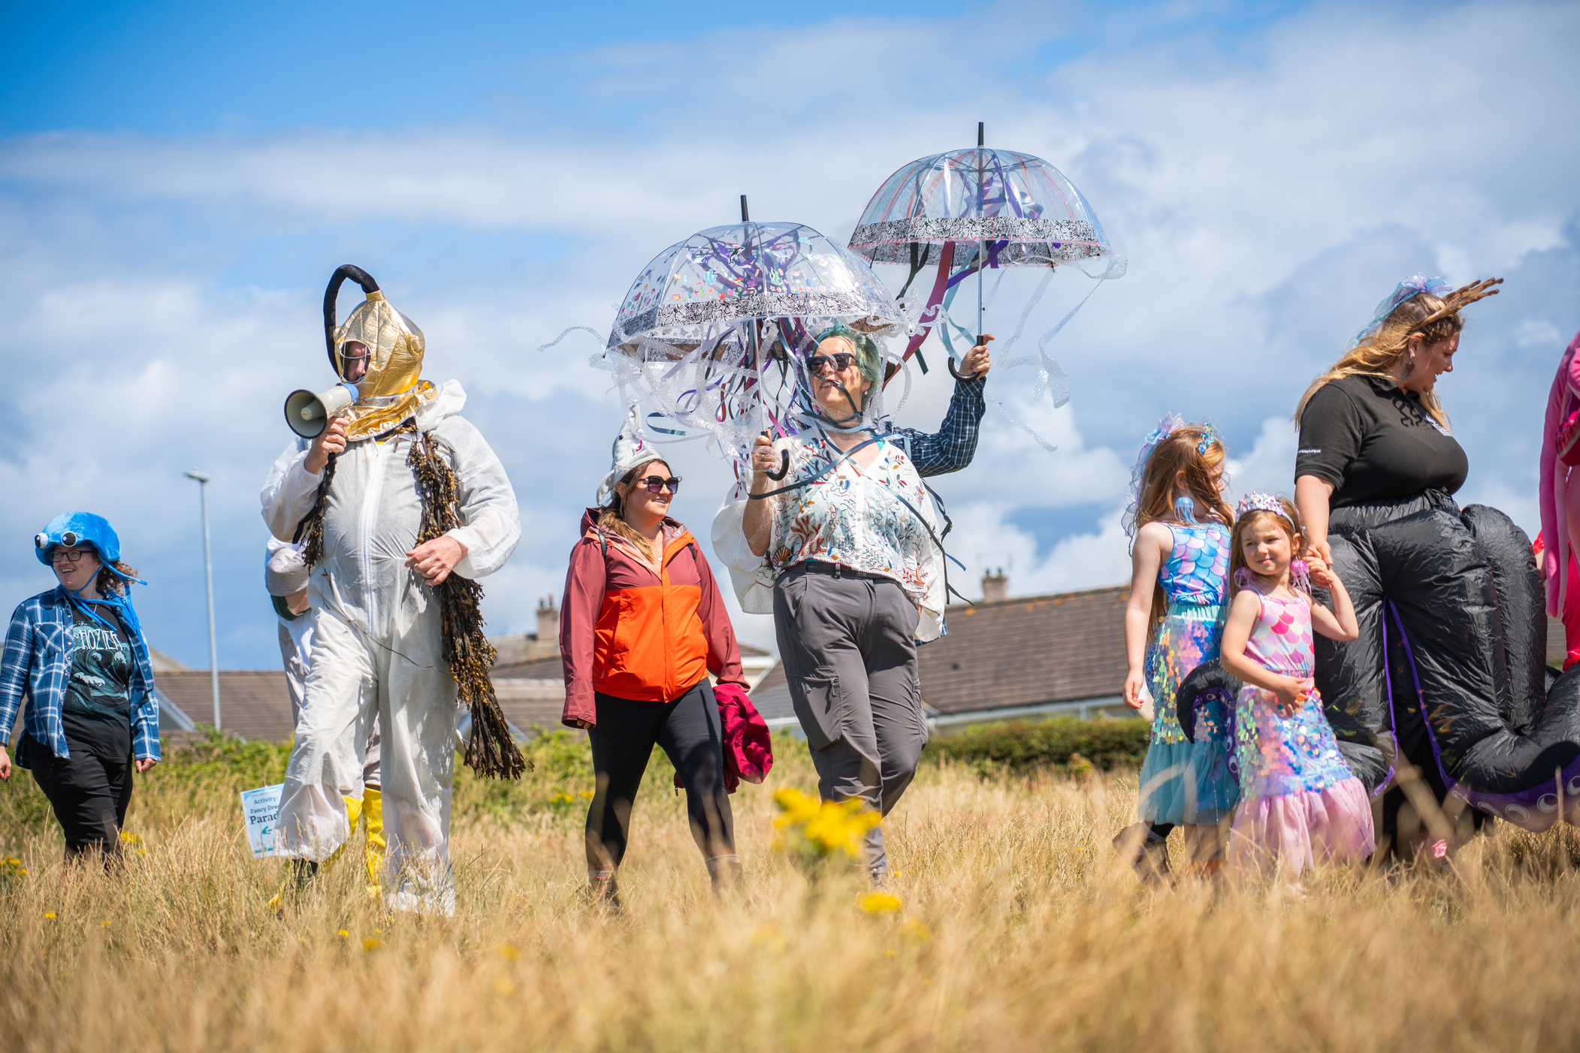
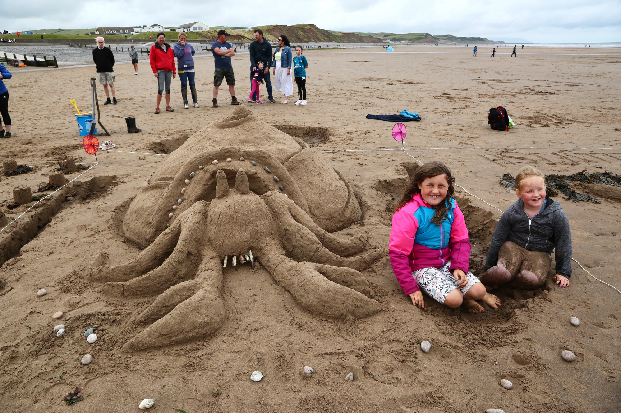
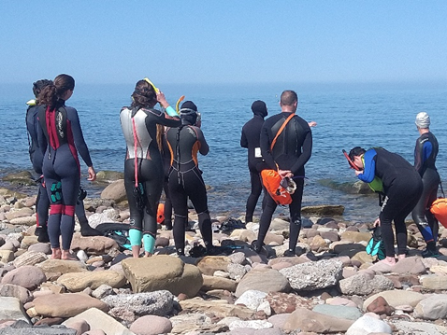
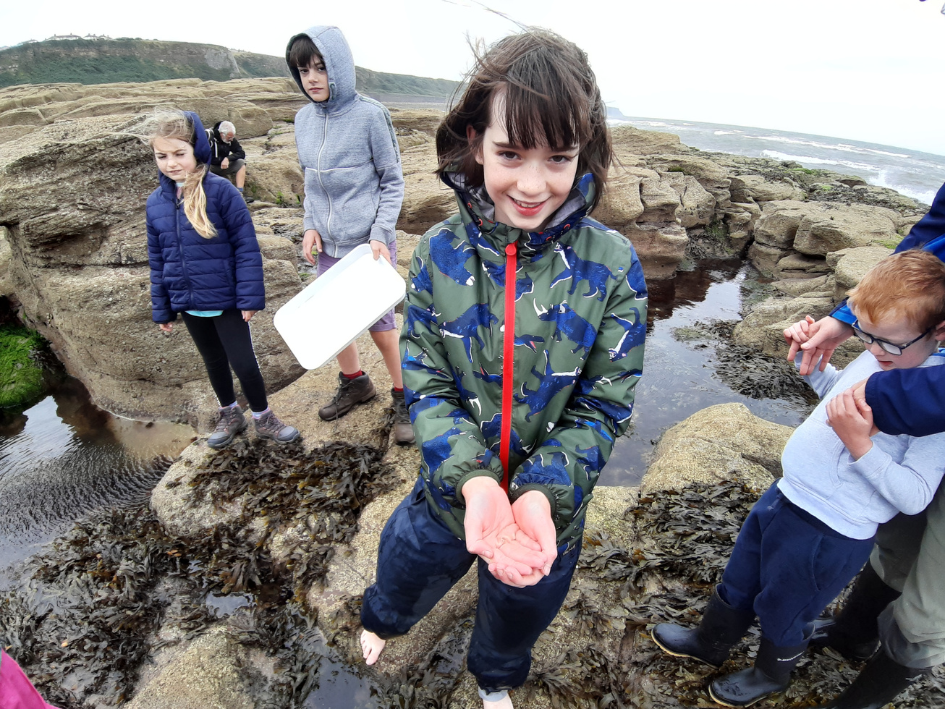

Slide 16
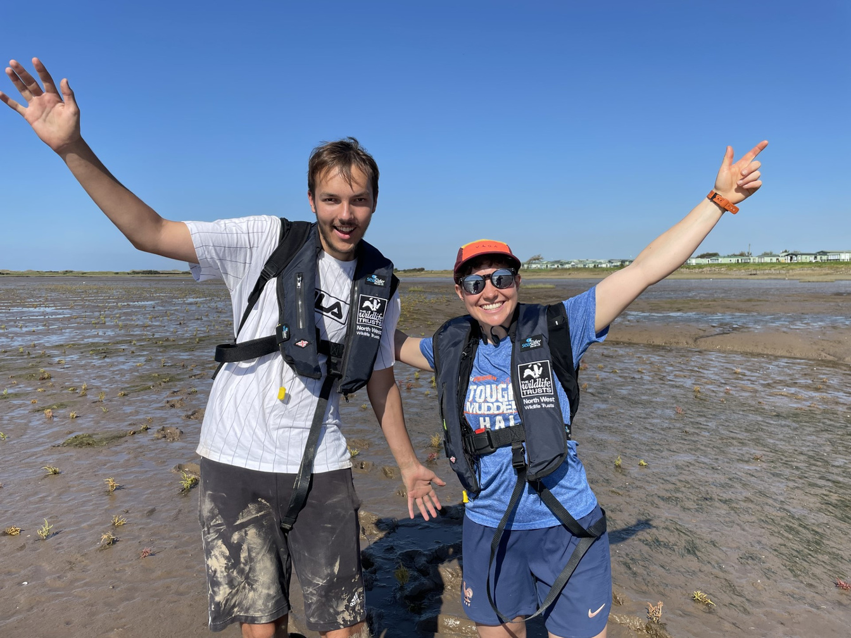
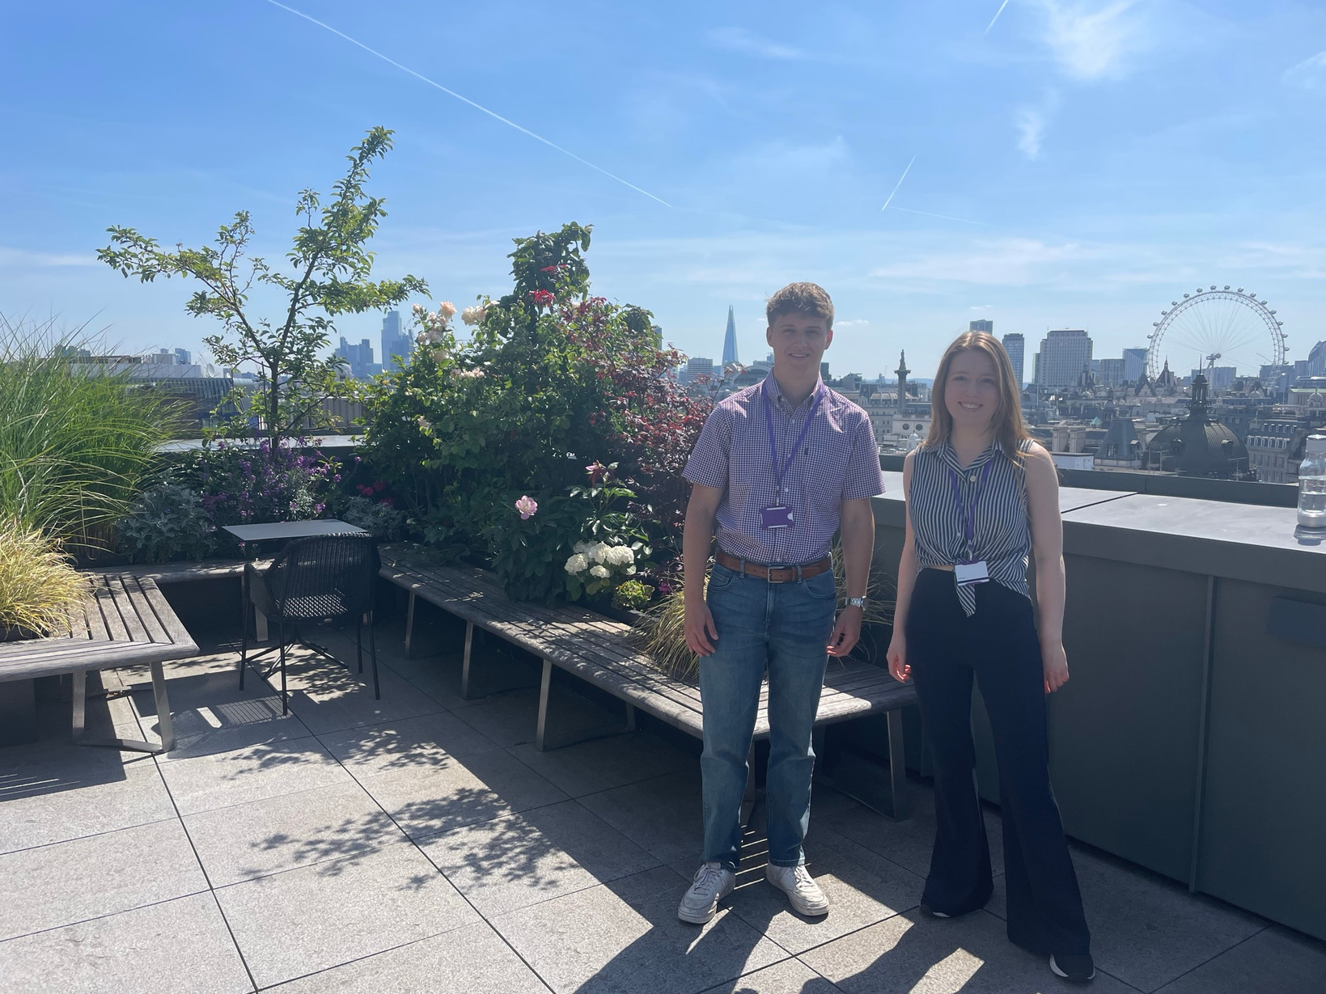





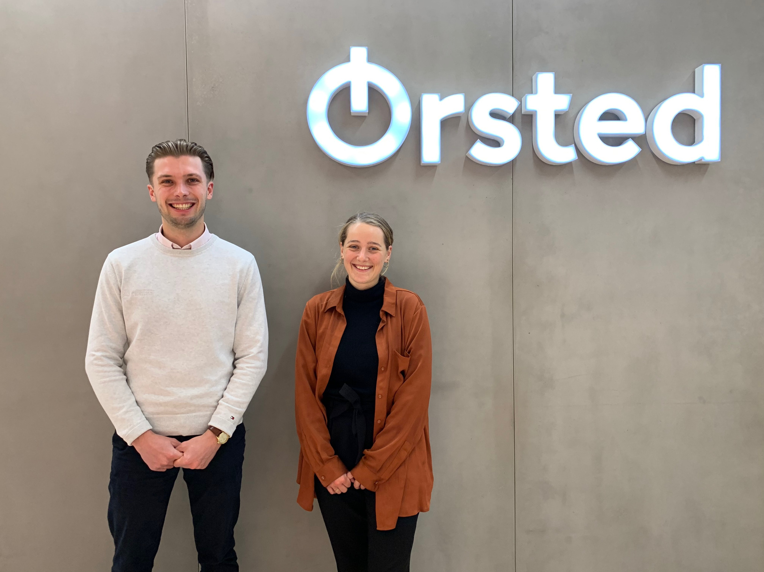
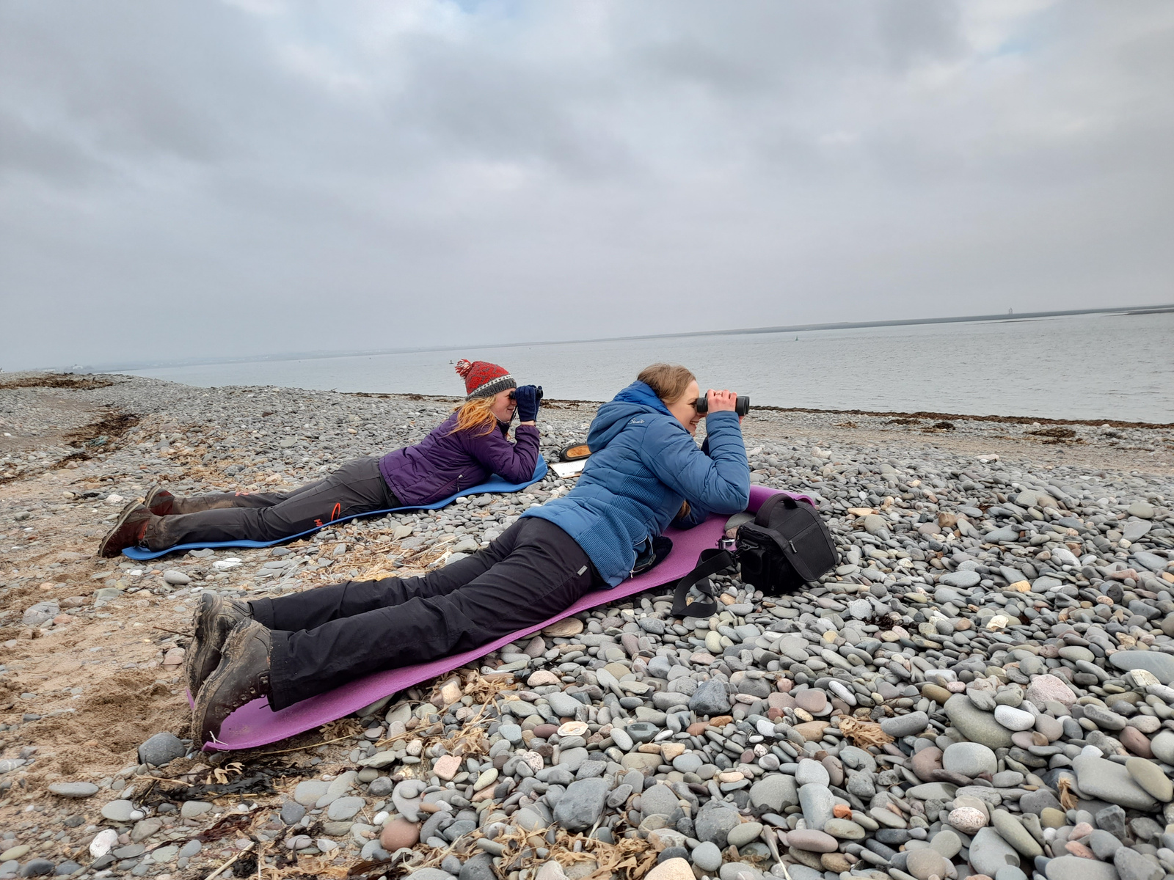
Marine Futures Internships
Notes:
We have a huge number of talented individuals entering the marine sector as evidenced by the Marine Futures Internship – but not only the successful candidates ( which you may recognize a couple of faces) – but every year we get around 80 applicants to the north west programme alone and so many of those are brilliant applications - we need to ensure the sector is accessible to young people and provide clear career opportunities for young professionals

Slide 17
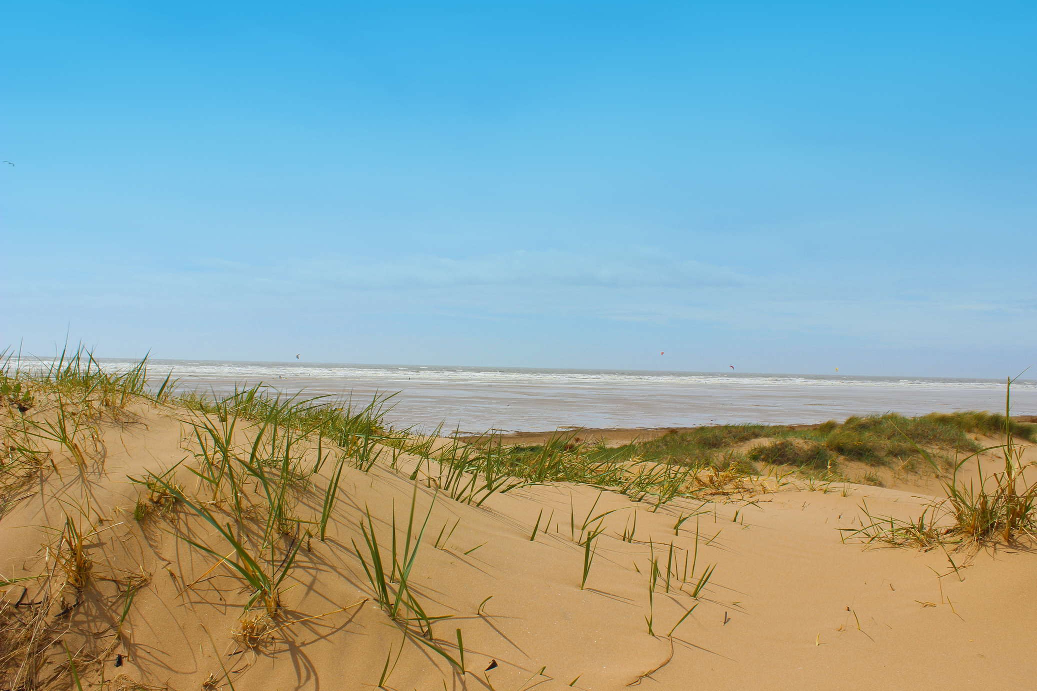


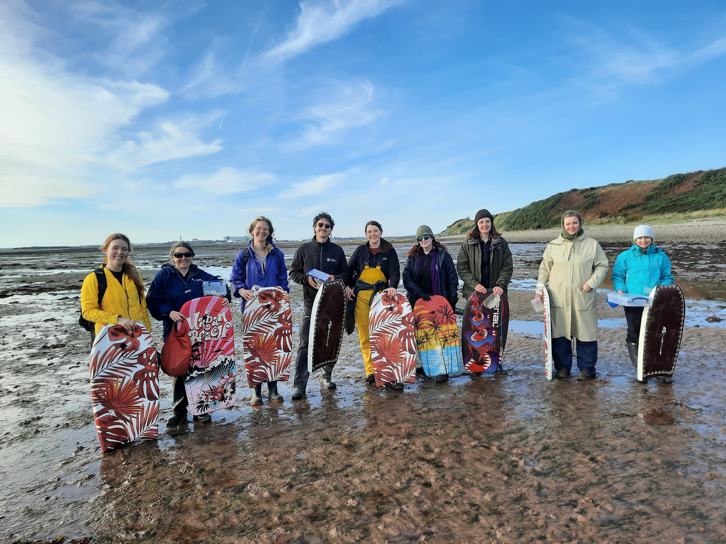
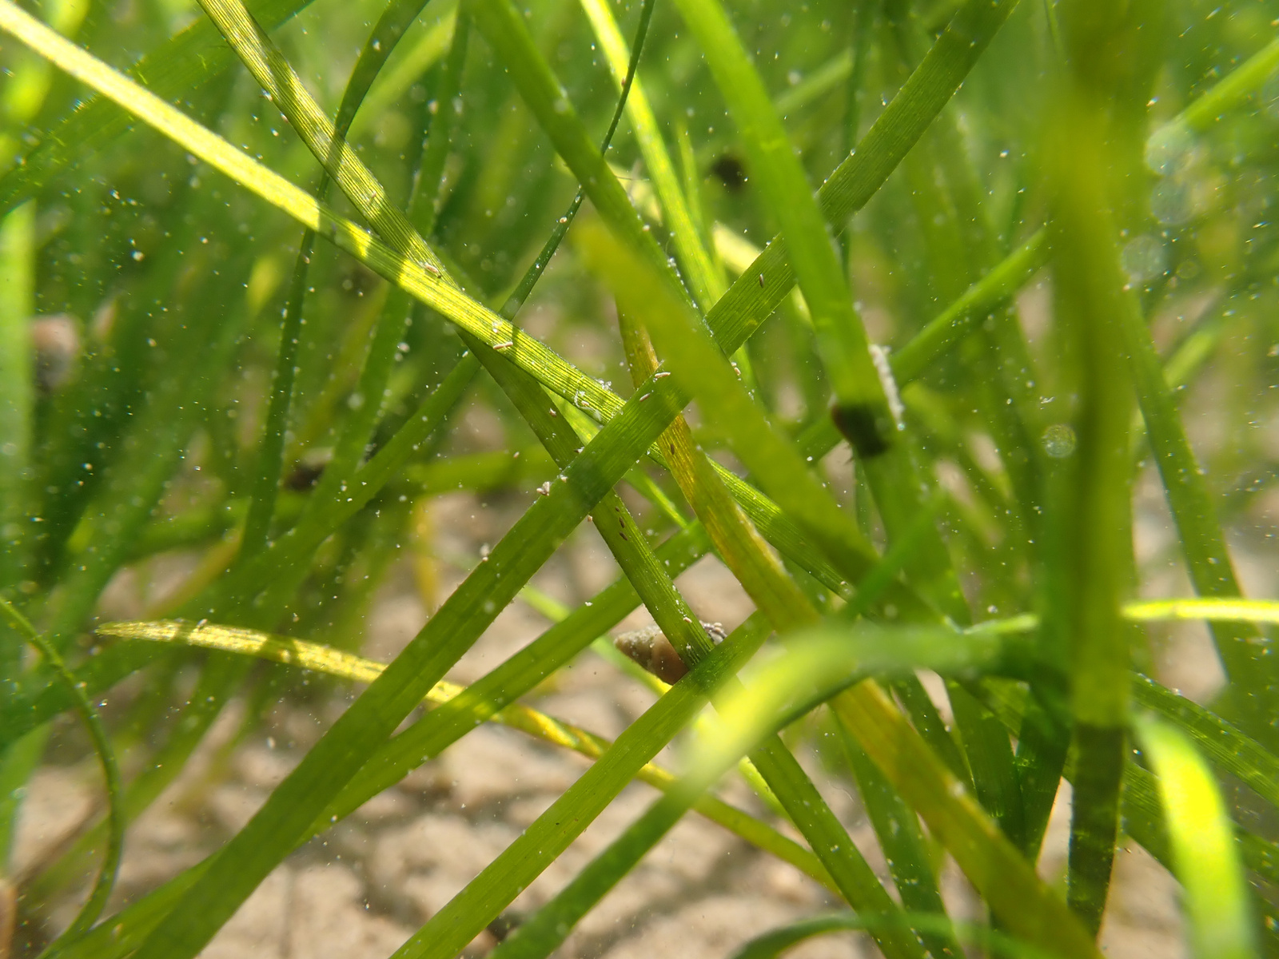
Restoration efforts and increased understanding
Volunteers helping with seed collection
Notes:
Active restoration efforts – and building up a greater understanding of our coastline. Only last month did we discover a previously unmapped seagrass bed in the North West!

Slide 18
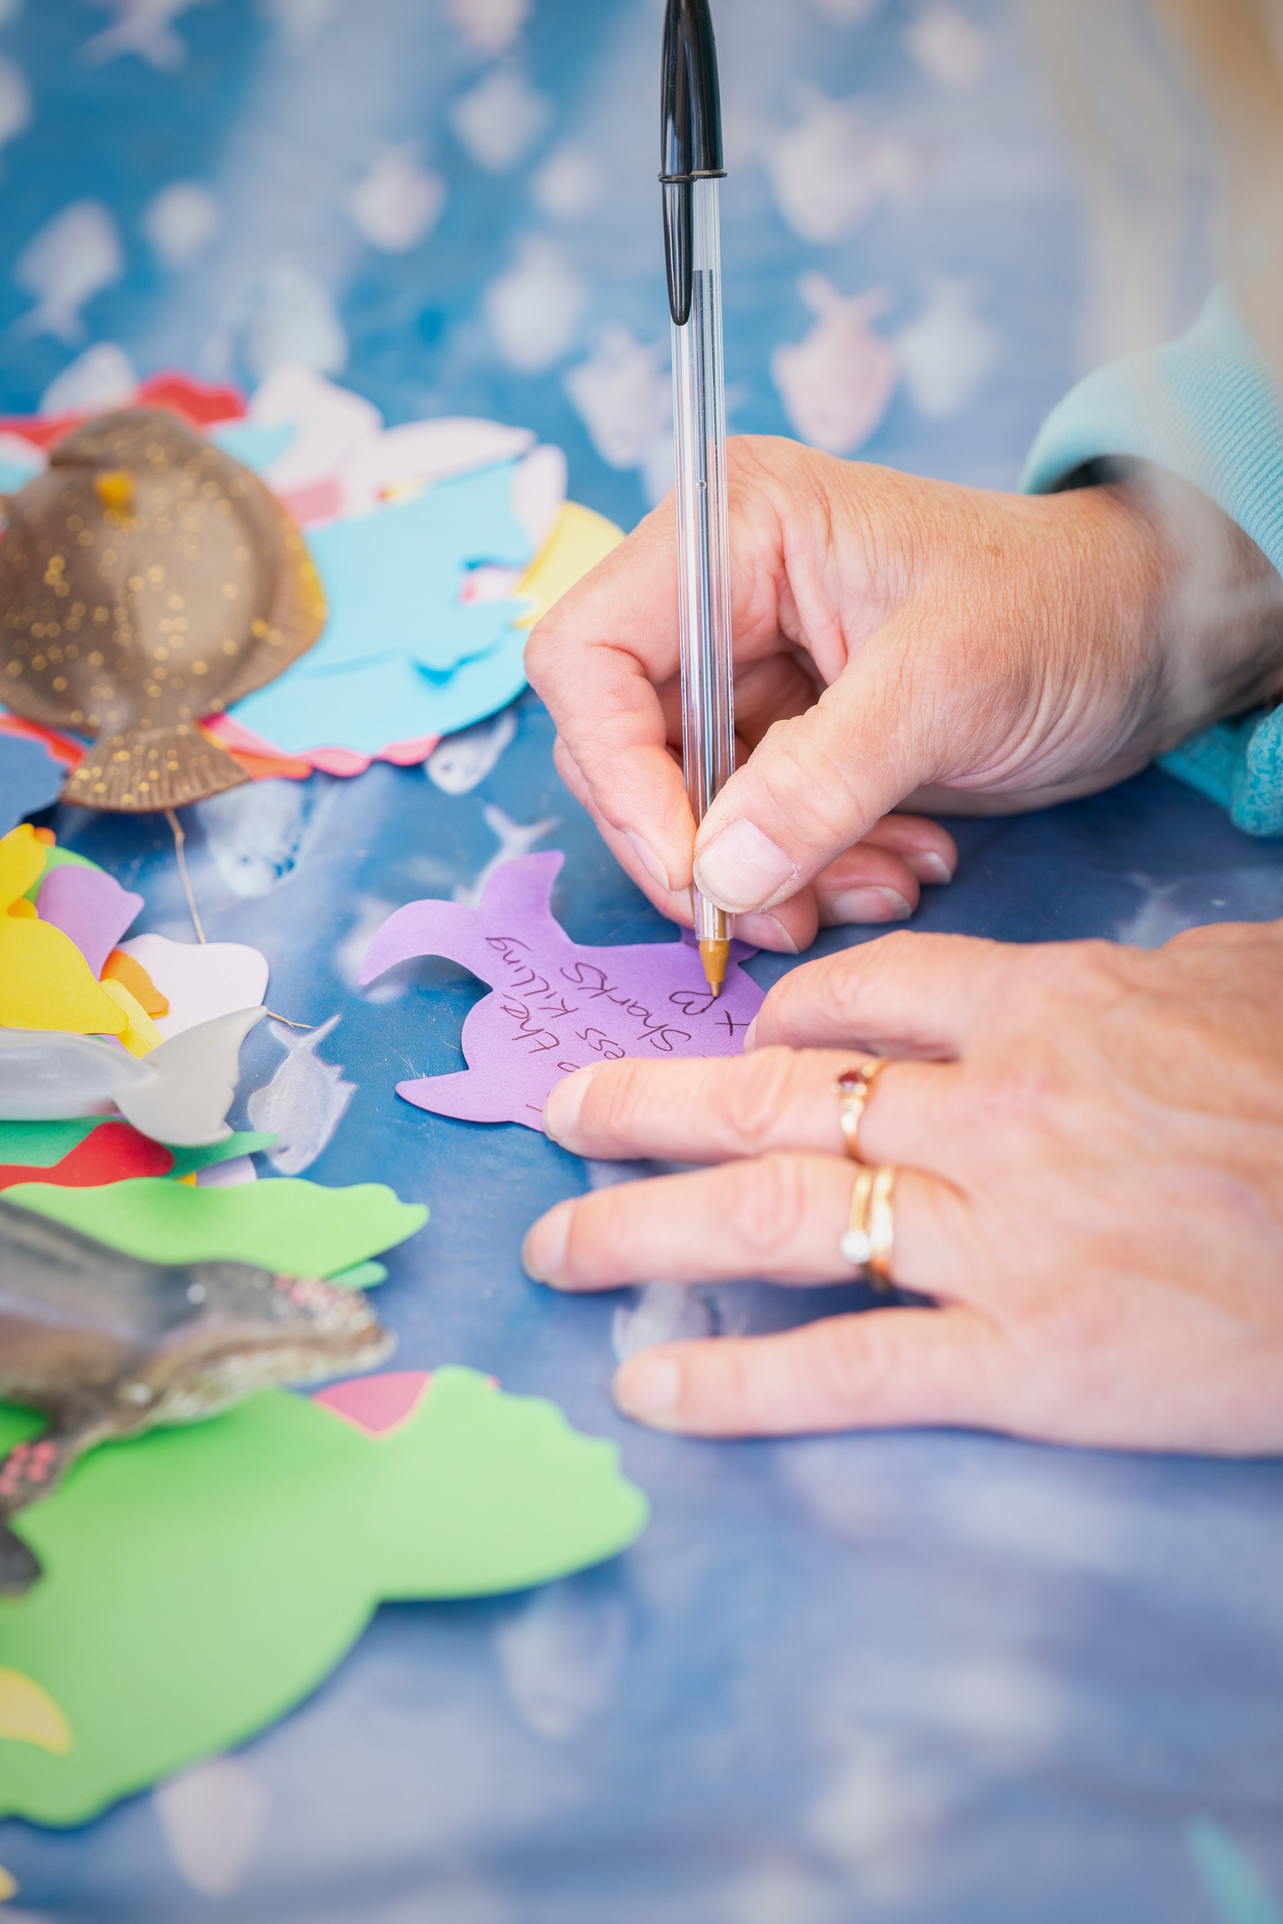
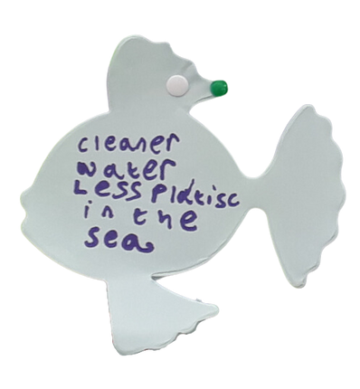

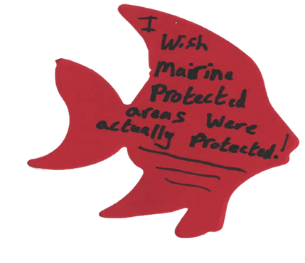




On Irish Sea Day 2024
71
415
wishes to stop plastic and litter entering the sea
people from around the Irish Sea added their hopes for the Irish Sea to the school of wish fish
97
wishes for better protection including MPAs, sustainable fishing and restoration
100
wishes for a cleaner Irish Sea and less pollution
79
wishes for more wildlife and healthier ecosystems
Notes:
And perhaps most encouraging of all, the tide of public opinion is turning. More people are aware, engaged, and demanding better stewardship of our seas than ever before.

Slide 19

Notes:
So, let this be a moment not just to share knowledge—but to strengthen commitment - not as isolated efforts, but as a collective movement.

Slide 20
Refreshment Break

