Slide 1


Plankton
Barry Kaye
CookandKaye, October 2025
Notes:
I have subtitled my presentation because …

Slide 2
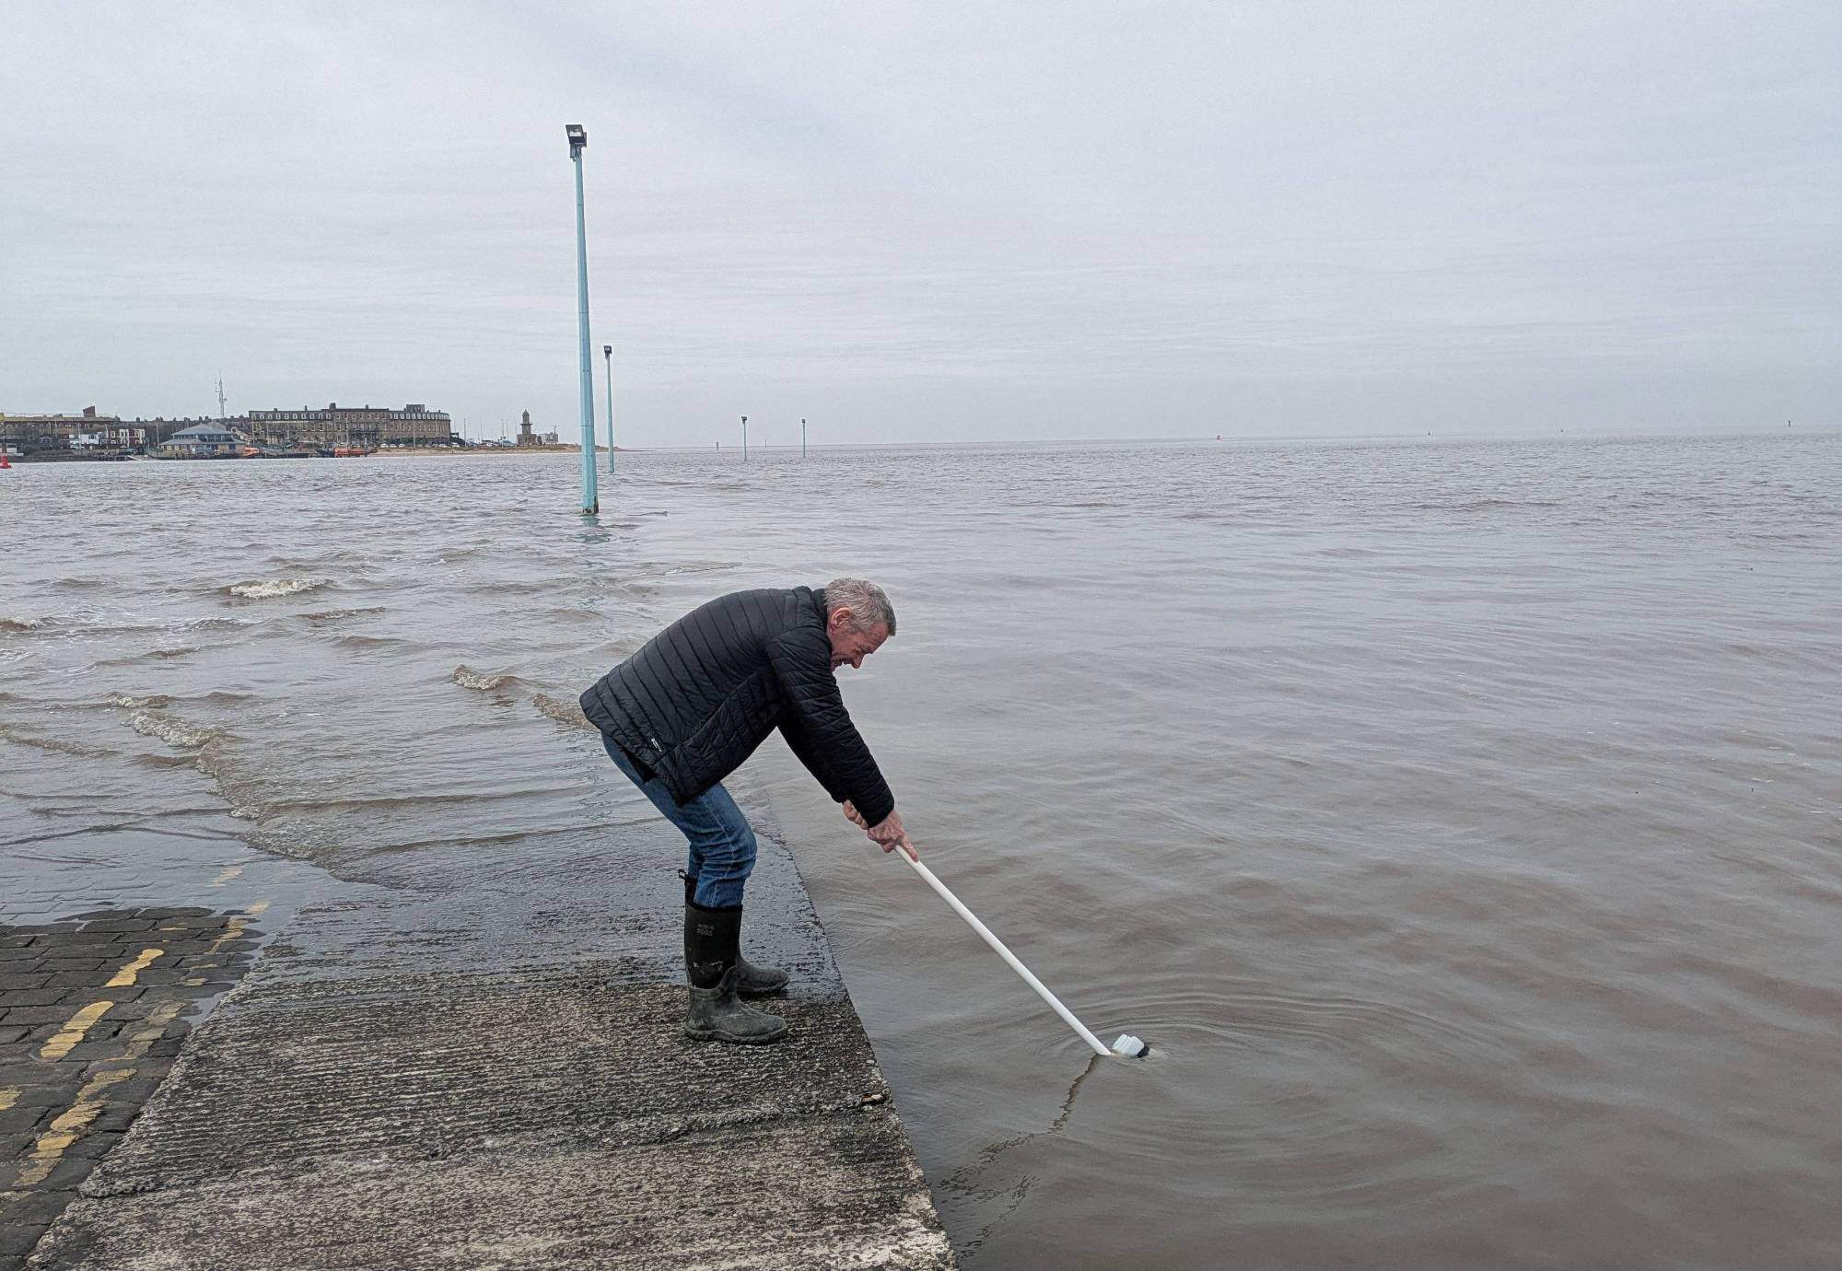
… (of the Wyre Estuary): Sampling plankton on Spring high waters at Knott End jetty since January 2022.
Notes:
… almost all of our samples were taken from Knott End jetty, with collections using trawl nets and simple sample bottles (shown) every fortnight on Spring high waters, as the water depth at the jetty is too low to run nets on neap tides.

Slide 3
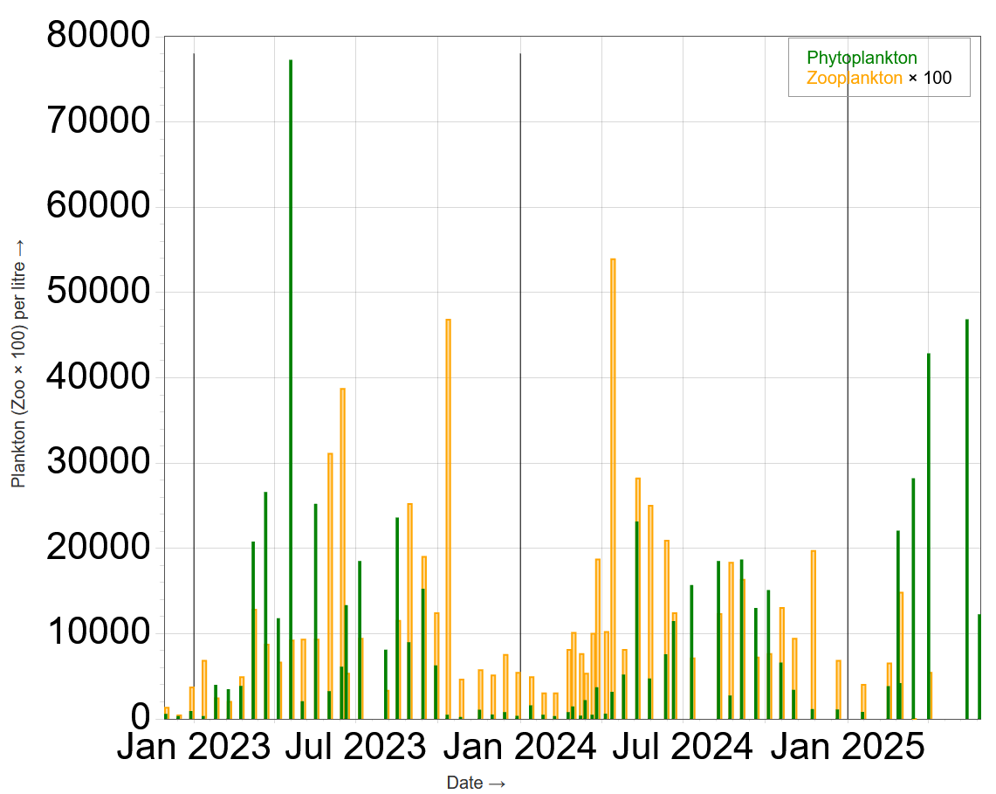
Notes:
Since late 2022 I have been trying to collect quantitative data on the amounts of plankton present, summarised here as a simple bar chart of phyto- and zoo- plankton numbers up to the present date.
We see a LOT of variation between years:
2023 we see a large Spring bloom of phytoplankton followed by a smaller bloom in late Summer. The Spring bloom accounts for about 50% of the total primary productivity.
2024 there is no Spring bloom. Summer phytoplankton numbers are similar to 2023, but the bloom extends a little later in the year.
2025 Spring bloom again.
This talk will focus on one possible explanation for the variability in the Spring bloom.

Slide 4
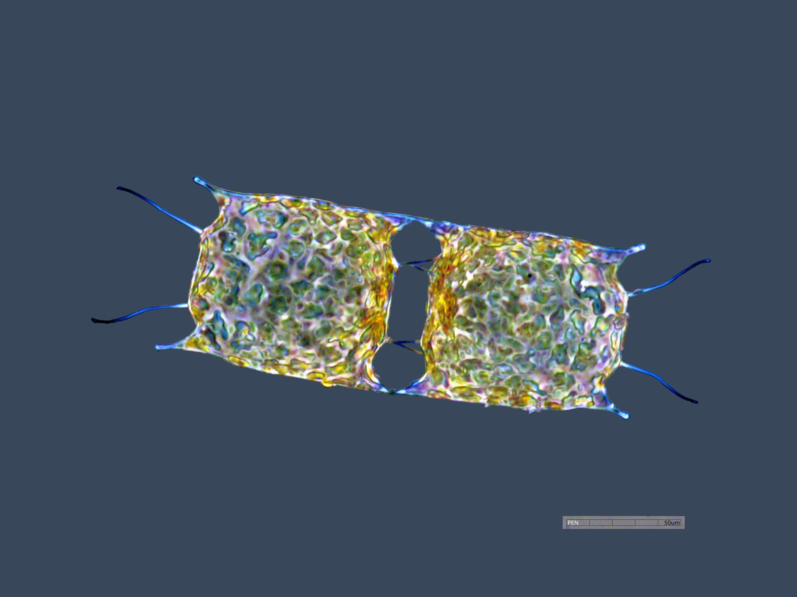
Odontella regia
Biddulphia regia or Trieres regia
Notes:
The Spring bloom is composed of three phytoplankton species – which behave similarly, so to simplify our graphs and explanations I will focus just on one – Odontella regia.
This species has been the first to form a significant bloom in the Wyre Estuary during our study period. It is not the first to bloom (Actinocyclus senarius), nor does it form the largest bloom (Asterionella glacialis) in the period to early April.

Slide 5
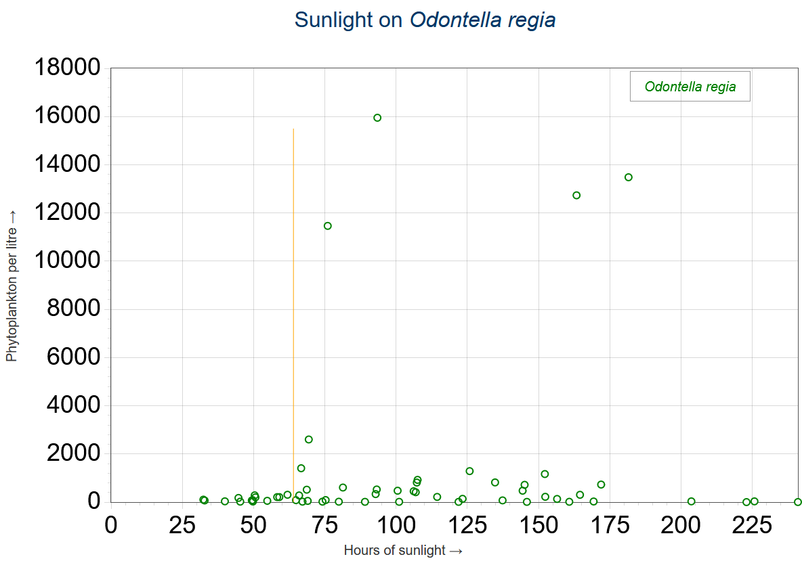
Notes:
We have enough data to be able to correlate plankton counts with a wide range of physical parameters, but the relationship to sunlight hours (From Met Office Bradford) is clearest.
Not unsurprisingly as phytoplankton are, after all, plants!
For the samples taken in the Wyre Estuary we do not see significant blooms formed if the number of hours of sunlight PCM is less than 64.
NOTE this limiting value is effectively defined by the 2023 count data, where we had a Spring bloom at relatively low but consistent sunlight levels between January and March.

Slide 6
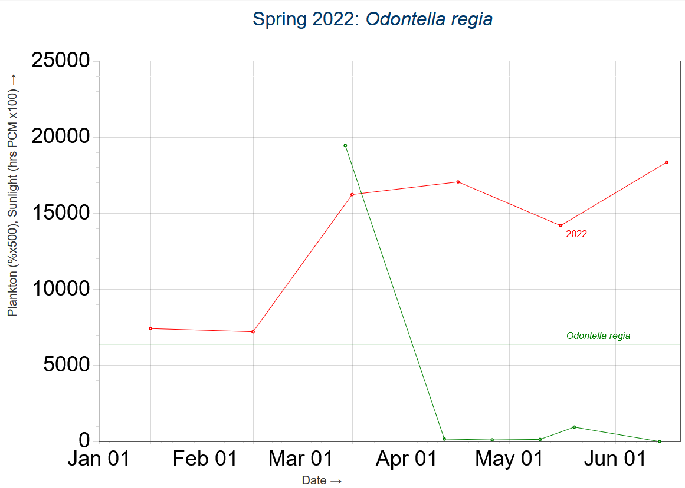
Notes:
Partial qualitative data from 2022 suggested a very large bloom in O.regia in late February and early March.
In this bloom January, February and March were all above the estimated threshold for sunlight hours .

Slide 7
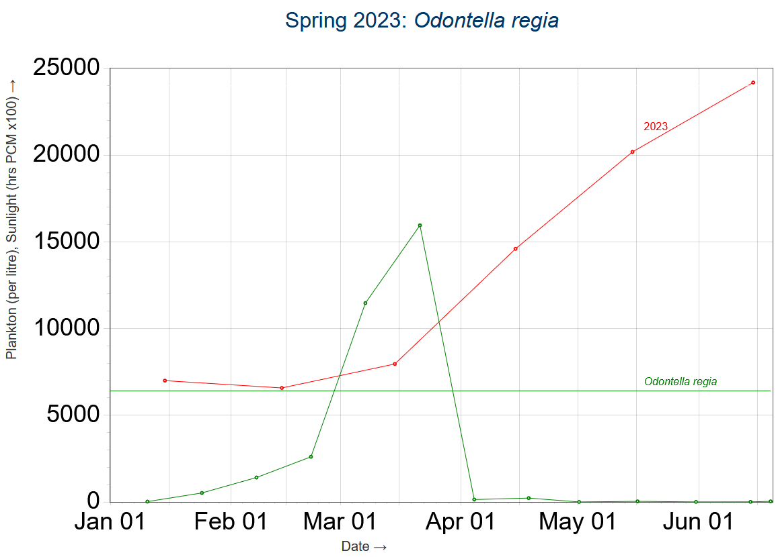
Notes:
In Spring 2023, again January – March are above the estimated threshold, and we see a well-defined population curve, which I decided to try and study in more detail in 2024...

Slide 8
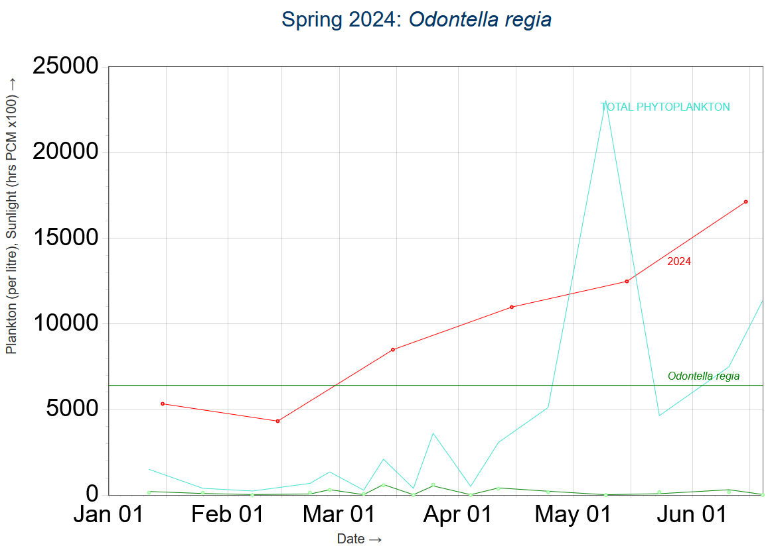
Notes:
In 2024, however, January and February are below the threshold, and March is only just above it. We see no bloom of O. regia – or any other species – in this Spring.

Slide 9
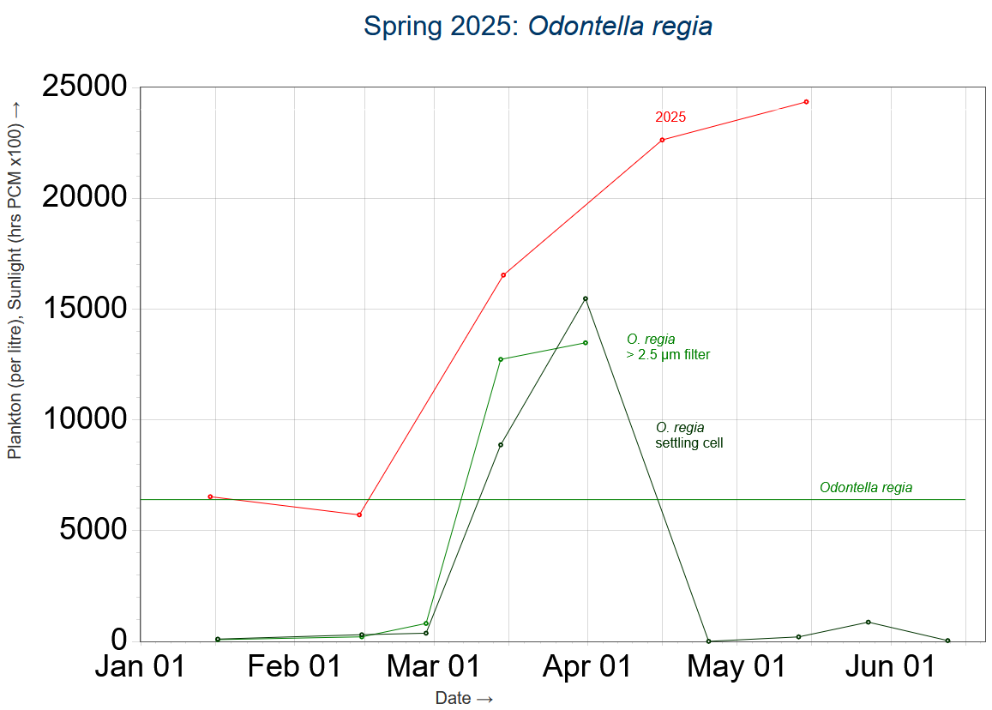
Notes:
In 2025, February just dips below the threshold, and numbers of O.regia in that month are low in comparison to 2023. Sunlight hours in March are very good, however, and we see a late, but strong, bloom.

Slide 10
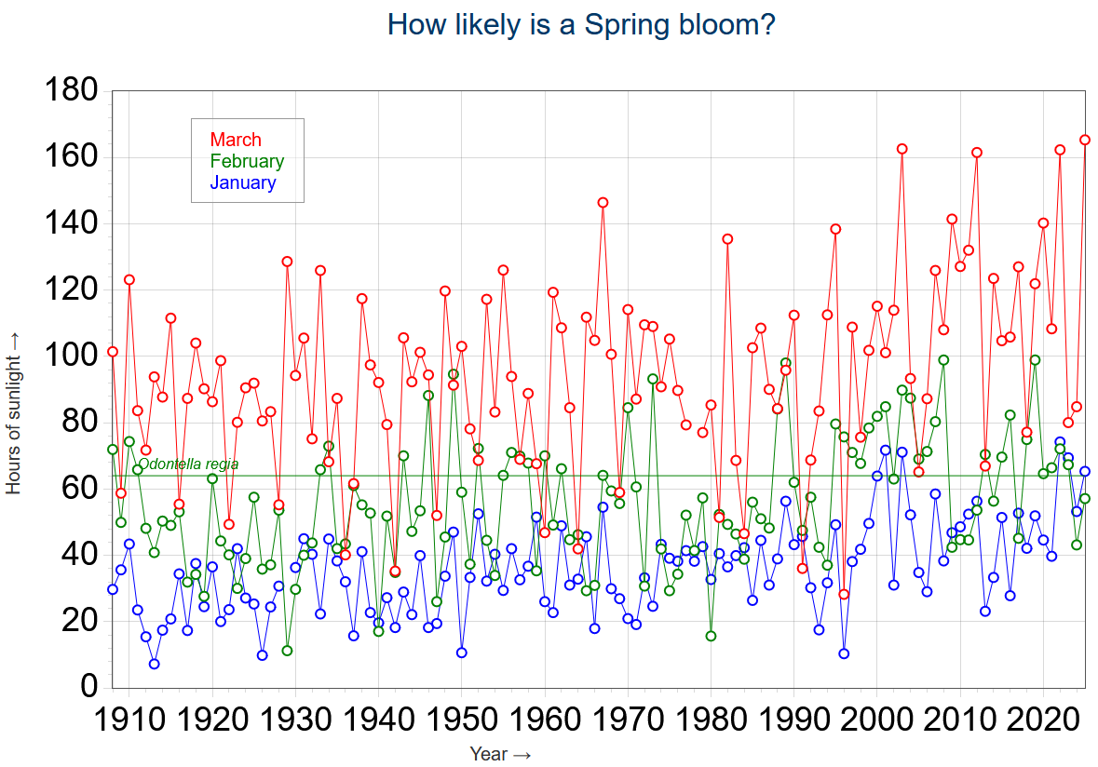
Notes:
The Spring bloom significantly impacts the annual levels of primary production in the Wyre Estuary, and the data we have implies a strong relationship between sunlight and the appearance of Spring bloom in the Estuary. Looking back over Met Office Bradford records for sun light, which are available from 1908 (using a Cambell Stokes recorder throughout the period), we can see that for much of the period the number of hours of sunlight in January and February would be below our threshold.
Since 1990, however, hours of sunlight in February have usually been above our threshold (and even some January’s make the grade!). There is, however, a lot of variation between years.

Slide 11
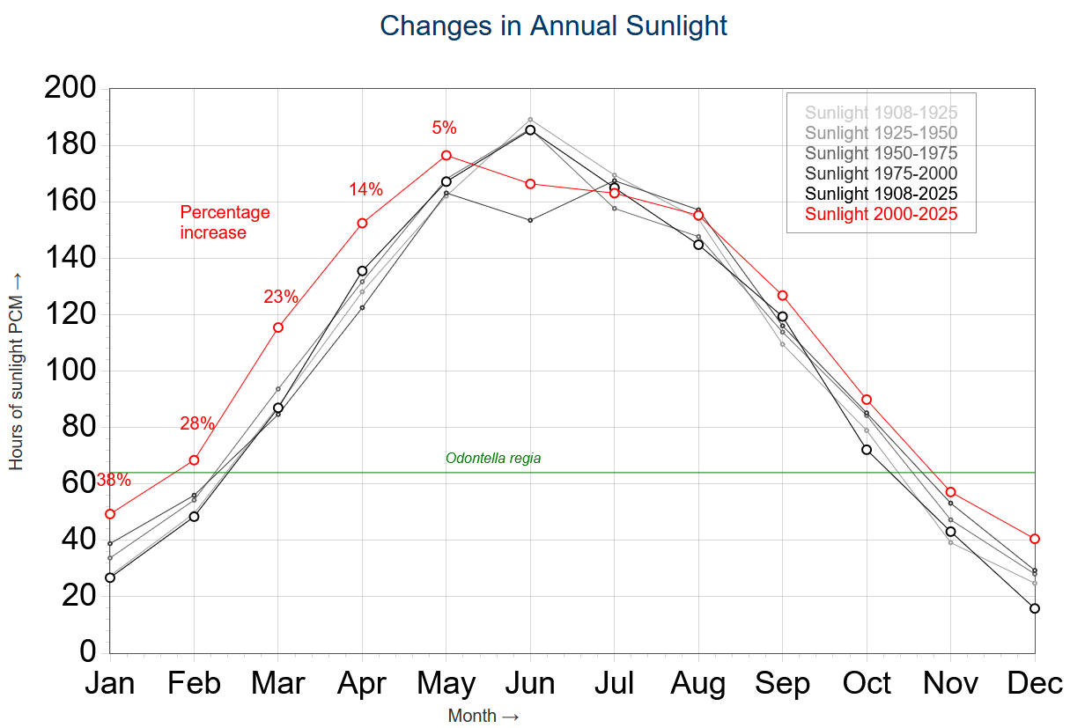
Notes:
How different the last 25 years have been is clearly picked out here. If this change proves permanent, I suggest that the chance of a Spring bloom will remain very much greater than in the period to 2000…

Slide 12
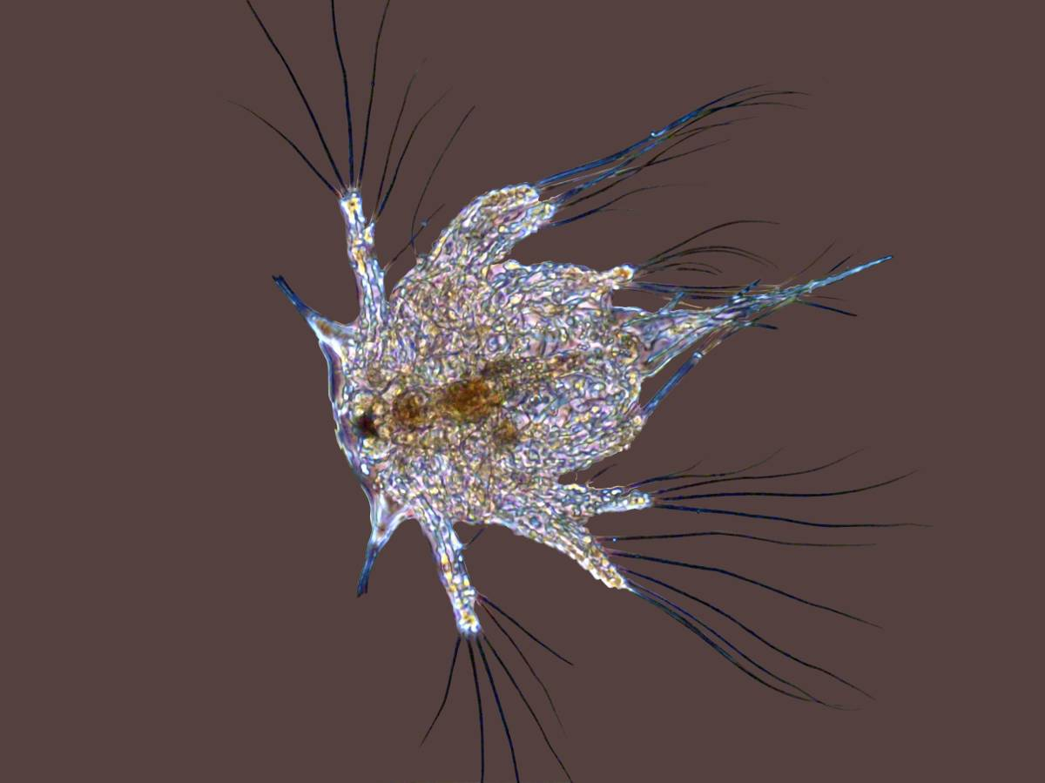
Summary
Annual primary productivity in the Wyre Estuary is extremely variable
The main cause of this is the inconsistency of the Spring bloom
This correlates with sunlight hours in February and March
The amount of sunlight in these critical months has increased significantly in the last 25 years
Notes:
My studies are, unfortunately, not able to evaluate the impact of periodic near doubling of the annual primary productivity.
The following supplementary slides (time allowing) look at the potential extend of the problem.
[END OF TALK]

